Slide 1
Ubiquitous Professional Development with the Global Physics Department
CO/WY AAPT Spring Meeting
Danny Caballero (@physicistdanny)
University of Colorado Boulder

Slide 2
Problems with Traditional PD
Shrinking school budgets
Broad vs. targeted
Location always stinks
It’s so boring

Slide 3
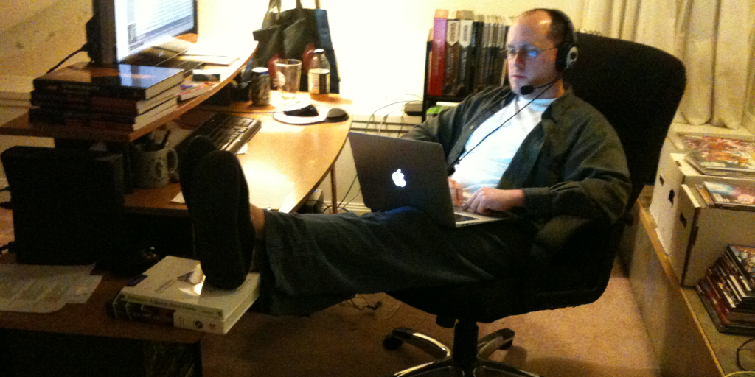
Professional development workshop of your dreams
Brian Carpenter @physicscarp Shaker Heights, OH

Slide 4
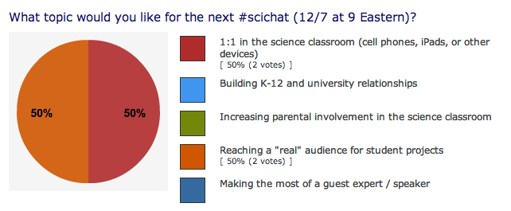
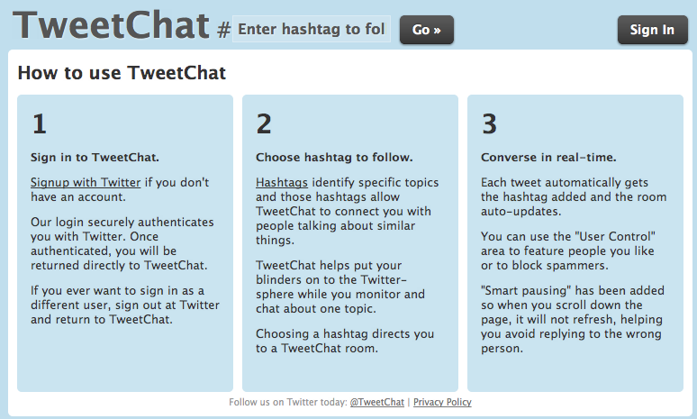
It all started on twitter…
Physics educators on twitter: bit.ly/physicstweeps
Weekly tweetchats Tuesdays, 7pm MT #scichat hashtag
Notes:
I think the scichat tweet chat is on hiatus these days. We'll likely start it again over the summer, but it hasn't been active in a while.

Slide 5
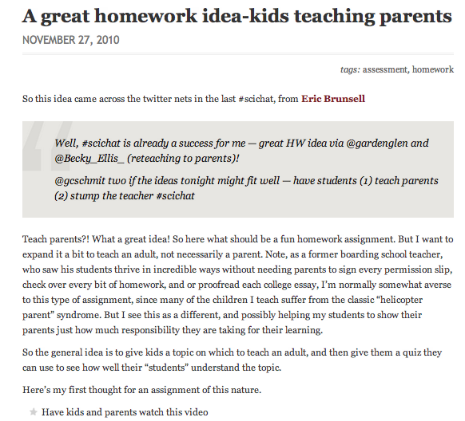
Great ideas abound…
http://bit.ly/physparenthw
Notes:
This was an Idea I got in a tweet chat—have my students show that video to their parents, and then have their parents take a quiz trying to explain it. Then have the students explain the video to the parents.

Slide 6
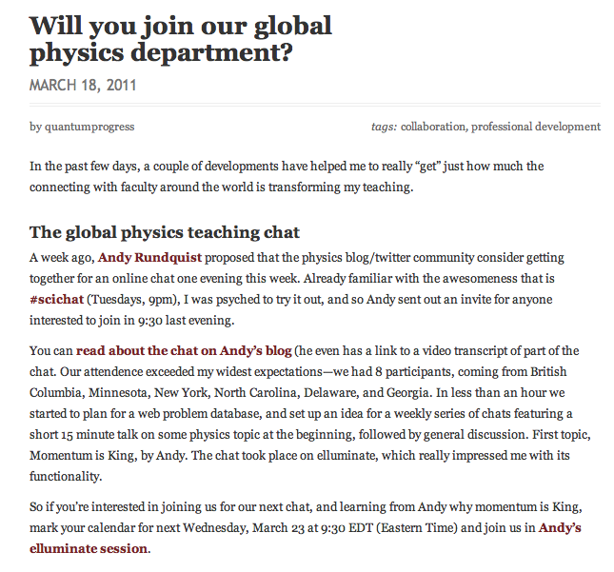
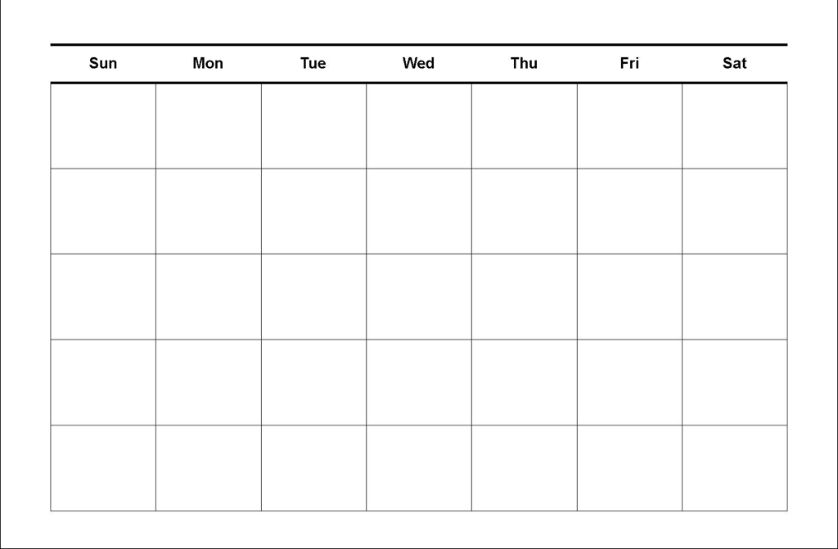
Next step: Going global
Wednesdays 7:30pm MT
http://bit.ly/GlobalPhysics
Host & Founder: Andy Rundquist, Hamline University
http://arundquist.wordpress.com/

Slide 7
Live Collaboration
http://bit.ly/gpdmccullough
Notes:
Live collaboration: This was just a slide I pulled to show how GPD works.

Slide 8
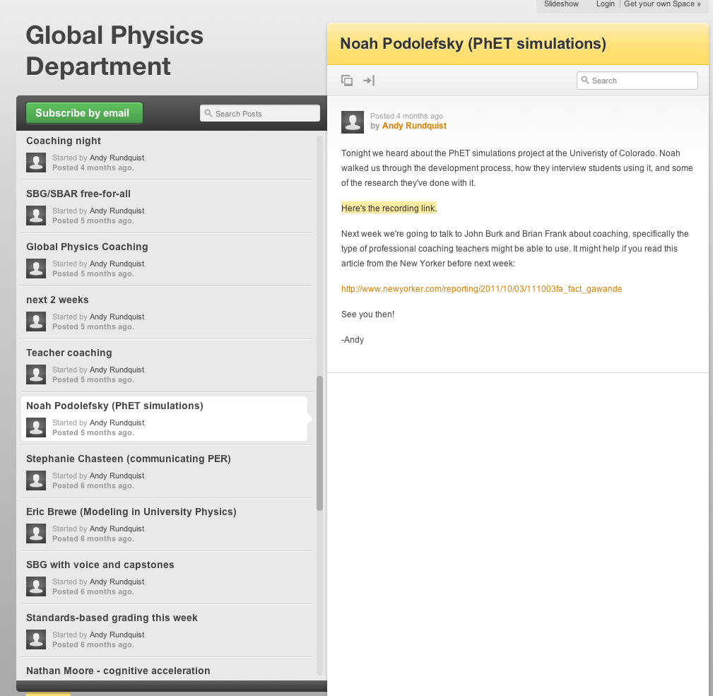
Huge Archive
http://globalphysicsdept.org
70+ archived recordings

Slide 9
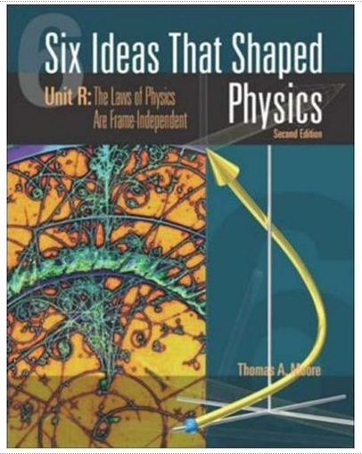
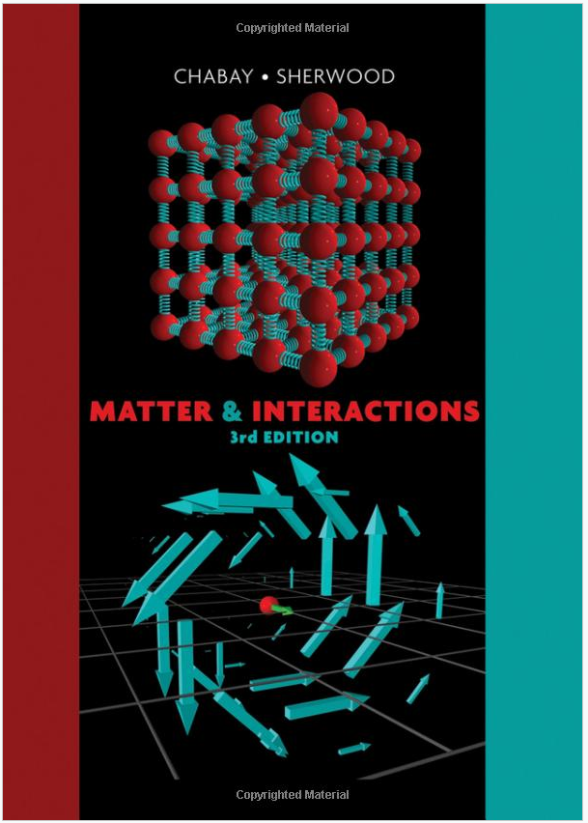
Hear from textbook authors
Thomas Moore
Ruth Chabay
Bruce Sherwood
Randall Knight
http://bit.ly/6ideasmooore
http://bit.ly/knightphysics
http://bit.ly/gpdmandi

Slide 10
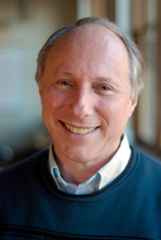
The Latest in PER
Ken Heller
http://bit.ly/gpdheller
Noah Podolefsky
http://bit.ly/gpdphet

Slide 11
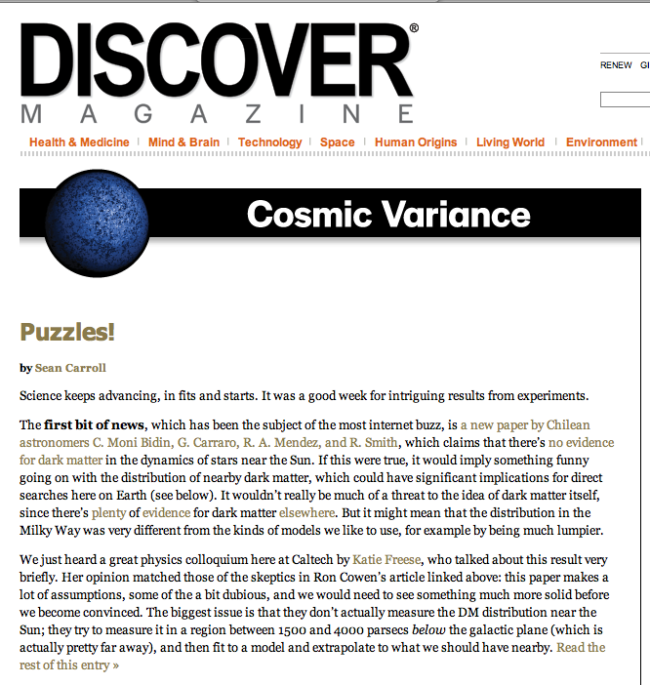
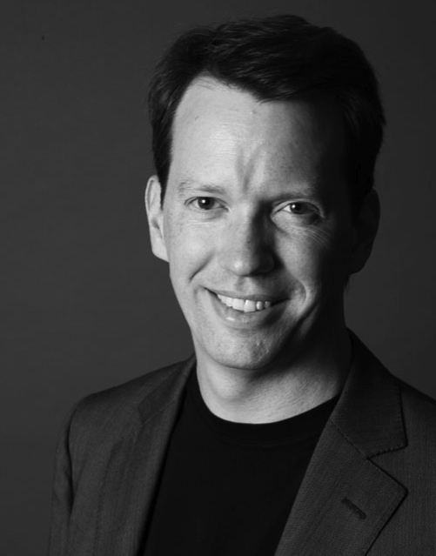
Hear Eminent Scientists
http://bit.ly/gpdcarroll

Slide 12
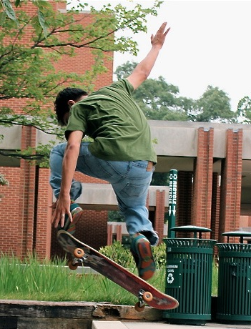
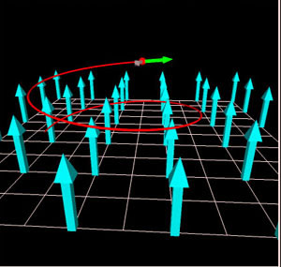
Learn new skills
Danny Caballero
http://bit.ly/gpdvpython
Andy Rundquist
http://bit.ly/gpdlatex
VPython

Slide 13
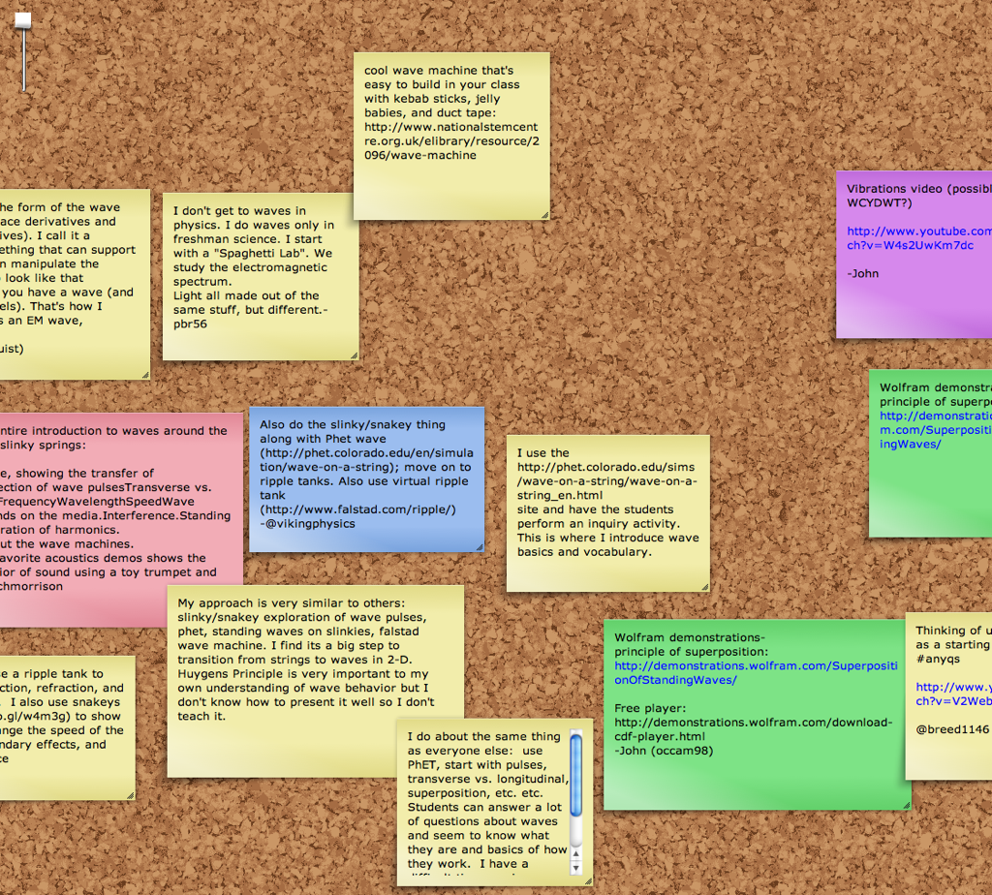
Brainstorm lessons
Notes:
Physics coaching—teachers film their classes, share it with GPD and get feedback.

Slide 14
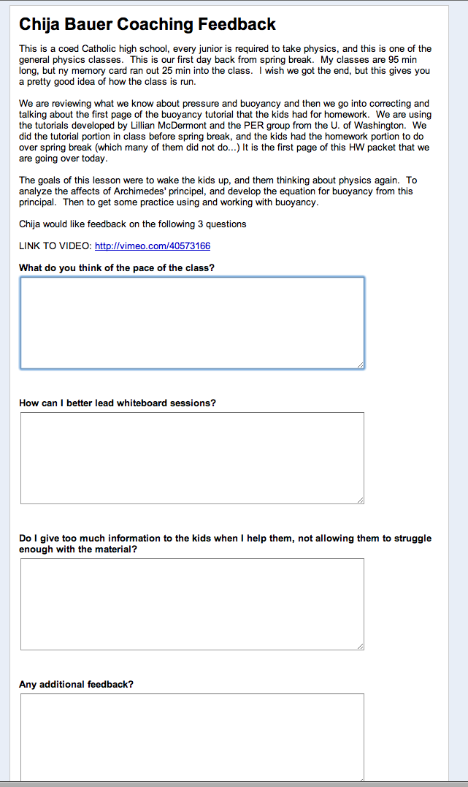
Physics Coaching

Slide 15
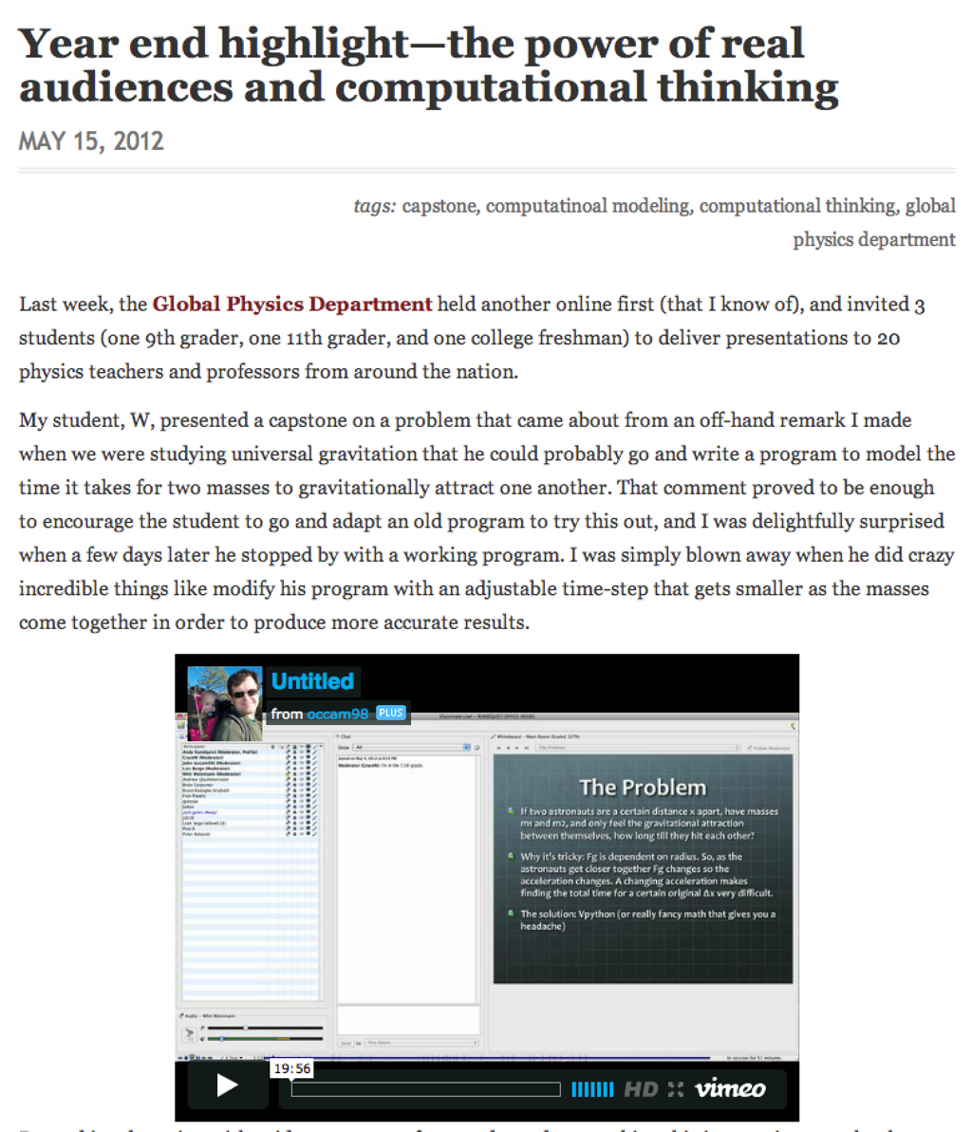
Student presentations

Slide 16
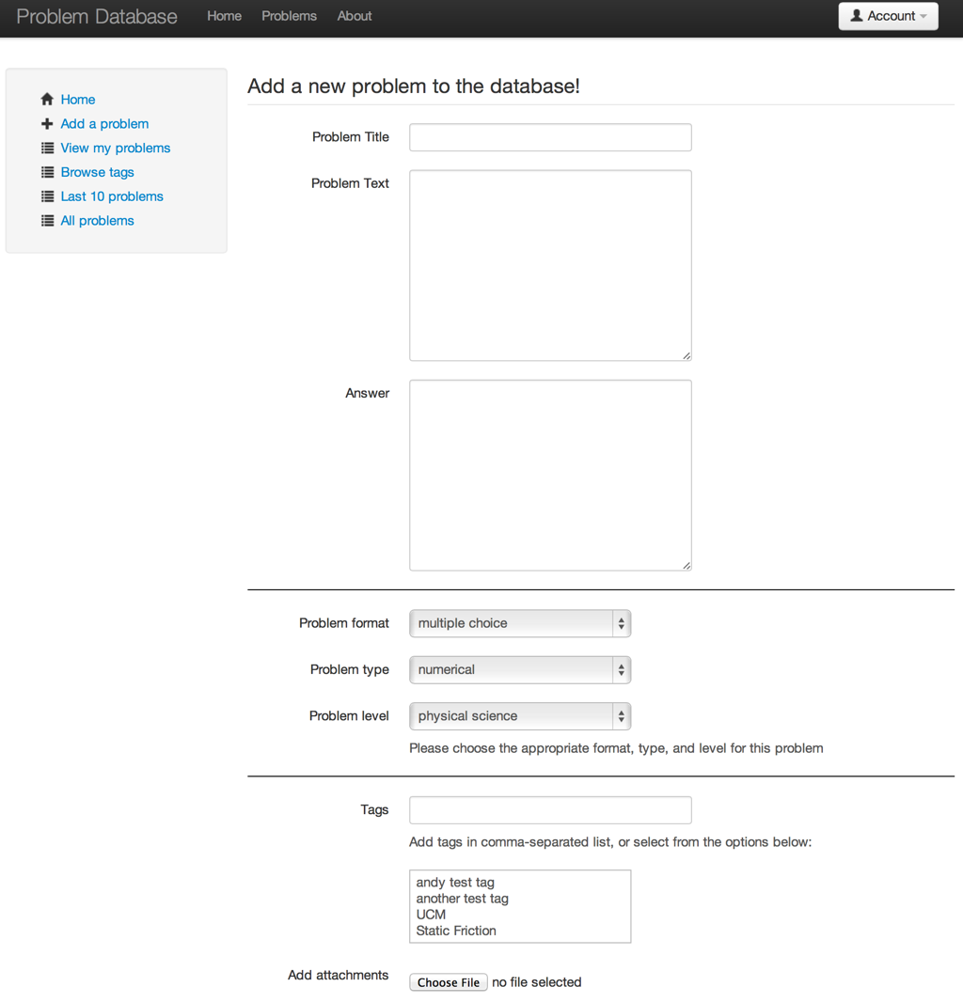
The Physics Problem Database
Notes:
Physics problem database. This is a database for sharing physics problems—it is mostly functional. We just need people to enter problems into it.

Slide 17
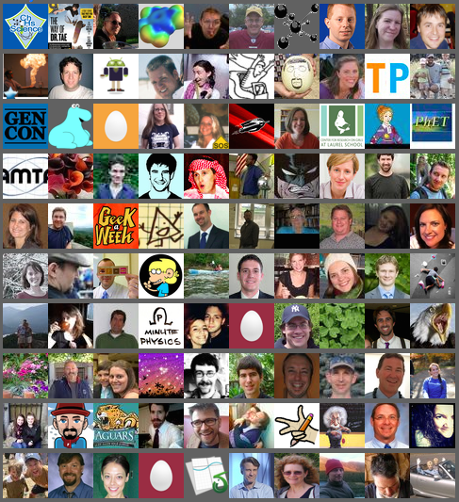
Future Plans
Rehearse talks for AAPT meetings
Improved website
Guide to physics twitter-blogosphere
Collaborative research?

Slide 18
Will you join us?
Next meeting: 7:30pm Wednesday, April 24:
Student presentation - Cutting DNA (SUNY)
Danny Caballero blog: thinklikeaphysicist.com twitter: @physicistdanny email: danny.caballero@gmail.com

