Slide 1

PhET Sims for Science Inquiry:
Free, researched, web-based
Ariel Paul
http://phet.colorado.edu

Slide 2
Outline
1. Introducuction to PhET
2. Sim design and research
  3. PhET’s future

Slide 3
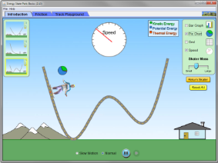
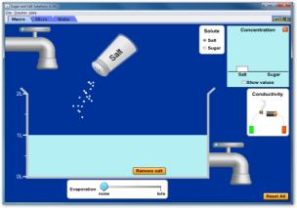
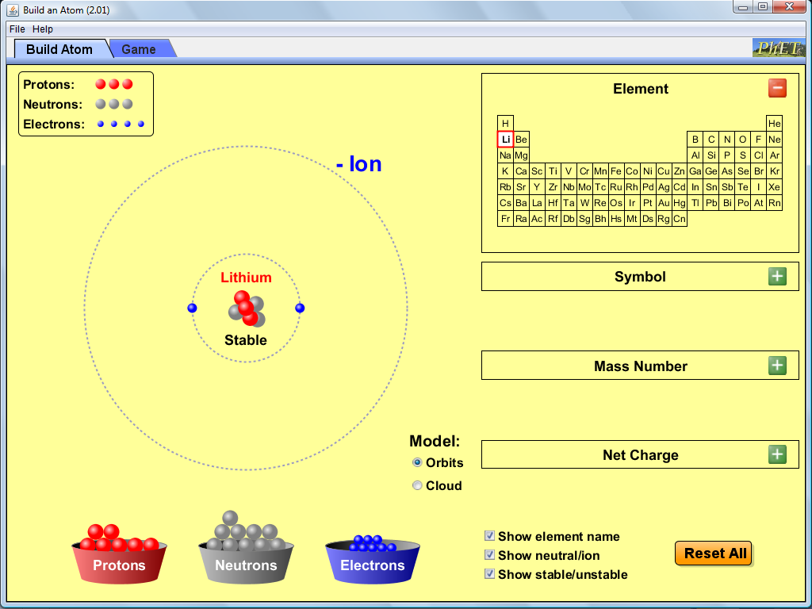
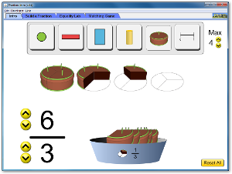
What Is PhET?
Suite of 127 interactive science and math sims!
PhET’s Mission:
To advance science literacy and education worldwide

Slide 4
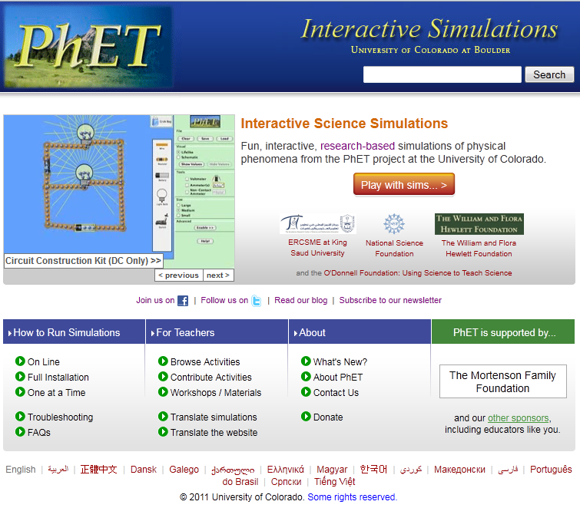
Where Is PhET?
http://phet.colorado.edu
Or download!
(∼280 MB)

Slide 5
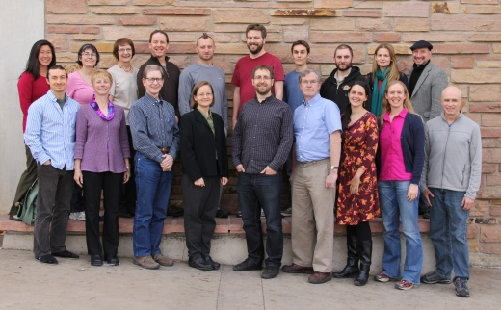
Who Are We?
Faculty, Post-docs, K-12 Teachers, Software Developers

Slide 6
PhET Goals for Students
See science as accessible and enjoyable
Make connections to everyday life
Achieve conceptual learning
Scientific exploration with multiple learning outcomes
Ownership of the learning experience

Slide 7







How Can PhET be Free?
NSF
Hewlett Foundation
The O’Donnell Foundation
King Saud University
University of Colorado
Carl Wieman and
Sarah Gilbert

Slide 8
Making PhET Accessible
Open-use License:
Creative Commons – Attribution
Easy to translate for World-wide Use:
Over 3000 translations in 63 languages
Over 35 million runs per year, and growing
Conversion to HTML5

Slide 9
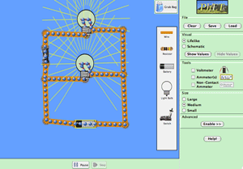
Flexibility
Pick and choose which sims to use
Your environment and your learning goals
Database of activities (>500 by PhET or Teacher-users)
CCK in grade school:
“Make the light bulb light”
CCK in college:
“Explain why the light dims when you turn the heater on”

Slide 10
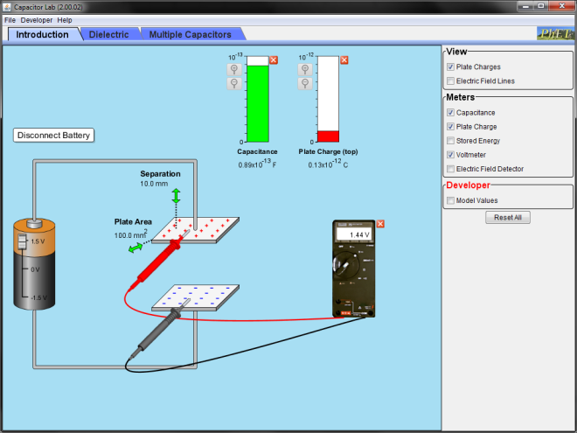
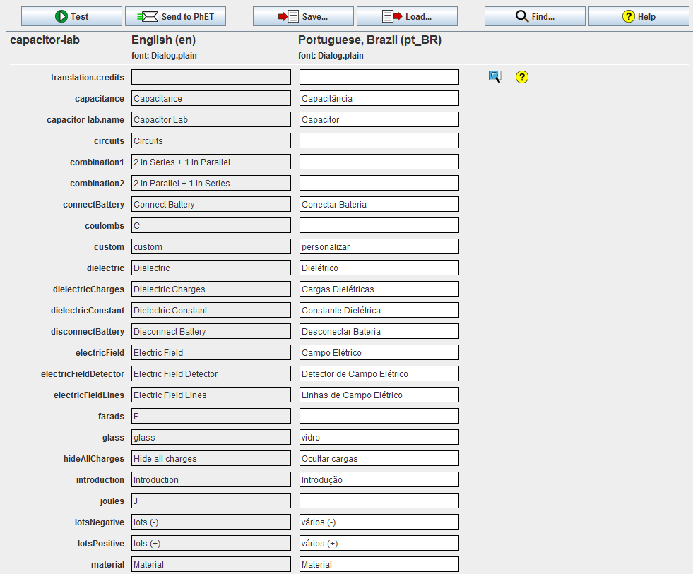
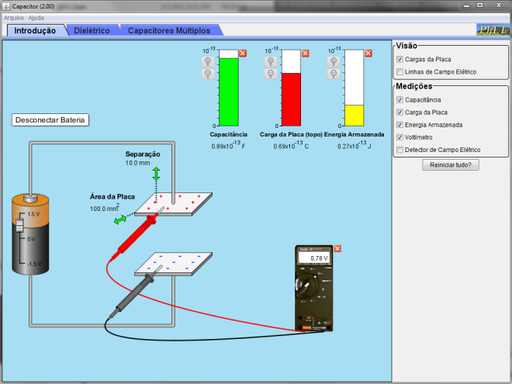
Easy to Translate

Slide 11
Design Process
Initial design
Final design
Research
Interviews
Classrooms
Redesign

Slide 12
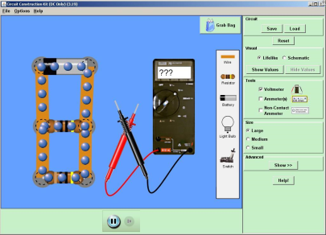
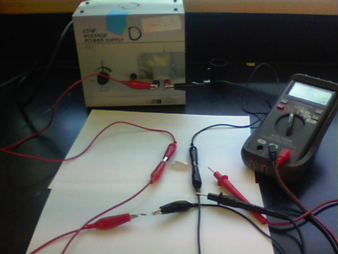
Compare These Tools?
“Affordances” and “Constraints”?

Slide 13
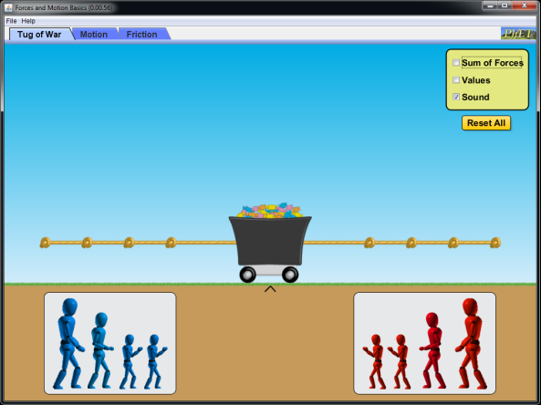
Is the Sim Intuitive?
What would you do next?

Slide 14
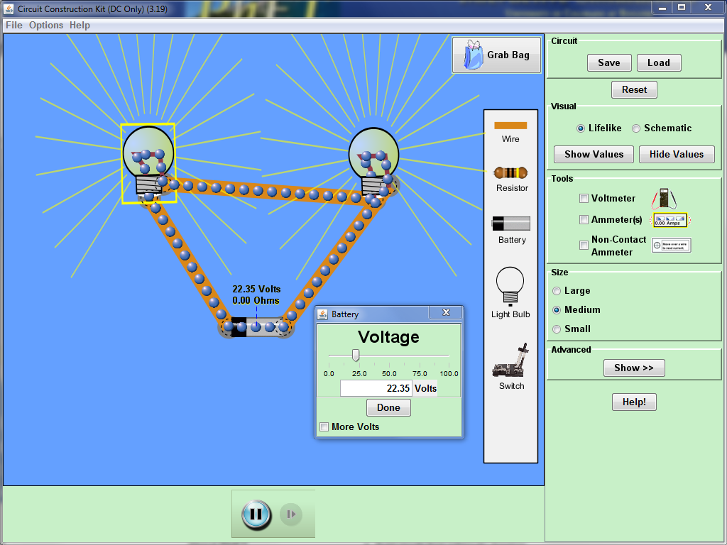
Designed to Support Inquiry
Accurate, dynamic visual representations
Highly interactive
Real-time feedback
Allow difficult or impossible actions
Intuitive interface

Slide 15
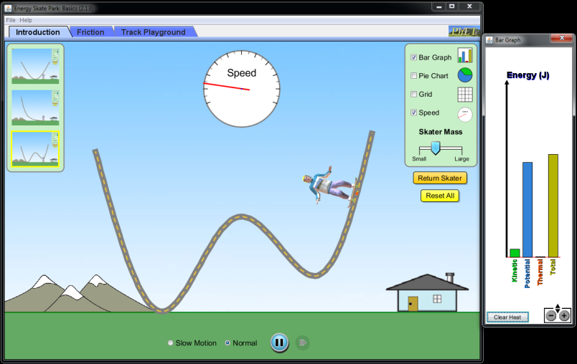
Designed to Scaffold Inquiry
Guide without feeling guided
Choice of controls
Show the invisible

Slide 16
Activity Sheet Guidelines
Begin with open play
Take advantage of sim features
Short activity sheet
Minimal wording
Scaffold – tables highly effective

Slide 17
Prompting Investigation
Example Challenge Prompts:
  Find all the ways to… make a complete circuit.
  What is the largest… molecule you can make?
  List all the essential items to…make a circuit.
  What are two ways to… change the Earth’s orbit?
  How can you make…the gravity force…bigger?

Slide 18
PhET’s Future
HTML5 – First conversions available August
Touch interfaces
Coming soon – “Teach with PhET” companion site

Slide 19

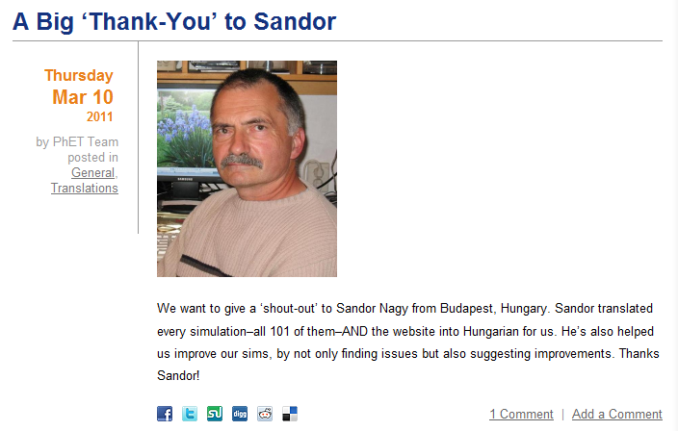
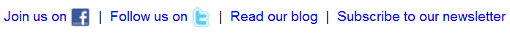
Stay in Touch with Social Media

Slide 20
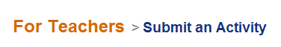
How You Can Contribute
Send us your ideas
for new sims!
Report bugs
Email: phethelp@colorado.edu

Slide 21
PhET!
Suite of interactive simulations (127)
Physics, chemistry, math
Expanding into biology, earth science
Research-based and user-tested
Free! Online or downloadable (~280 MB)
Easy to use and incorporate in class
http://phet.colorado.edu

