Slide 1

How Physics, Psychology, Philosophy, and Science Can Save All Mankind:
A Humble Presentation
Craig A. Foster
United States Air Force Academy

Slide 2
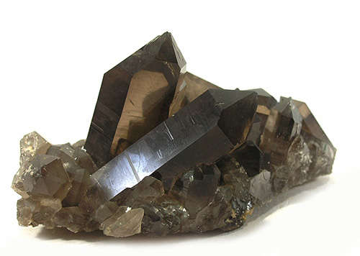

What is Pseudoscience?
Pseudoscience promotes scientific claims even while the claims have no scientific reliability.
Pseudoscience

Slide 3
Pseudoscience: Common Themes
Pseudoscience often…
  relies on non-representative anecdotes to justify its claims.
  exhibits a disregard for refuting information.
  claims that it is treated unfairly.
  argues that one should believe a claim because an authority says the claim is true.
  structures its theories so they can only be confirmed.
  tries to appear scientific.
  lacks an explanatory mechanism.
  promotes claims that have small effect sizes.

Slide 4
Climate Change Denial:
Common Themes
Exhibits a disregard for refuting information.
Claims that it is treated unfairly.
Works to undermine the authority of science.
Promotes a claim with a small effect size (with a twist).

Slide 5
Persuasion: Recommendations
Know your audience
Moderate disagreement = greatest attitude change
Persuasion occurs through two channels
Cue #1: Liking
Cue #2: Credibility
Familiarity
Outreach
Critical thinking
Defeasibility
Distanced perspective

Slide 6
Thank You!

