Slide 1
Just-in-Time Teaching (JITT) in different environments
Tom Christensen
Professor, Department of Physics
AAPT – CO-WY April 23, 2016

Slide 2
Just-in-Time Teaching
Ask web-based questions
  Ask about content BEFORE it is covered in class
  Due shortly before class
  Multiple choice is easier – but open-ended is much more informative
    Include opportunity for students to comment
  Blackboard or Moodle work very well

Slide 3
Just-in-Time Teaching
Use the student responses
  To better assess the student’s understanding
  To inform what happens in class
    Don’t spend time on something everyone already knows
  To motivate discussion
    Give examples from responses (anonymously)
    Summarize trends in responses

Slide 4
How does this work?
For different types of classes?
  General education (Astronomy)
  Introductory calculus-based physics
  Upper division (Astrophysics)
For different types of institutions?
  Regional public university
  Highly selective private liberal arts college

Slide 5
Results
Compare different types of classes at UCCS – results averaged across several sections
 | General Astronomy | Intro Physics (Calculus-based) | Upper Division Astrophysics
% of class attempting any assignment | 76% | 87% | 87 %
% of class completing ALL assignments* | 19% | 53 % | 32%
Ave # of missed assignments |  | 1.21 | 1.84
Average Score | 88% | 81% | 88%
*Note: I dropped the lowest assignment.

Slide 6
Compare two different Colleges
Same class, same instructor
UCCS
  11,300 students
  Selective (… not very)
  Serves Southern CO
  Wide age range
  Mixed motivation
  Class size (93)
Macalester College
  2000 students
  Highly selective
  International
  Mainly traditional age
  Motivated
  Class size (17)

Slide 7
RESULTS
Compare 2nd semester calculus-based general physics classes
at UCCS and Macalester College
 | UCCS | Macalester
% of class attempting any assignment | 87% | 90%
% of class completing ALL assignments* | 53% | 47 %
Ave # of missed assignments | 1.21 | 1.00
Average Score | 81% | 88%
*Note: I dropped the lowest assignment.

Slide 8
RESULTS - Comments
UCCS Students
  "On-line preclass questions encouraged thinking instead of researching."
  "Preclass questions were helpful but difficult.”
Macalester Students
  “Gets a little bit confusing some weeks, but it’s great as we start thinking before class.”
  “I like them! They force me to figure out the conceptual things.”

Slide 9
Seven Principles for Good Practice in Undergraduate Education
Chickering - 1987
Encourage contact between students and faculty
  Electronic comments both ways
Develop reciprocity and cooperation among students
  Students allowed to cooperate – most do not
Encourage active learning
  Depends on design of question
Give prompt feedback
  Answers/grades posted quickly, use in class that day
Emphasize time on task
  Varies with student
Communicate high expectations
  Students answer questions BEFORE covered in class
Respect diverse talents and ways of learning
  Mix visual, textual, data-related questions

Slide 10
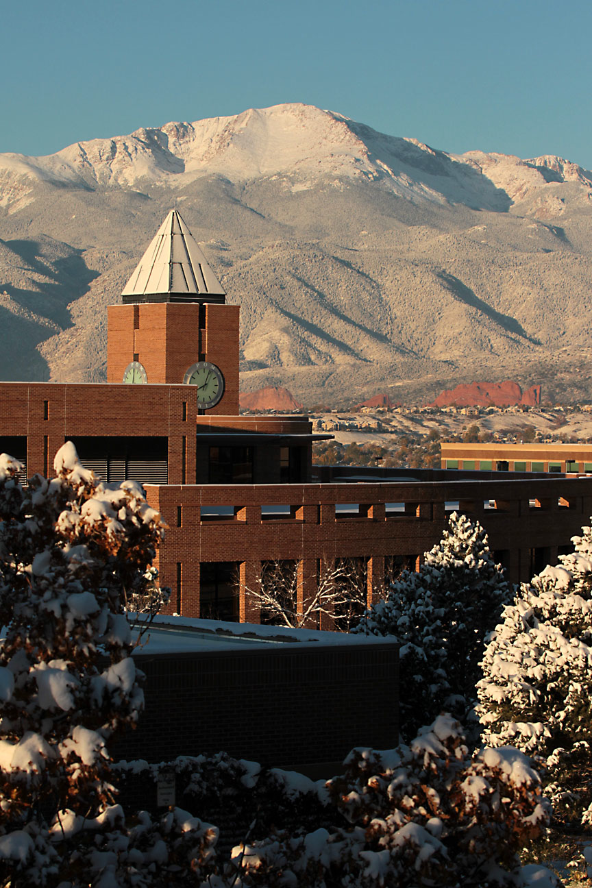
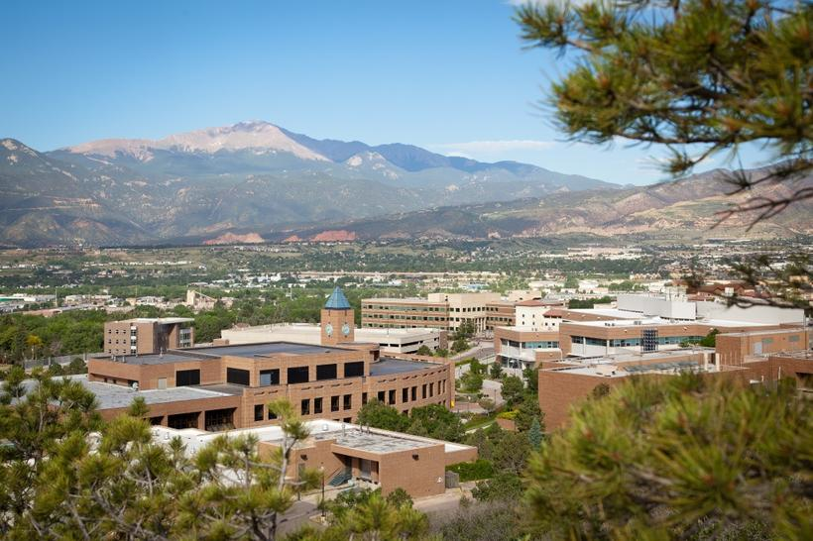
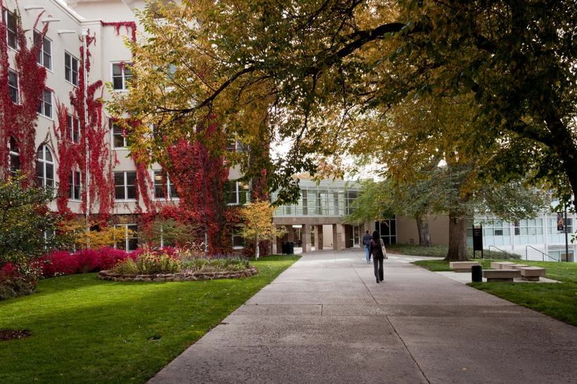
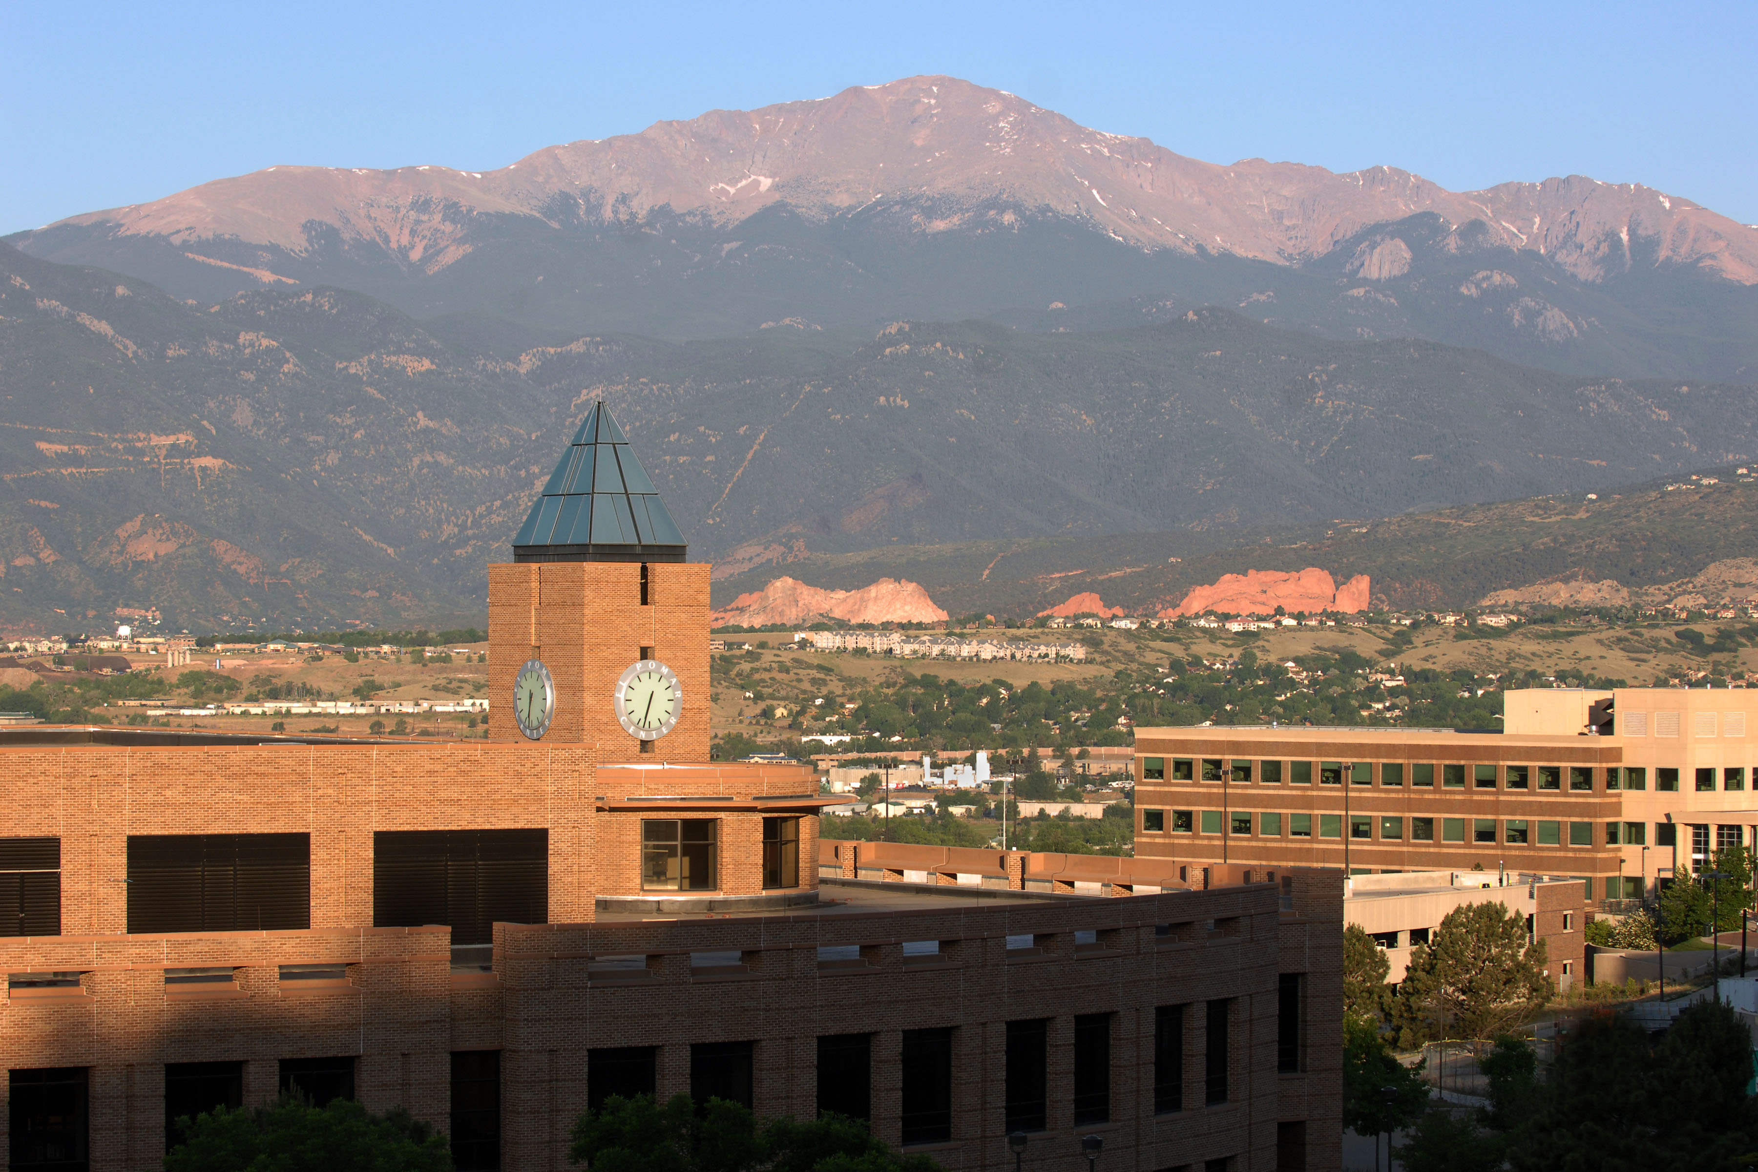
Thank You!

Slide 11
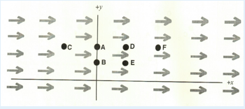
Examples
Content questions:
  Coulomb's Law and Newton's Law of Gravitation (Ch. 13-2) are very similar in form. How would you experimentally distinguish an electric field from a gravitational field ?
  We have a large region of space that has a uniform electric field in the +x direction as indicated by the arrows in the figure below. At the point (0,0), the electric field is 30 N/C.
    Rank the magnitude of the electric field from greatest to least at the following points within this region. Some points might be the same (tied).
    The coordinates of the points are A: (0,6), B: (0,3), C(-3,6), D(3,6), E (3,3), F(6,6).

Slide 12
Examples
General Questions:
  If you would like to explain any of your multiple choice answers here, you are welcome to. If you have any questions or comments about the physics content, that could also go here !
    Explain Gauss Law slowly!
    I don't know how to solve integrals with vectors in them, I assume it is different than purely scalar integrals. Will this be problematic?
    What is the utility of putting gaussian surfaces in uniform electric fields and finding the flux that goes through them?
  Any general questions, comments, physics jokes ... ?
    How picky are you about uncertainty and significant figures? It seems like each professor has a different policy on this, and I just wanted to see where you stand on the issue.

