Slide 1

Climate Change:
Simple, Serious, Solvable
Scott Denning
Director of Education, ESMEI
Atmospheric Science, CSU
Email Scott.Denning@ColoState.edu for a copy of this presentation

Slide 2
Simple

Slide 3


Ever Wonder Why?
Day is warmer than night
Summer is warmer than winter
Phoenix is warmer than Fargo

Slide 4

Heat Budgets
Heat in
Heat in
Heat out
Heat out

Slide 5
Dancing Molecules and Heat Rays!
Nearly all of the air is made of oxygen (O₂) and nitrogen (N₂) in which two atoms of the same element share electrons
Infrared (heat) energy radiated up from the surface can be absorbed by these molecules, but not very well
O
O
N
N
Diatomic molecules can vibrate back and forth like balls on a spring, but the ends are identical

Slide 6
Dancing Molecules and Heat Rays!
Carbon dioxide (CO₂) and water vapor (H₂O) are different!
They have many more ways to vibrate and rotate, so they are very good at absorbing and emitting infrared (heat) radiation
O
C
O
O
H
H
Molecules that have many ways to wiggle are called “Greenhouse” molecules
Absorption spectrum of CO2 was measured by John Tyndall in 1863

Slide 7
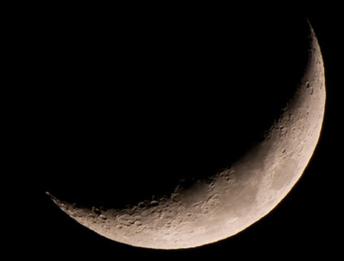
Spring Night
in Colorado
radiation
emitted
by soil
8 PM surface temperature = 20 °C = 68 °F
420 W m⁻²
4 inches
= 10 cm
sT⁴_{ground}

Slide 8
Spring Night
in Colorado
radiation
emitted
by soil
8 AM surface temperature = -60 °C = -78 °F
420 W m⁻²
4 inches
= 10 cm
sT⁴_{ground}

Slide 9
Spring Night
in Colorado
sT⁴_{sky}
radiation
emitted
by air
radiation
emitted
by soil
340 W m⁻²
6 AM surface temperature = 10 °C = 50 °F
420 W m⁻²
4 inches
= 10 cm
sT⁴_{ground}

Slide 10
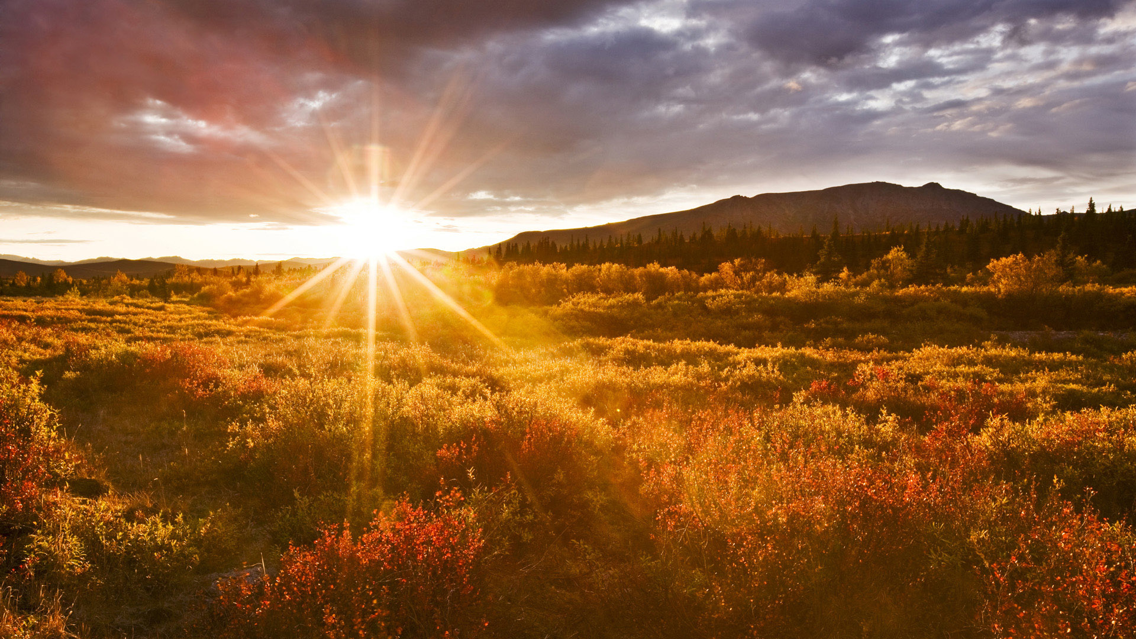
The strongest evidence for the
Greenhouse Effect
is that we can
survive night!

Slide 11
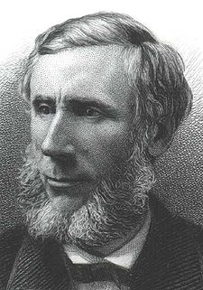
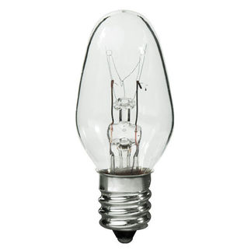
Common Sense
1 m
Doubling CO₂ would add 4 watts to every square meter of the Earth, 24/7/365
Doing that would make the surface warmer
This was known before light bulbs were invented!
4 Watts
1 m
John Tyndall, January 1863

Slide 12
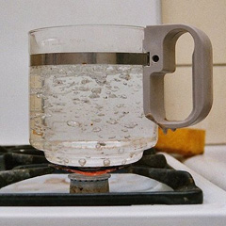
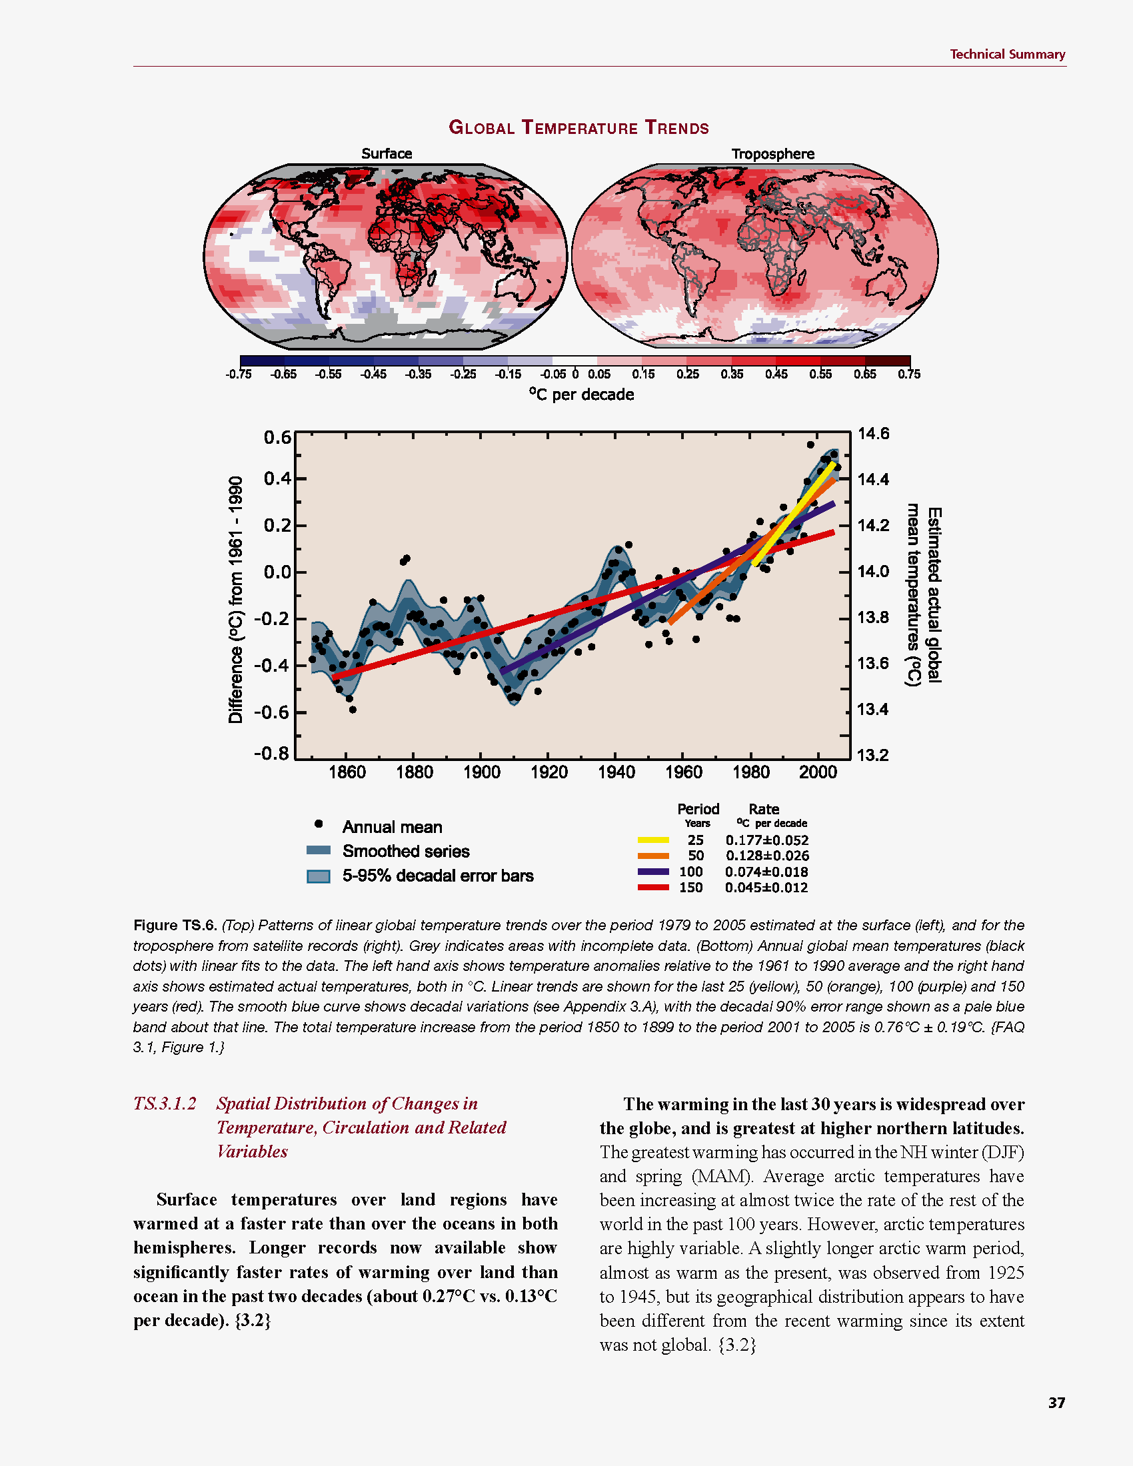
Common Myth #1
“Scientists expect a warmer future because it’s been warming up recently”
WRONG!
It’s because we know that when we add heat to things, they warm up

Slide 13
Serious

Slide 14
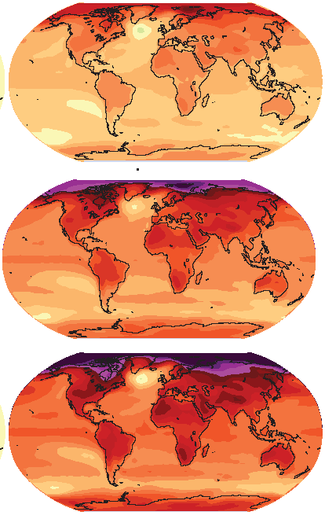

How much warmer?
Land vs ocean!
North vs South
Global mean
warming of 2º to 5º C
North American
warming of 3º to 6º C
= 5º to 11º F
Arctic warming of
8º to 14º F
Low
Emissions
Moderate
Emissions
High
Emissions
Rainfall? Agriculture?
Water demand? Tourism?
Mass immigration?

Slide 15
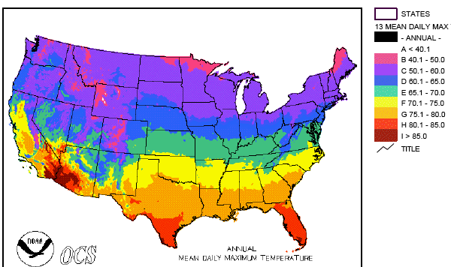
Where is it 10º F Warmer
“on average?”
Seattle ➔
Sacramento
Denver ➔
Amarillo
Illinois ➔
Mississippi
Washington DC ➔
Tallahassee
10 ºF warming is like moving
600 – 800 miles South!
Water? Crops?
Real Estate? Health?

Slide 16
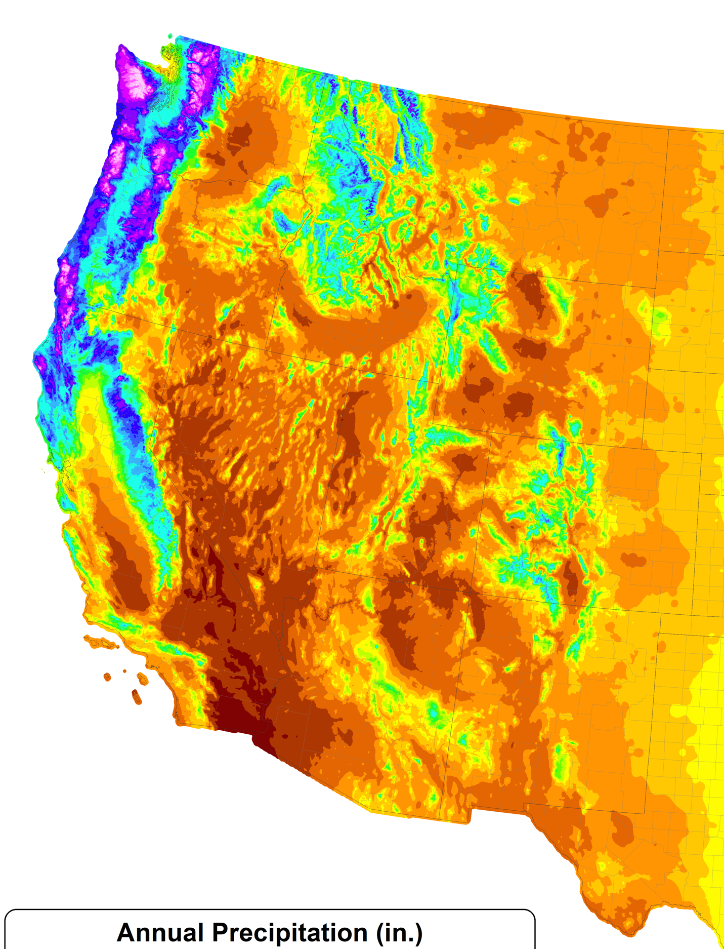
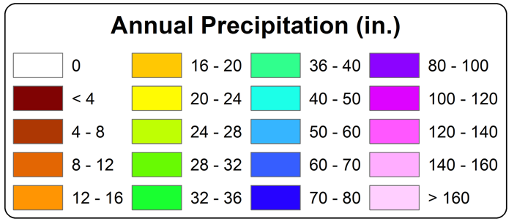
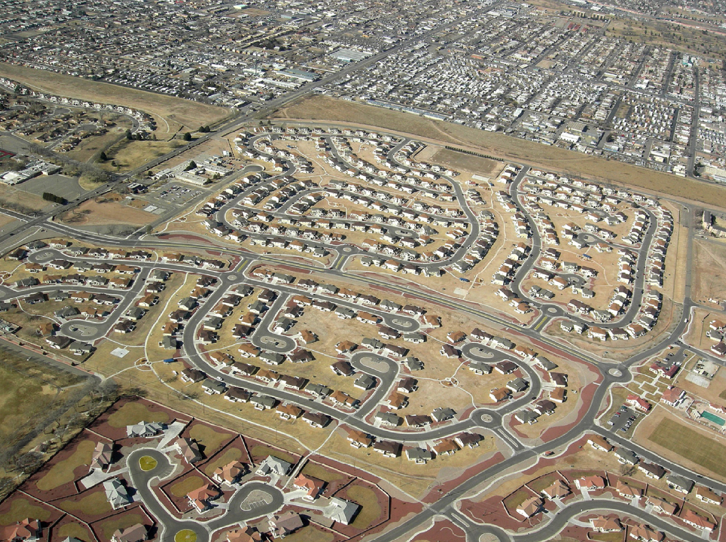
A Region
On the Edge
WA
MT
OR
WY
ID
NV
UT
CO
75 million people in the western US live in a region with marginal precipitation
Just enough snow to support forests and reservoirs
Just enough irrigation water to support farming
Just enough water for cities and towns
AZ
CA
NM
TX

Slide 17
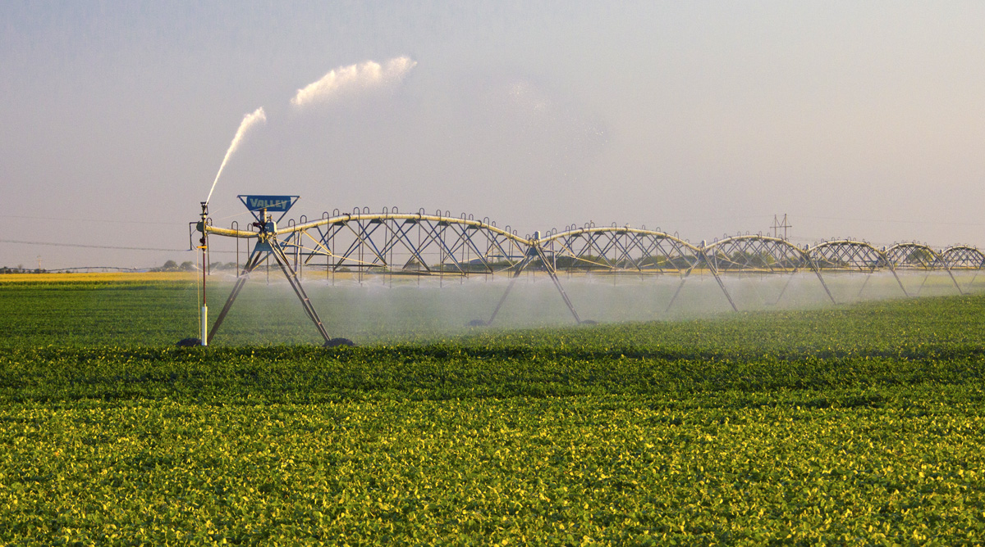
Water Budgets
Evaporative demand increases w/ temperature
In
Out
Drought is the running sum
of water out minus water in

Slide 18
Solvable

Slide 19
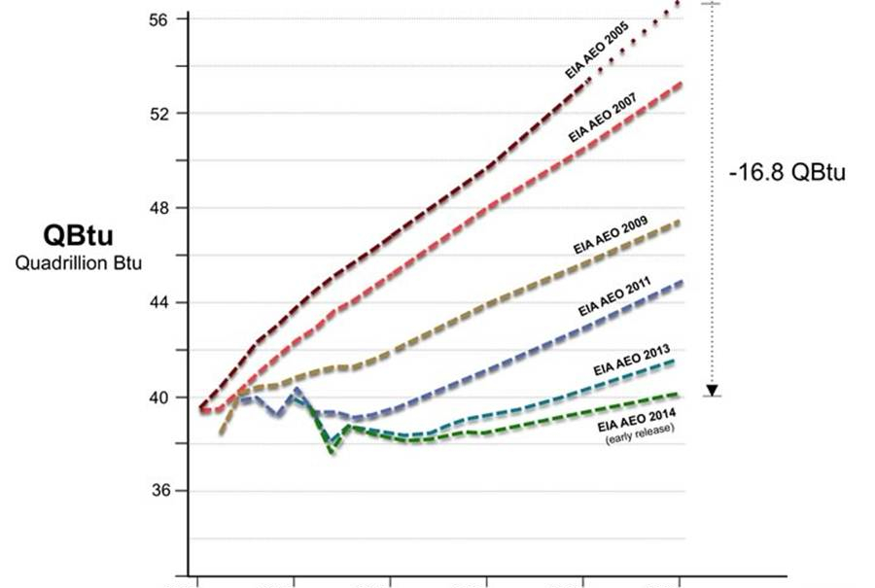

Efficient Architects!
$4.5 TRILLION SAVINGS !
Energy to Power US Buildings
2010
2020
2030

Slide 20
Predictions vs Reality
SOLAR
Year after year, the International Energy Agency predicts very slow penetration of renewable energy
Year after year, they’re WAY wrong!
Why?
WIND

Slide 21
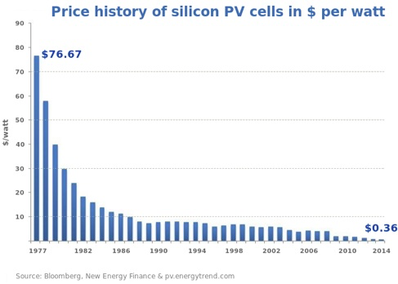
Price of Solar
PV Cells ($/watt)
Price has fallen by factor of 200 since I graduated from high school
Factor of 5 since 2011
Now as cheap or cheaper than coal or gas
Drop in 1970s
Flatter in1990s

Slide 22
Solar Resources
Germany gets less sun than Alaska!
German electricity
4% wind & solar in 2000
32% wind & solar in 2016
US vs Germany

Slide 23
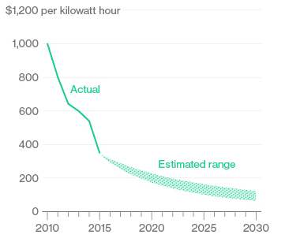
Battery Storage
In 2015, BNEF predicted $150/kWh by 2025
2017
Chevy
Bolt
Chevy Bolt reached $145 already
(8 years early)!
Now 7 times cheaper than in 2010!
Next year: Tesla “Gigafactory”
Bloomberg New Energy Finance Data

Slide 24

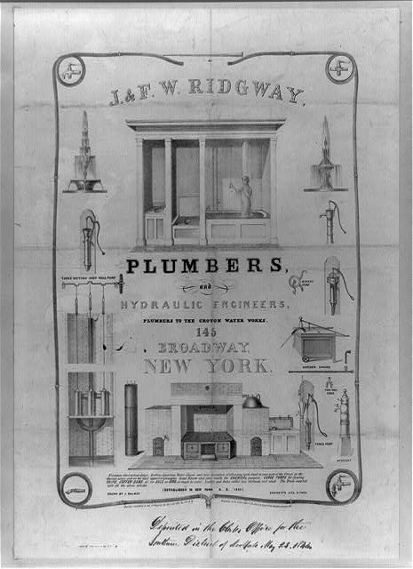
Costs
Conversion to 100% noncarbon energy will cost about
1% of GDP
That’s about what it cost to retrofit all the world’s cities with indoor plumbing a century ago …
It was worth it!

Slide 25
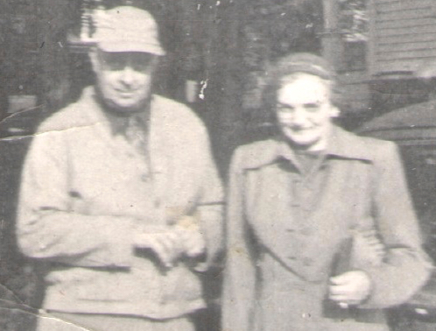
My Grandparents

Slide 26
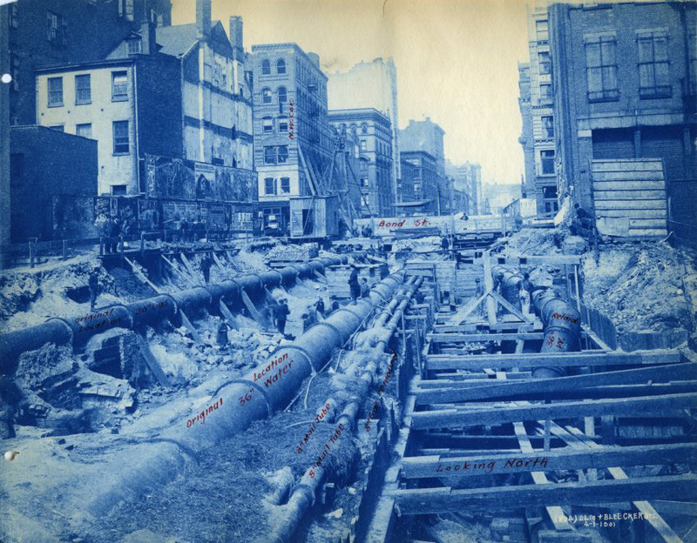

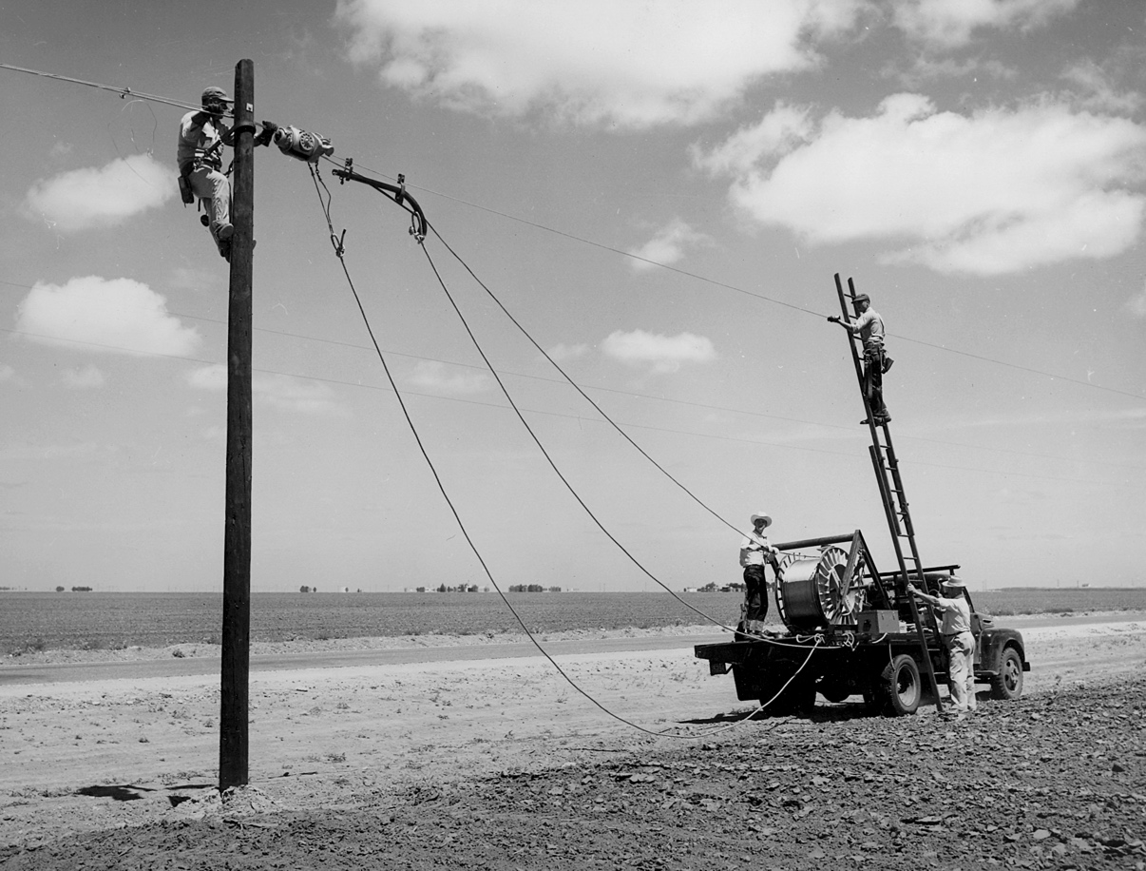
My Grandparents’ Generation
Built subways, sewers,
the electrical grid, defeated the Nazis

Slide 27
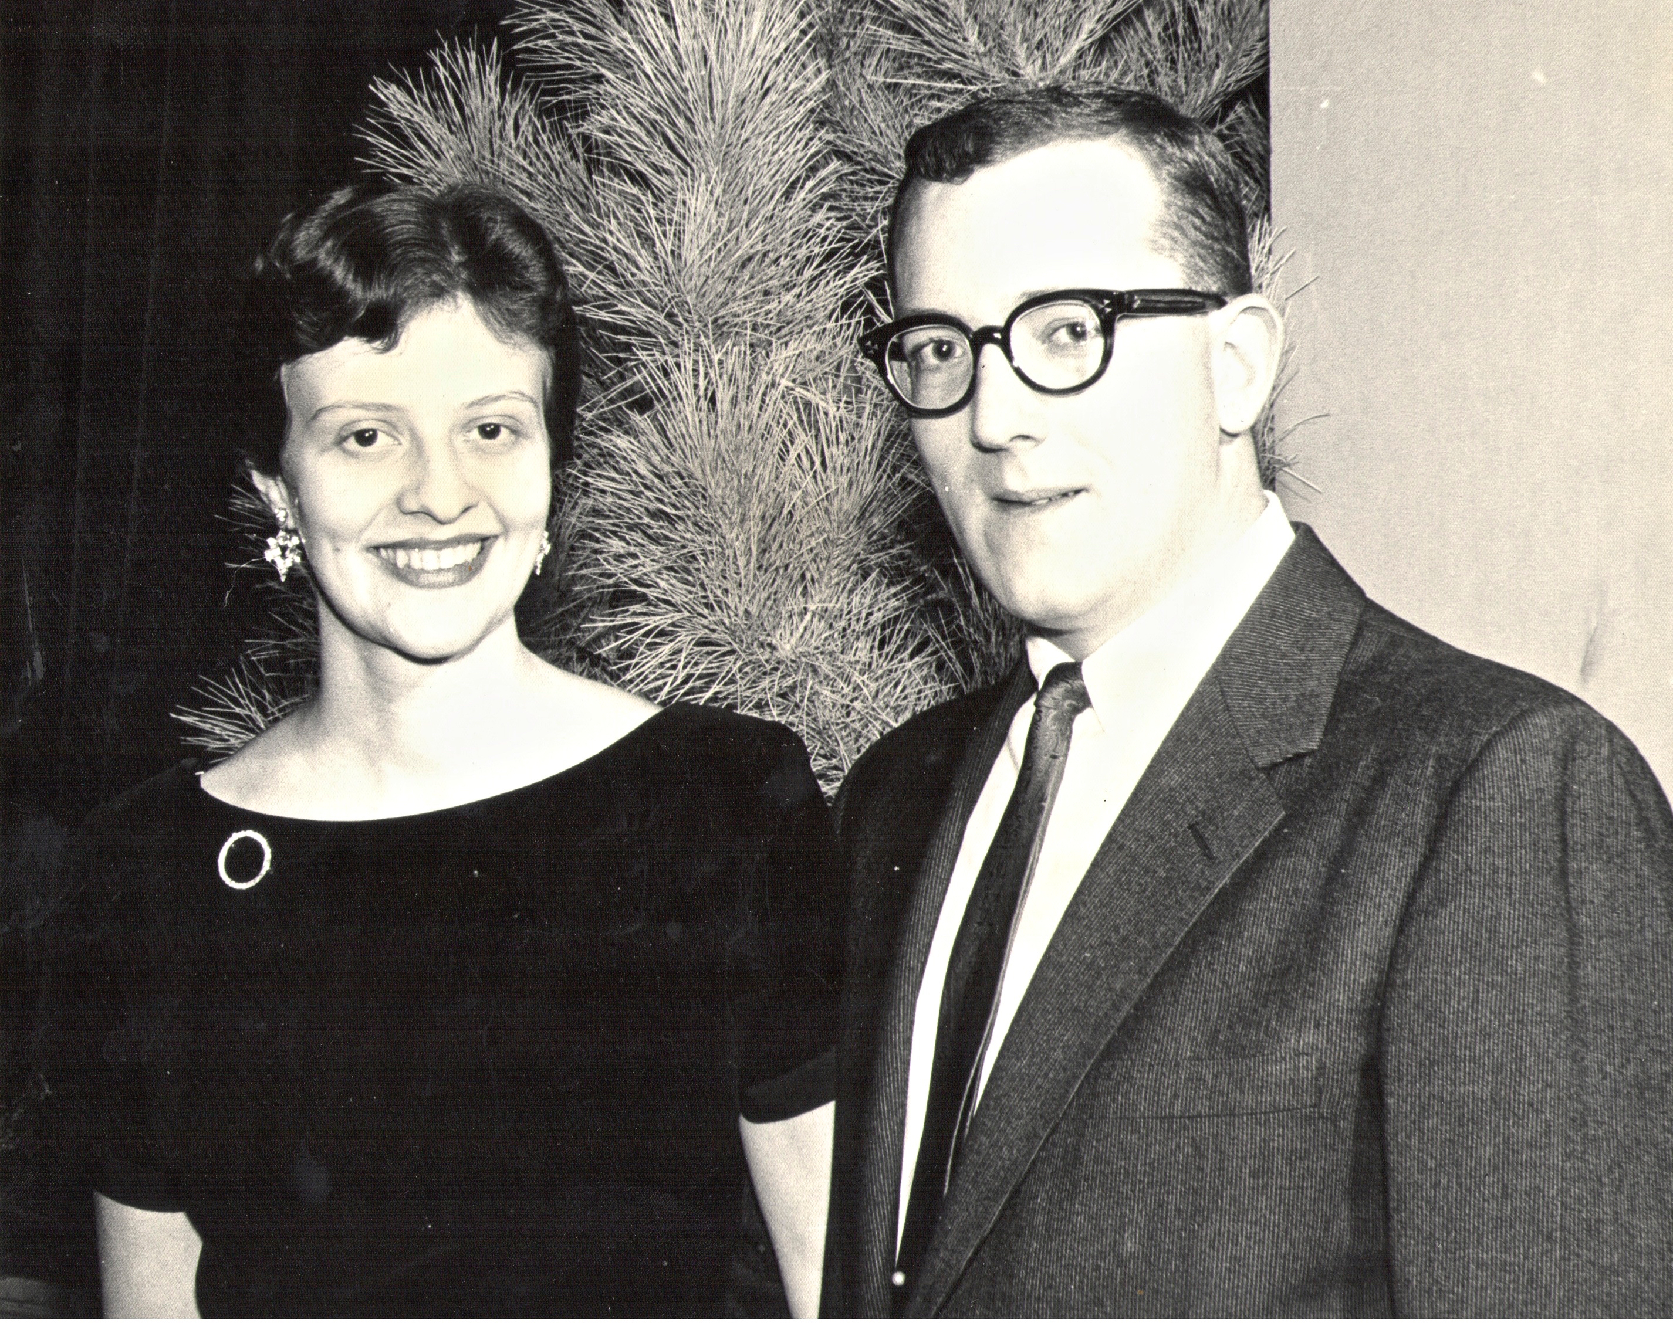
My Parents

Slide 28
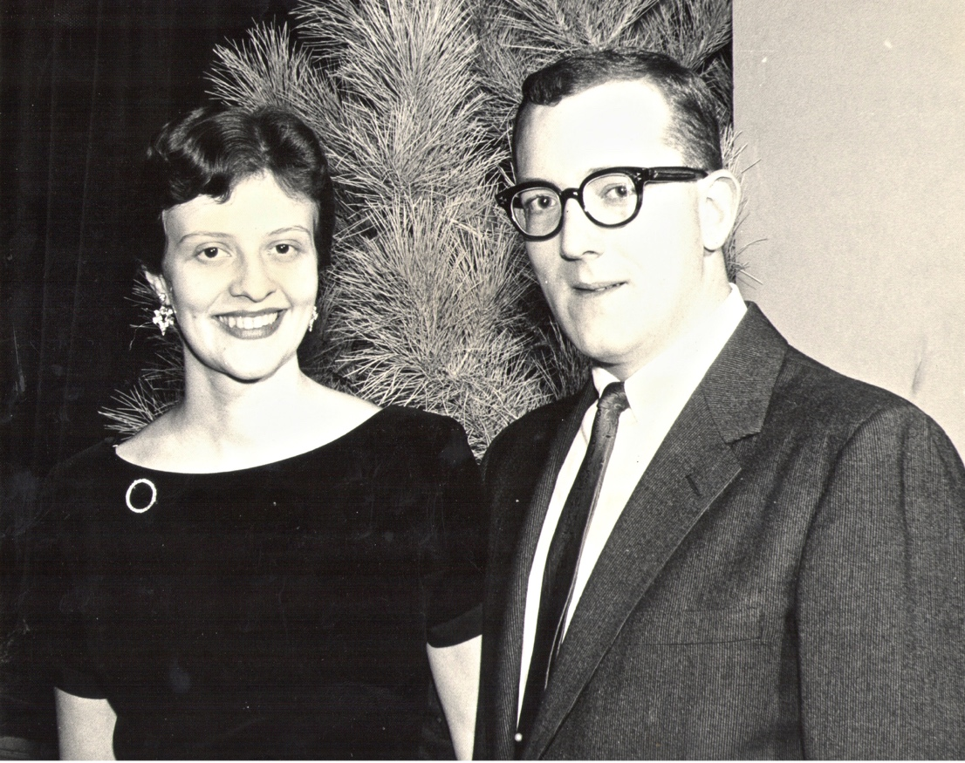
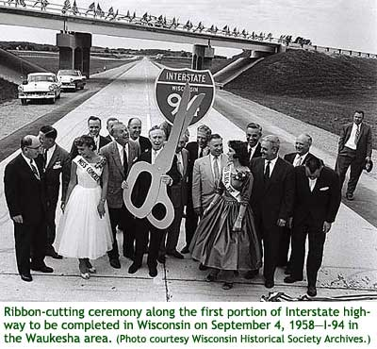
My Parents’ Generation
Built the Interstate Highways,
fought the cold war, landed on the Moon!

Slide 29
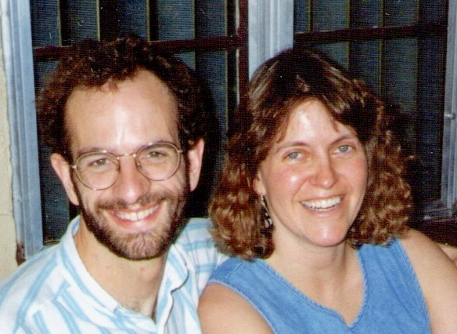
Jennifer & Me

Slide 30
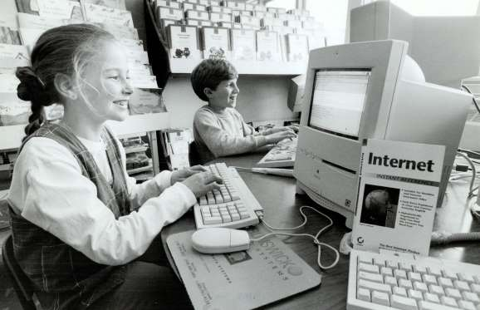
My Generation
Invented the PC, Built the internet,
replaced billions of land-lines with cell phones

Slide 31
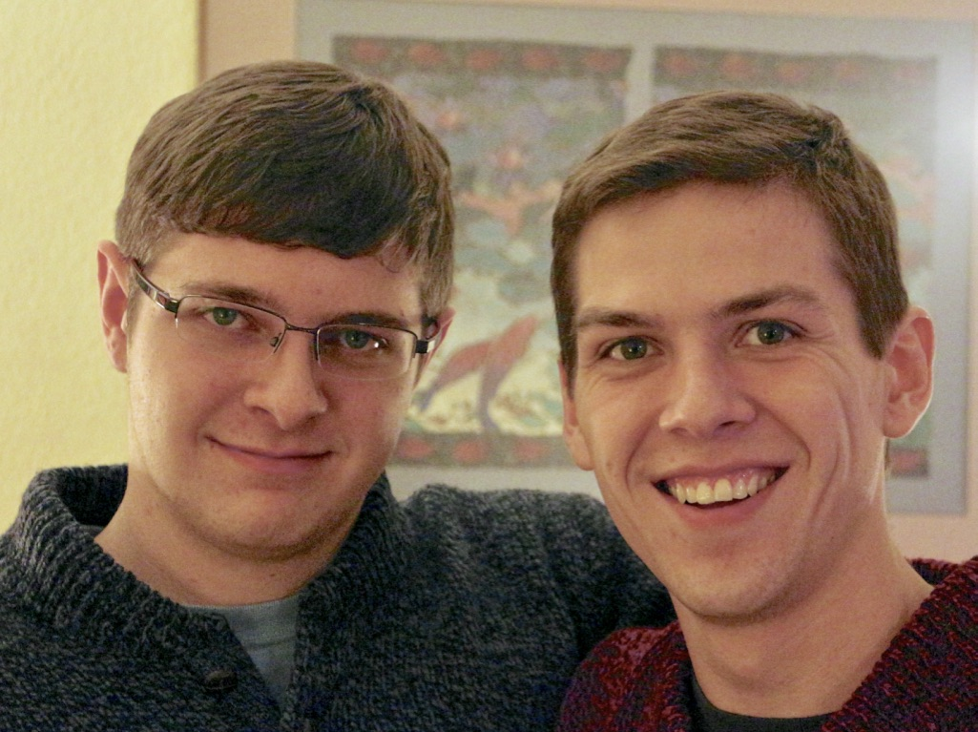
My Kids

Slide 32
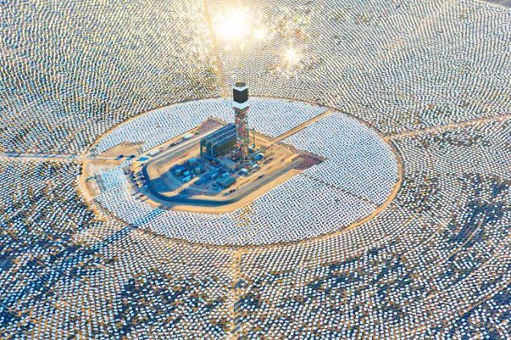
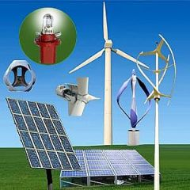
My Kids’ Generation
Will replace the world’s energy system again!

Slide 33
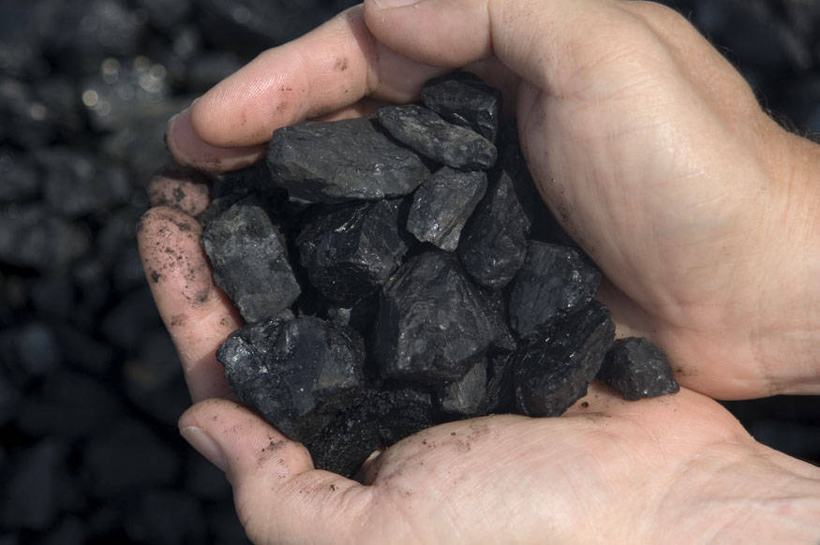
Choose Your Future
Many people think:
  “Our well-being is based on
  stuff we extract from the ground”
When we stop burning coal, will our descendants shiver in the dark?

Slide 34

Choose Your Future
I prefer:
  “We create our well-being through creativity, ingenuity, and hard work”
The future is bright!

Slide 35
Take my Class this Summer!

