Slide 1

Many Chances to Fail:
Scholarly Teaching in Physics
@CO/WY AAPT Meeting, April 2014
Dr. Jeff Loats
Associate Professor of Physics
Faculty Associate to the
Center for Faculty Development

Slide 2
Being A Scholarly Teacher
Two versions:
Apply the rigor we bring to the discipline of physics to the discipline of teaching.
Choose teaching methods that are strongly informed by the best empirical evidence available.
Contrast teaching E&M with treating diabetes

Slide 3
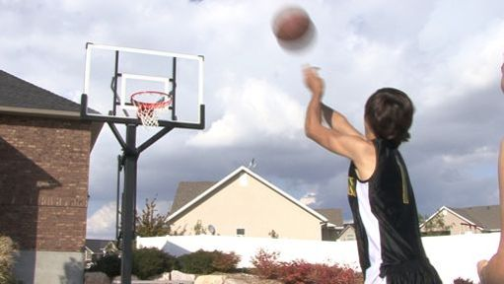
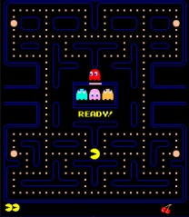
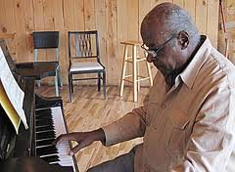
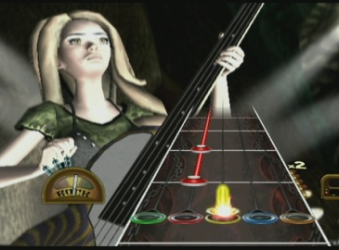
How Do People Like to Learn
Do we ever enjoy learning?
Some candidates come to mind:

Slide 4
Common Elements?
Feedback is (nearly) instantaneous
Failure is expected
The cost of failure is very low
Mastery requires iterative learning
Pause: Consider typical feedback loops in the college classroom…

Slide 5
In your typical class, is there a method for holding students accountable for preparing for class?
  Stern threats and/or playful pleading.
  A paper method (quiz, journal, others?)
  A digital method (clickers, others?)
  Just in Time Teaching.
  Some other method.
20%
45%
11%
7%
18%
(others)

Slide 6
Just in Time Teaching
Learner
Teacher
Online pre-class assignments
(“WarmUps”)
First half:
Conceptual questions, answered in sentences
Graded on thoughtful effort

Slide 7
Just in Time Teaching
Learner
Teacher
Online pre-class assignments
(“WarmUps”)
First half:
Conceptual questions, answered in sentences
Graded on thoughtful effort
Second half:
Responses are read “just in time”
Instructor modifies the plan accordingly
Aggregate and individual (anonymous) responses are displayed in class.

Slide 8
Just in Time Teaching
Learner
Teacher
A different student role:
Actively prepare for class
(not just reading/watching)
Actively engage in class
Compare your progress & plan accordingly
A different instructor role:
Actively prepare for class with you
(not just going over last year’s notes )
Modify class accordingly
Create interactive engagement opportunities

Slide 9
In a typical day in your class, what fraction of students did their preparatory work before coming to class?
0% - 20%
20% - 40%
40% - 60%
60% - 80%
80% - 100%
27%
33%
20%
14%
6%
~200 others
Notes:
Jeff’s results: Depending on the class 70-80% of my students do their WarmUps, self-reporting that they spend ~40 minutes reading/responding (very consistent average)
Others results come from ~ 40 faculty, ~30 higher ed technology folks and ~10 students
For this group:

Slide 10
Student Feedback
315 students in 7 classes over 4 terms (roughly ±6%)
The WarmUps have… | Agreed or Strongly Agreed
…helped me to be more prepared for class than I would otherwise be. | 70%
…helped me to be more engaged in class than I would otherwise be. | 80%
…helped me to learn the material better than I otherwise would | 64%
…been worth the time they required to complete | 57%

Slide 11
More on JiTT?
Much more information to be had:
Theoretical basis for effectiveness
Empirical evidence for effectiveness
Writing good questions
Best and worst implementation tools
Practical questions and pitfalls

Slide 12
In a typical day in your class, what fraction of class time is spent on lecture-based delivery of content?
0% - 20%
20% - 40%
40% - 60%
60% - 80%
80% - 100%
2%
10%
13%
38%
37%
~100 others
Notes:
This comes from ~50 people, including ~20 students and ~30 Higher Ed. IT people

Slide 13
Clickers: Very Well Studied
When used well…
Quick/easy attendance in large class sizes.
Everyone participates and retains anonymity
Encourages active learning
Improved concentration
Improved exam scores
Improved learning and retention
Efficient use of class time
Engages students in metacognition.
Notes:
Major caveat: Using classroom response system does not automatically bring these benefits. The method matters much more than the means.
Hinde & Hunt: We survey 219 first-year business studies students tackling introductory economics, and find that the technology enhances learning in lectures because, among other things, it improves concentration, provides instantaneous and more effective student feedback, and allows students to make comparisons on how well they fare relative to their peers.
Moreau, 2010: Overall, the experimental group scored higher on the posttest than the control group, and weak students in the experimental group made more improvement as measured by the posttest than similar ability students in the control group
Poirier & Feldman, 2007: There are reports of modest increases in exam grades when instructors use clickers to test concepts and probe opinions in large sections of introductory psychology .
Anderson, et al. 2011: Compression (dropping topics that are well understood) based on group, or individual-level performance caused no decrease in learning compared to no compression.

Slide 14
Peer Instruction
Multiple choice questions
  Conceptual
  Hard
Students answer Individually
Discussion with peers
Students answer post-discussion
Class-wide discussion
Notes:
Carefully chosen questions
Ideally: 30-70% correct on first try)
In 95% of cases, students “migrate” towards correct answer, often dramatically.
Explanation and discussion by instructor follows the second “vote”, as necessary.
In my class, participation is required (5% of final grade) but correctness is not required.

Slide 15
“Many Chances to Fail”
A line adopted from business:
  “Fail early, fail often, fail well…”
Grounded in constructivist learning theory:
Constructing new ideas often requires facing the failure of previous ideas.
Confusion and conflict make clear the need to build functional ideas in place of those that failed.
Notes:
TRANSITION: I’m going to use my own classes as an example of how this can work… all from an evidence-based perspective

Slide 16
Iterative Learning Loops
On a given topic…
Before class: Engage with Just-in-Time Teaching “warm-up” questions that enforce reading & require thought
During class: Respond (digitally) to difficult questions, peer discussions
After class: Online homework with immediate feedback and low(ish) stakes.
Perhaps 10-20 chances to test their understanding before they encounter a high-stakes exam.

Slide 17
My Summary
Challenge yourself to be a scholarly-teacher
Follow the evidence!
Be moderate… follow the 10% rule
Engage with peers! Share, steal, and combine.

Slide 18
Your Summary
  For yourself… or to share?
  What one “nugget” do most want to take away from this short presentation
  Contact Jeff: Jeff.Loats@gmail.com
  Slides: www.slideshare.net/JeffLoats
I love talking and working with faculty,
don’t hesitate to get in touch.

Slide 19
JiTT References & Resources
Simkins, Scott and Maier, Mark (Eds.) (2010) Just in Time Teaching: Across the Disciplines, Across the Academy, Stylus Publishing.
Gregor M. Novak, Andrew Gavrini, Wolfgang Christian, Evelyn Patterson (1999) Just-in-Time Teaching: Blending Active Learning with Web Technology. Prentice Hall. Upper Saddle River NJ.
K. A. Marrs, and G. Novak. (2004). Just-in-Time Teaching in Biology: Creating an Active Learner Classroom Using the Internet. Cell Biology Education, v. 3, p. 49-61.
Jay R. Howard (2004). Just-in-Time Teaching in Sociology or How I Convinced My Students to Actually Read the Assignment. Teaching Sociology, Vol. 32 (No. 4 ). pp. 385-390. Published by: American Sociological Association
Stable URL: http://www.jstor.org/stable/3649666
S. Linneman, T. Plake (2006). Searching for the Difference: A Controlled Test of Just-in-Time Teaching for Large-Enrollment Introductory Geology Courses. Journal of Geoscience Education, Vol. 54 (No. 1)
Stable URL:http://www.nagt.org/nagt/jge/abstracts/jan06.html#v54p18

Slide 20
Clicker References & Resources
Banks, D. A. (Ed.). (2006). Audience response systems in higher education: Applications and cases. Hershey, PA: Information Science Publishing.
Hinde, K., & Hunt, A. (2006). Using the personal response system to enhance student learning: Some evidence from teaching economics. In Banks, D. A. (Ed.), Audience Response Systems in Higher Education: Applications and Cases. Hershey, PA: Information Science Publishing.
Martyn, M. (2007). Clickers in the classroom: An active learning approach. EDUCAUSE Quarterly, 30(2), 71-74.
(http://www.educause.edu/ir/library/pdf/EQM0729.pdf)
Moreau, N. A. (2010). Do clickers open minds? Use of a questioning strategy in developmental mathematics, CAPELLA UNIVERSITY, 2010, 157 pages; 3389211
Poirier, C. R., & Feldman, R. S. (2007). Promoting active learning using individual response technology in large introductory psychology classes. Teaching of Psychology, 34(3), 194-196.
Mazur, E. 2004 ”Introduction to Peer Instruction” talk presented at New Physics & Astronomy Faculty Workshop, 2004, UMD.
Hake, R.R. 1998a. “Interactive-engagement vs traditional methods: A six thousand-student survey of mechanics test data for introductory physics courses,” Am. J. Phys. 66(1): 64-74; (www.physics.indiana.edu/~sdi/ajpv3i.pdf)
Anderson, L., Healy, A., Kole, J., & Bourne, L. (2011). Conserving time in the classroom: the clicker technique. The Quarterly Journal of Experimental Psychology, 64(8): 1457-1462.
Thought Questions: A New Approach to Using Clickers
CU Science Education Initiative & UBC Science Education Initiative
(http://www.cwsei.ubc.ca/resources/files/CU-SEI_Thought_Questions.pdf)
Clicker Resource Guide from the CU Science Education Initiative & UBC Science Education Initiative
(http://www.cwsei.ubc.ca/resources/files/Clicker_guide_CWSEI_CU-SEI_04-08.pdf)
Duncan, D. (2009). Tips for Successful “Clicker” Use. Retrieved January 31, 2009.
(http://www.cwsei.ubc.ca/resources/files/Tips_for_Successful_Clicker_Use_Duncan.pdf)
Why Are Clicker Questions Hard To Create?
Blog post by Ian Beatty, Science Education Researcher and Professor of Physics at the University of North Carolina at Greensboro
(http://ianbeatty.com/blog/archives/100)
Good resource list at Carleton College’s website: http://serc.carleton.edu/sp/library/classresponse/index.html

