Slide 1

Beyond Ohms Law: Arduino / Physics / Maker Movement
brian.huang@sparkfun.com
@sparkfun @bri_huang

Slide 2


About Me…
Industry experience → Classroom
Industry + Classroom → Prof. Development

Slide 3



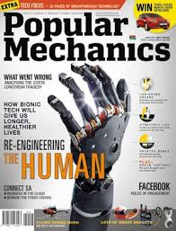







Slide 4
Game Changers / Tools
1
STEaM
2
Copper Tape, Conductive Ink, & Paper Circuits
3
Probe-ware / Modeling Physics
4
Arduino
5
Programming as a Literacy

Slide 5
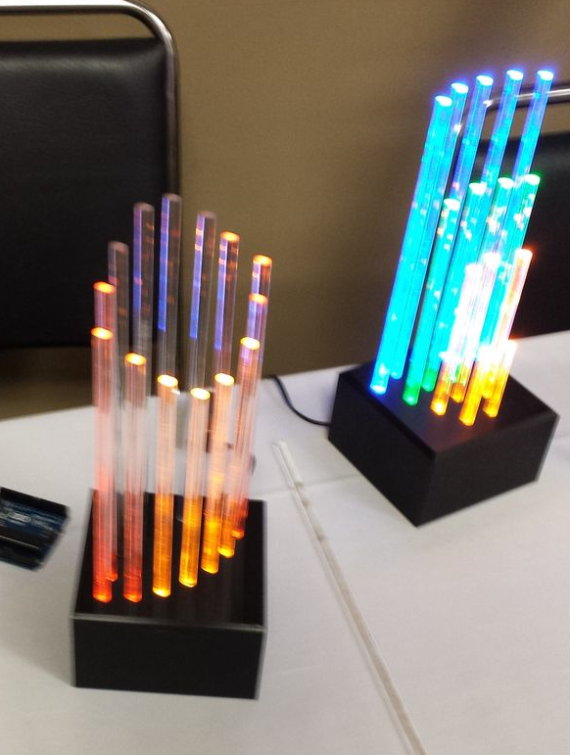
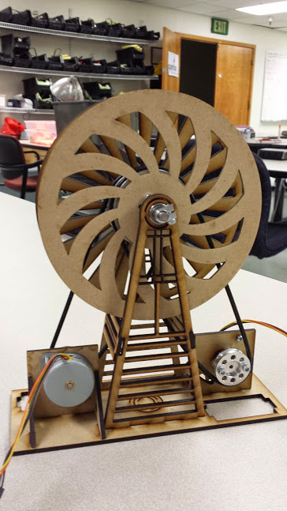
1 - STEAM Projects

Slide 6
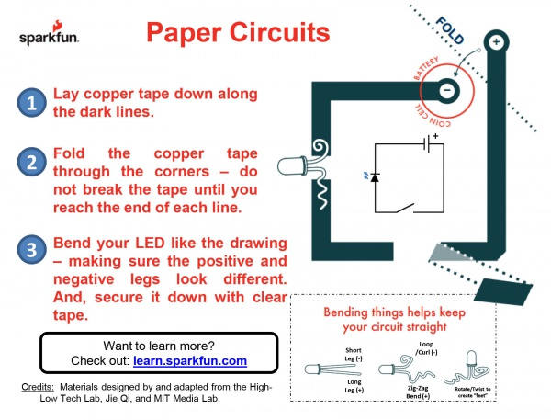
2 - Copper Tape & Paper Circuits

Slide 7
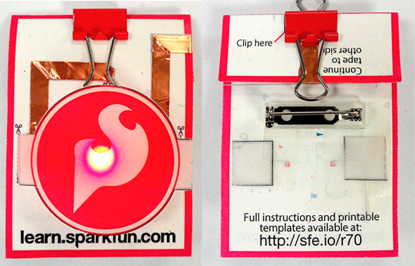
Make it art!

Slide 8

3 - Arduino
What is it?
Why use it?
Where do I start?
  www.arduino.cc
  Sparkfun learn site:
    http://learn.sparkfun.com
  Arduino in the physics classroom:
    http://bit.ly/ArduinoPhysics
  Physics 120B (UC-San Diego) Physical Meas II:
    http://physics.ucsd.edu/~tmurphy/phys120b/

Slide 9
3 – Arduino for Physics
Just a few ideas – not at all exhaustive:
  Photogate Timer
  RC Time Constant
  RGB Color Mixing / Subtraction
  MakerScience – DIY-style

Slide 10
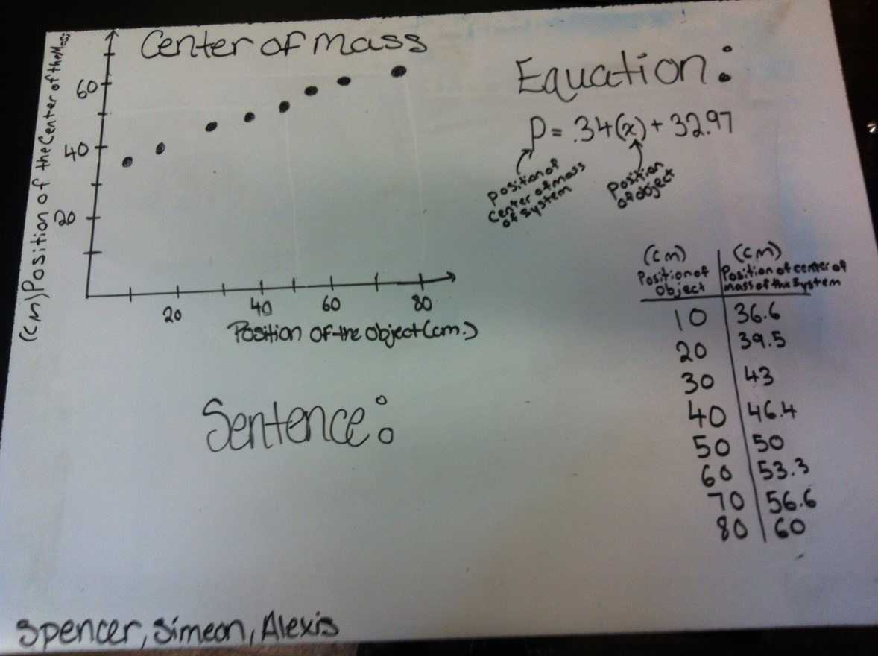

4 - Probe-ware / Modeling Physics
$$y=m∙x+b$$
How does x affect y?

Slide 11
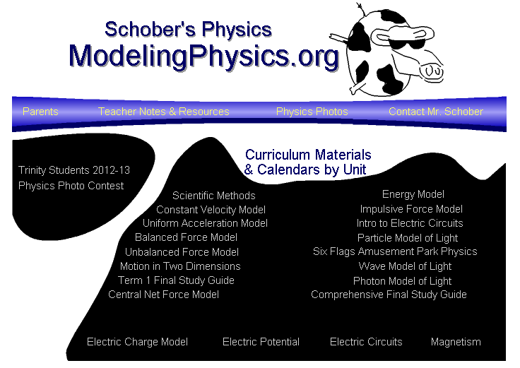
http://modeling.asu.edu/

Slide 12
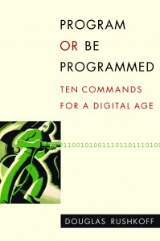


5 - Program or be programmed…

Slide 13







Slide 14


Slide 15

Thank you
Contact Information:
brian.huang@sparkfun.com
@bri_huang
learn.sparkfun.com

