Slide 1
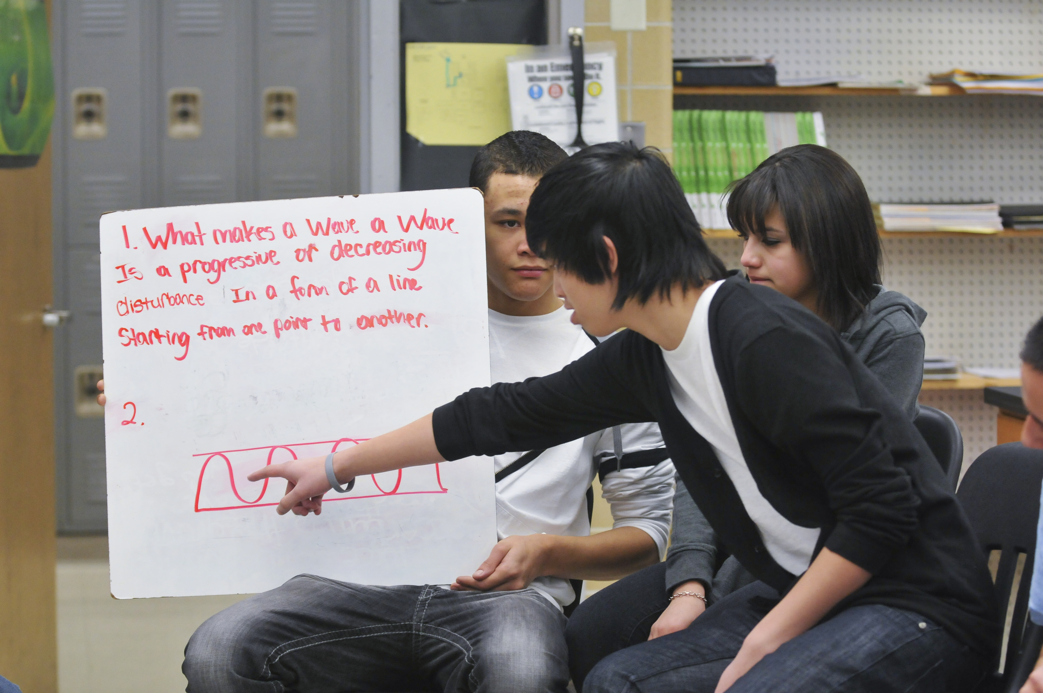
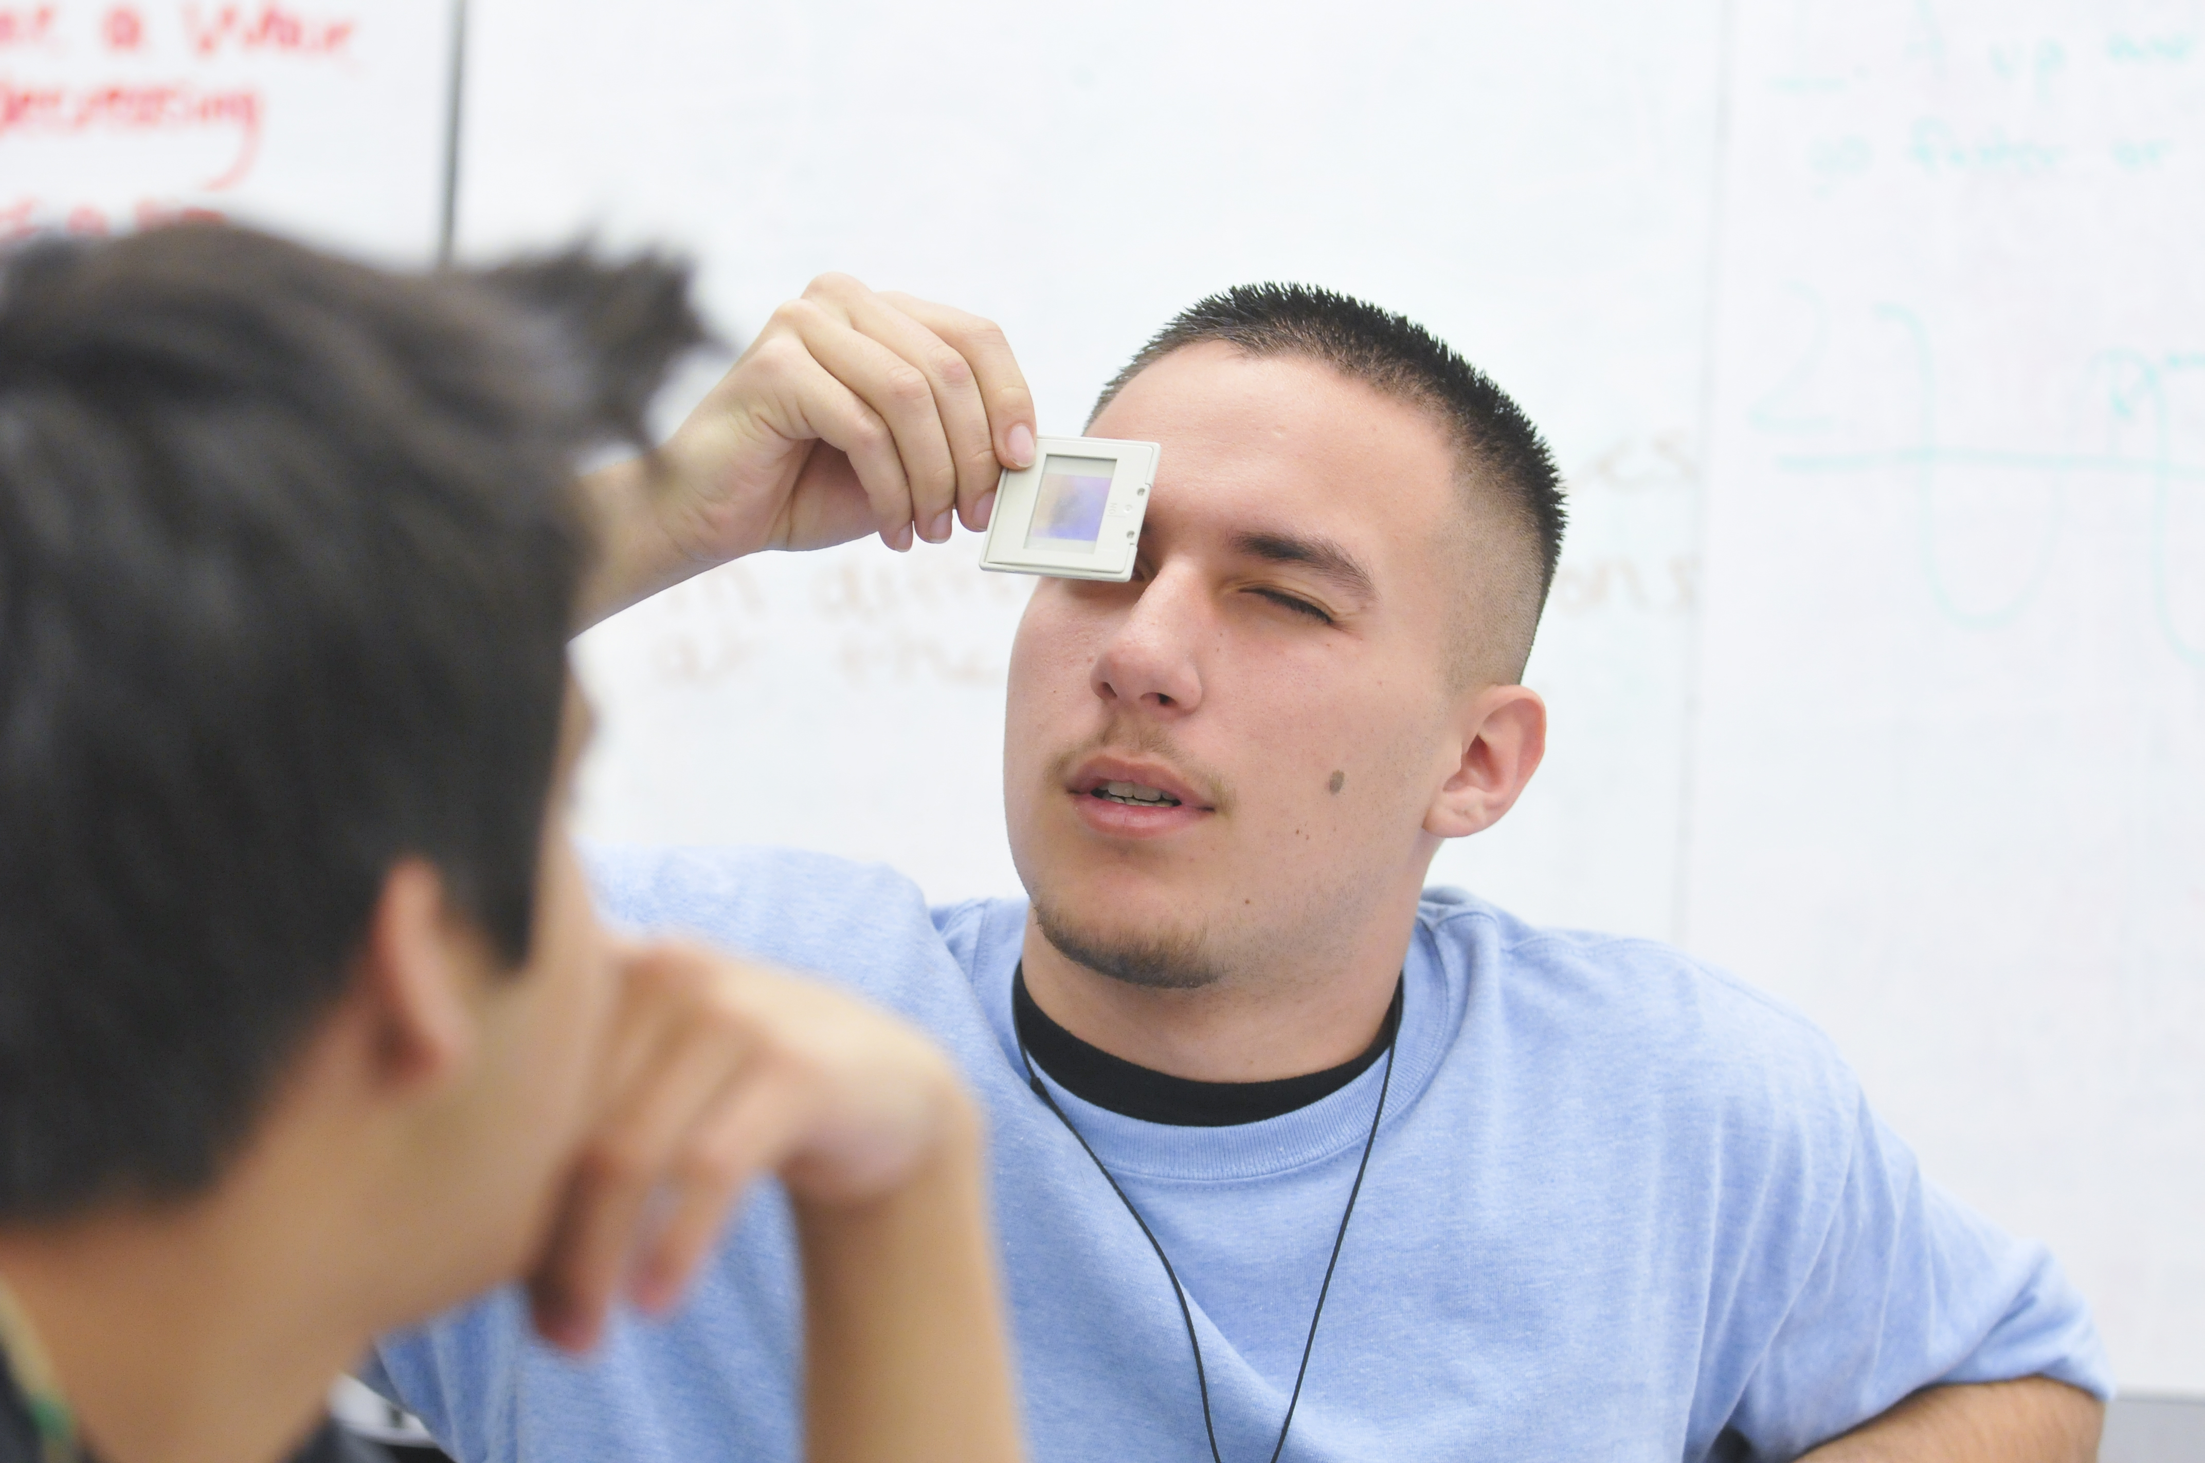
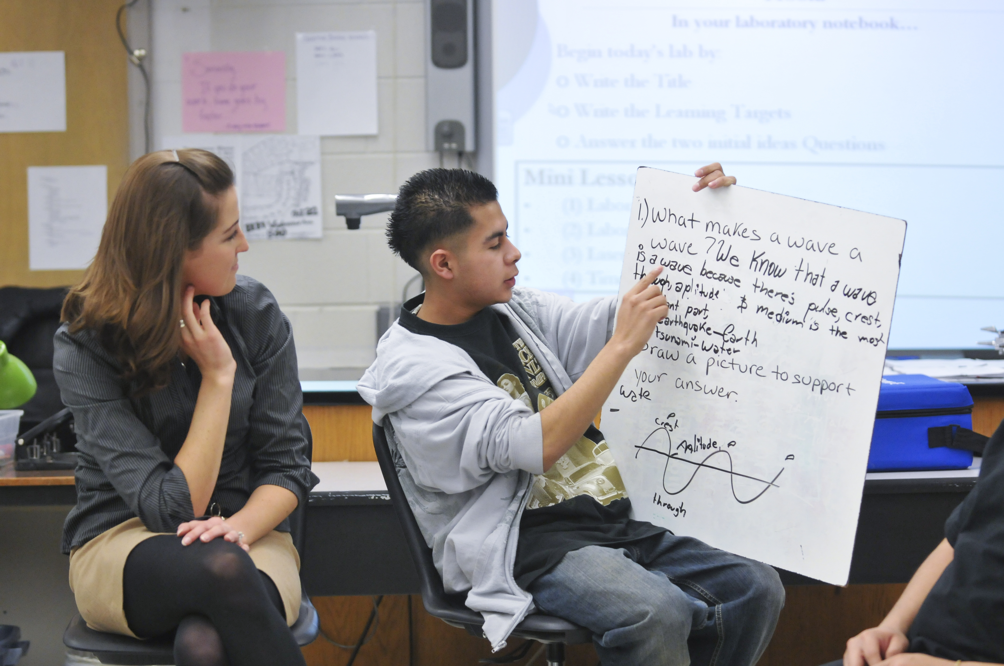
Introducing Chapter W - Waves
Extensive open-source materials for teaching waves in high school physics
www.PEERphysics.org

Slide 2
INTRODUCING PEER PHYSICS
NGSS-Aligned
Curricular Resources for General Physics Courses
Targeted
Professional Learning,
Learning Labs, Coaching
Purposeful Networking and Support for Teachers, Schools, and Districts

Slide 3
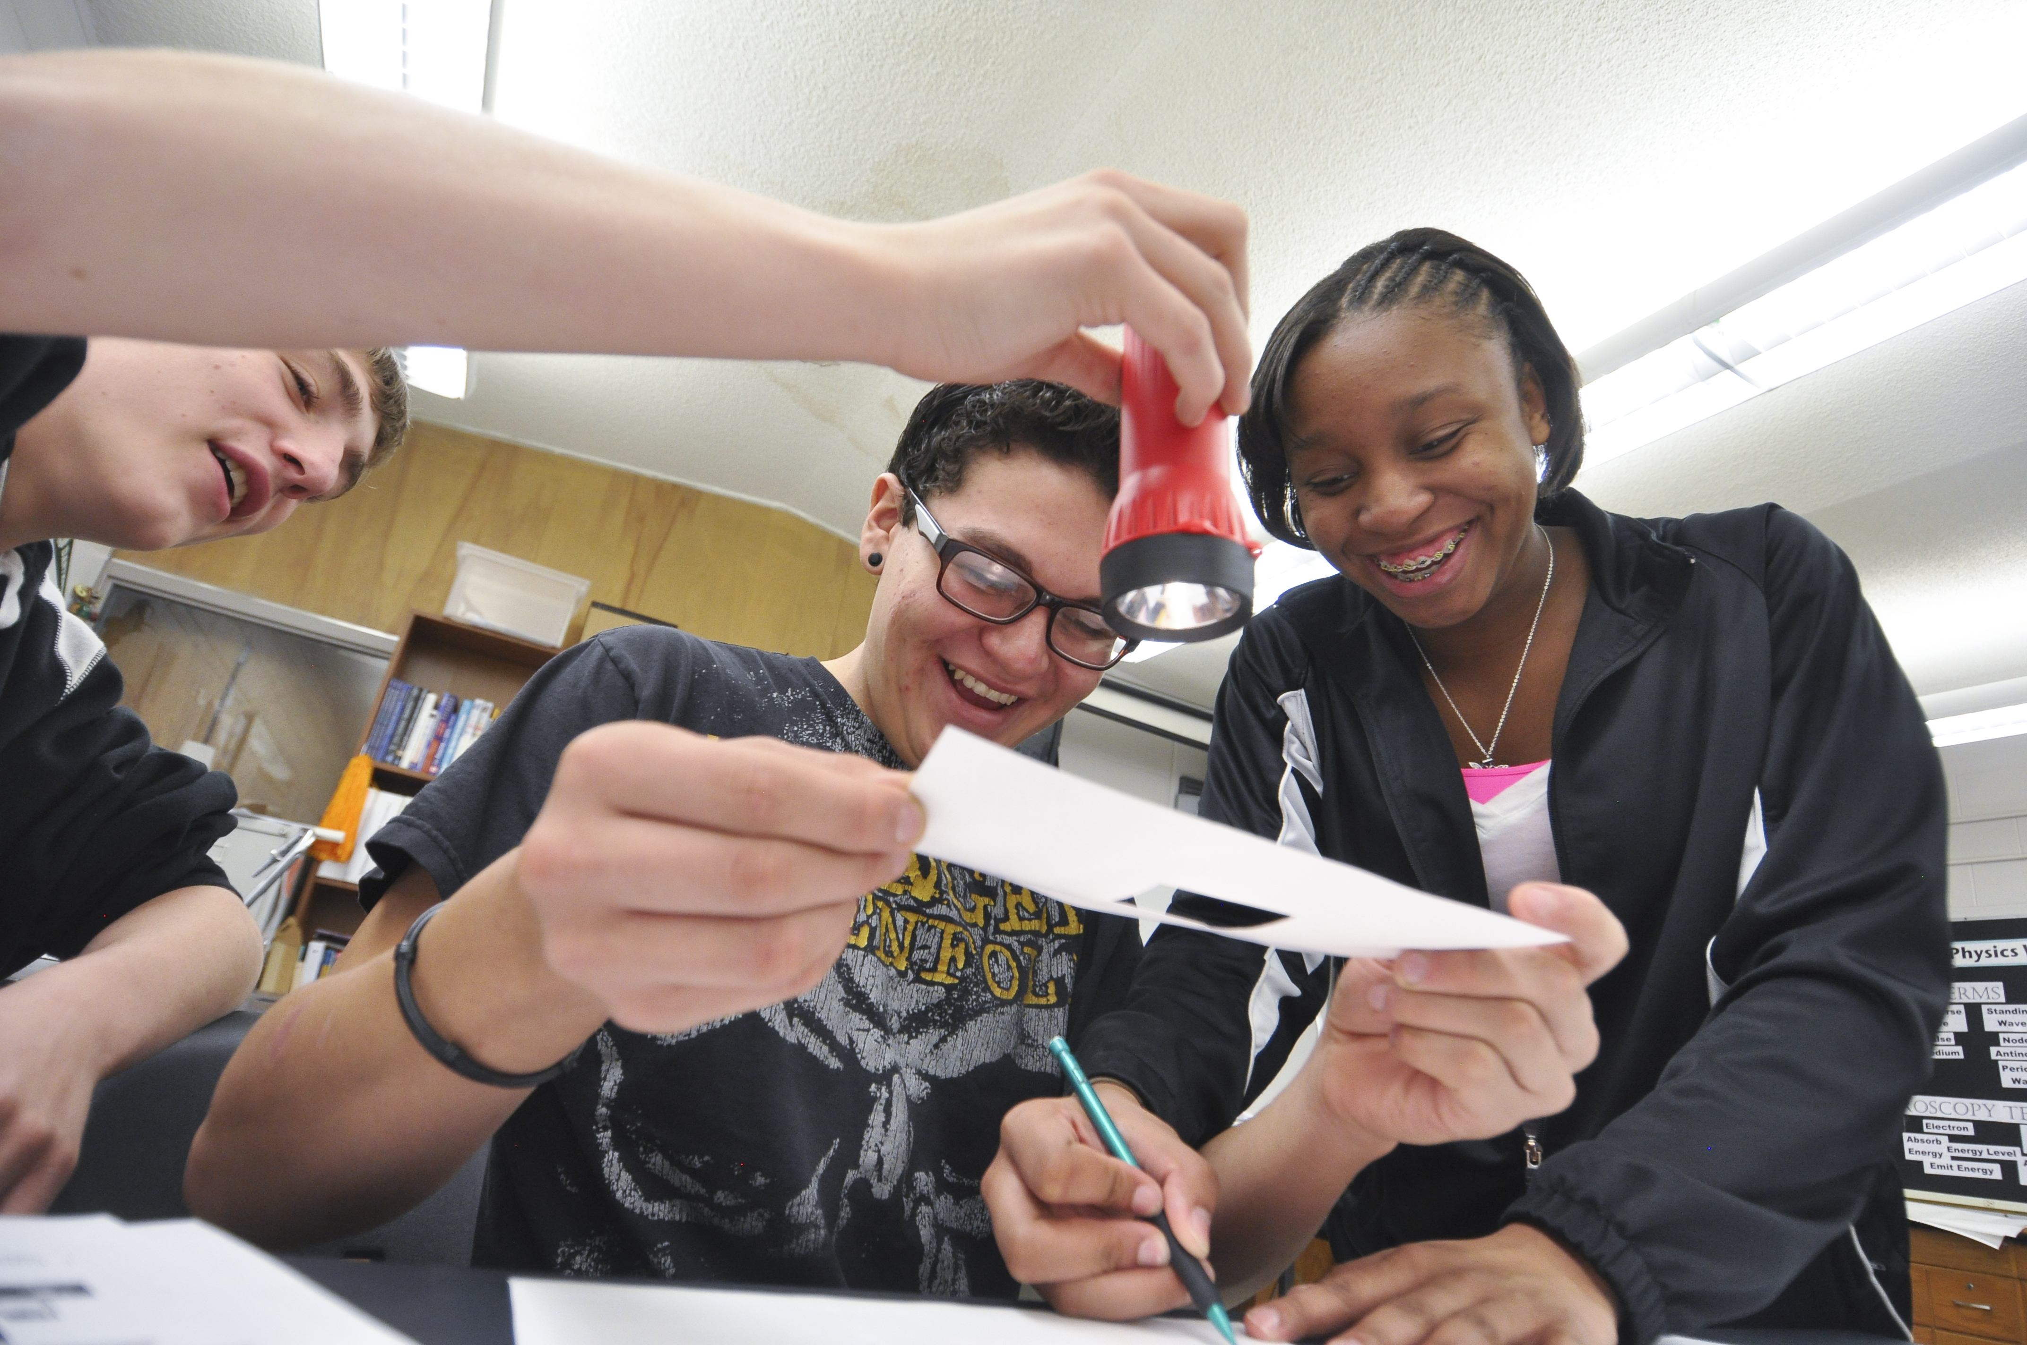
A BRIEF HISTORY
Built from Physics and Everyday Thinking
Goldberg, Robinson, Otero, 2007

Slide 4
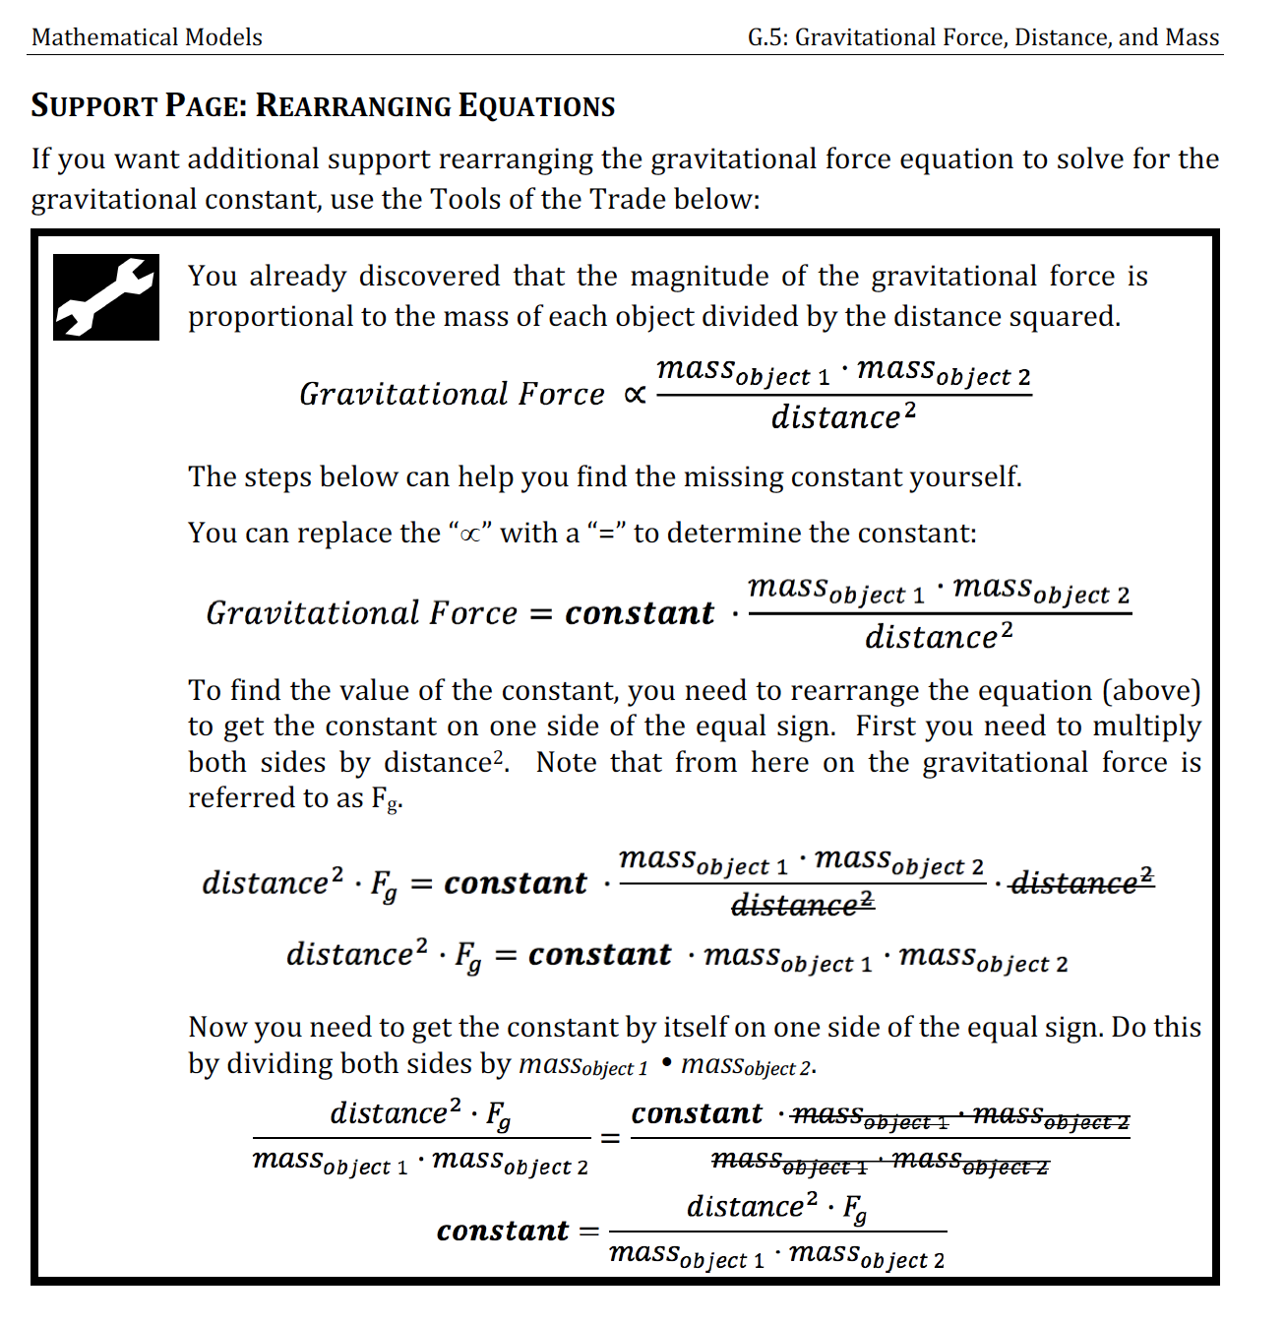
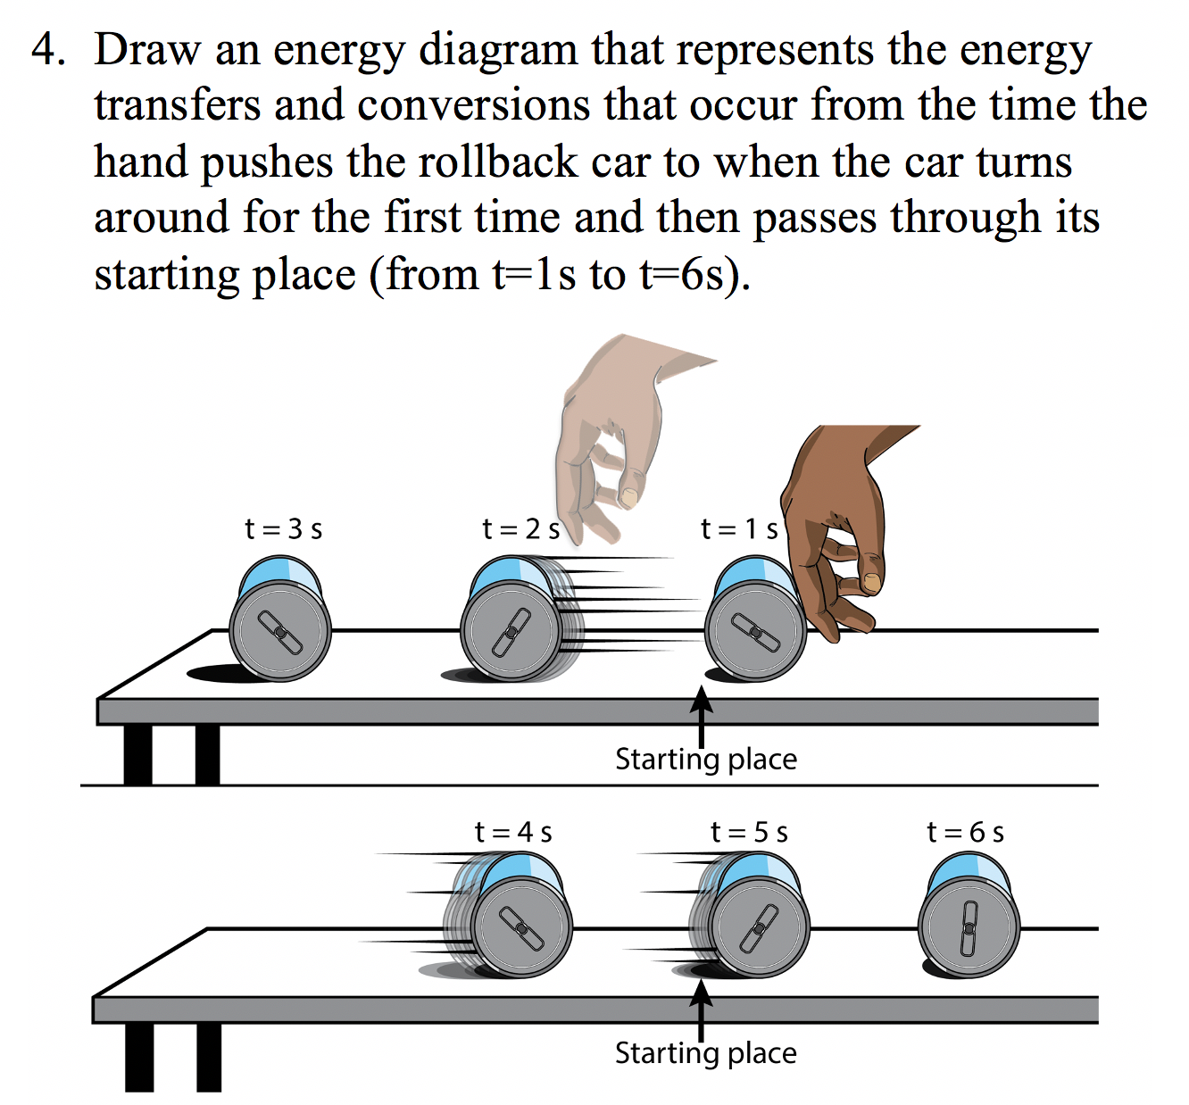
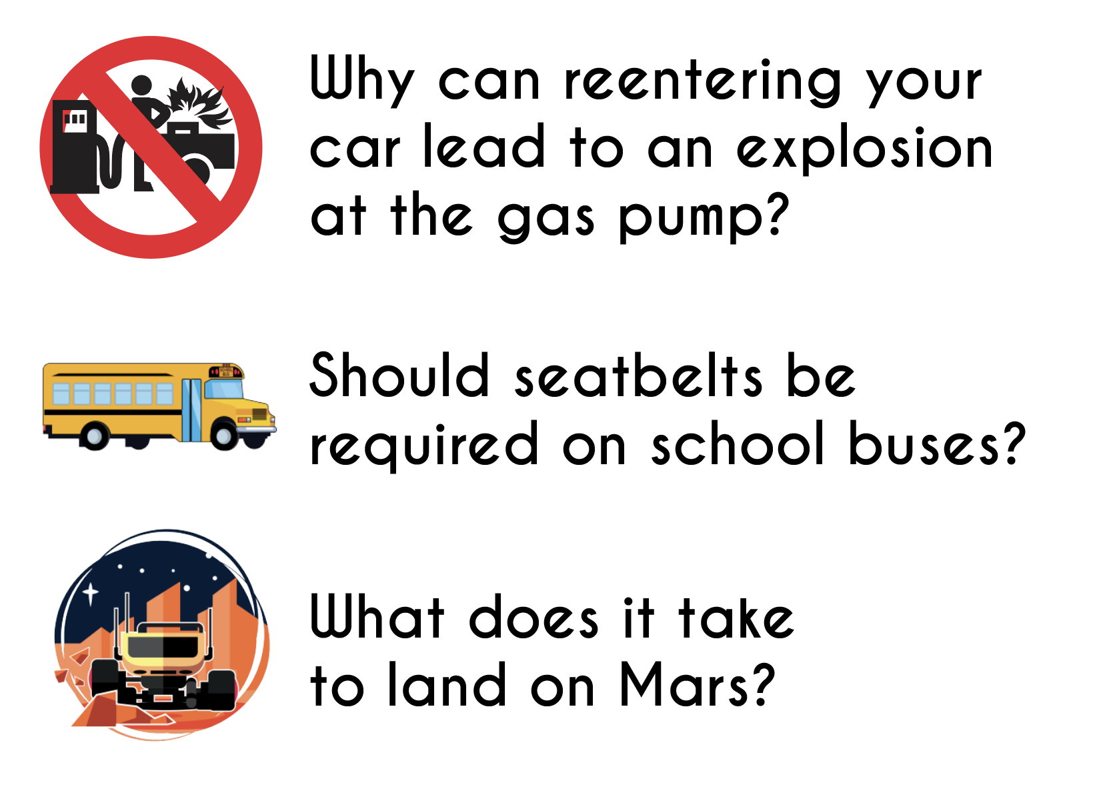
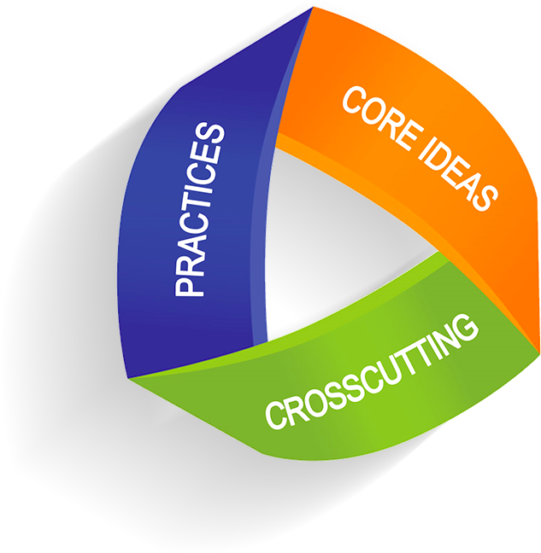
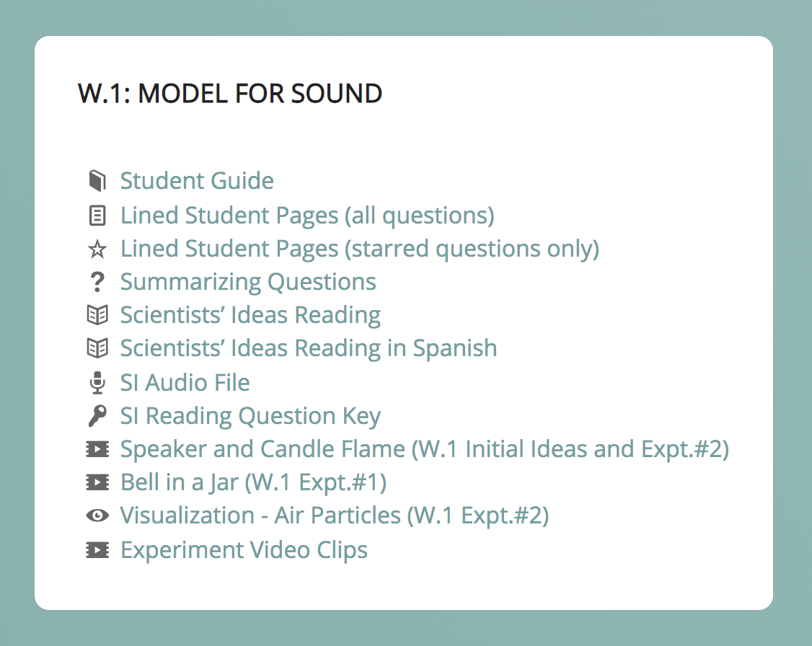
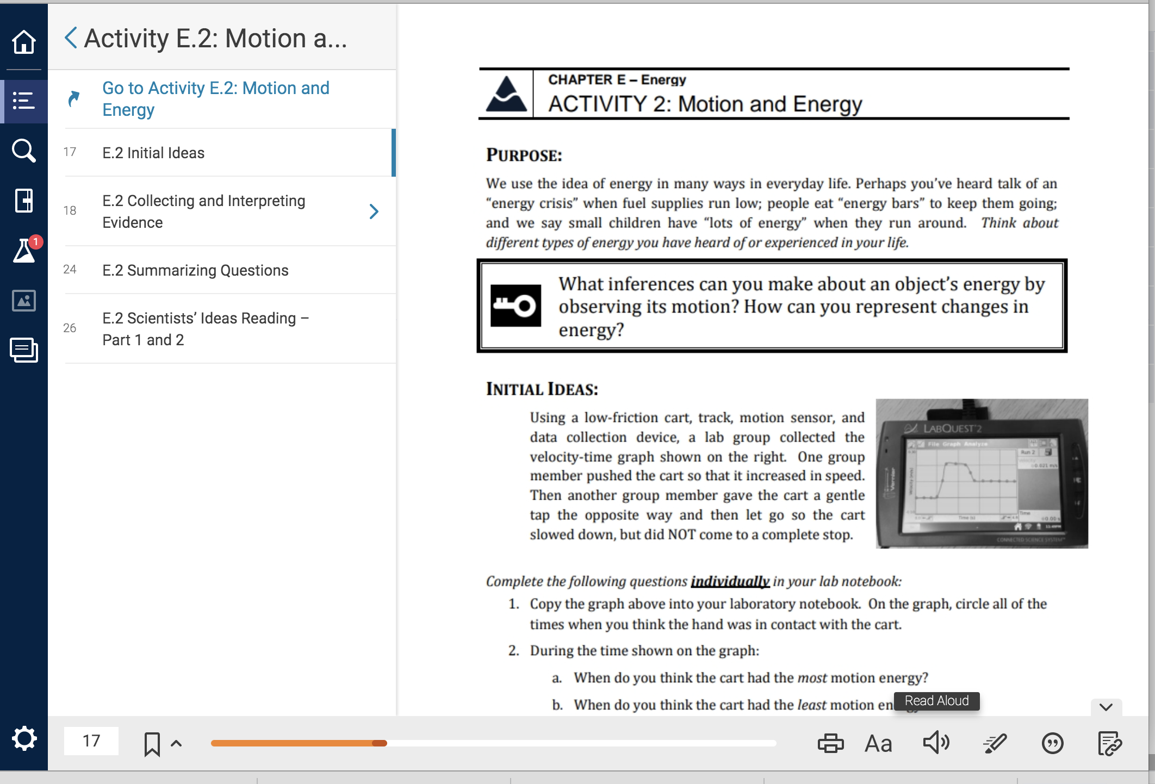
A BRIEF HISTORY
Built from Physics and Everyday Thinking
PET was revised and adapted for:
Depth and breadth of content – preparing high school students for advanced physics and meeting NGSS disciplinary core ideas
Integration of relevant phenomena
Inclusion of 3D assessments and engineering design
Adaptability for all high school grade levels, and even for advanced middle school
Adaptability to diverse school and district objectives, contexts, and values
Accessibility for diverse populations
From the PEER Physics
Teacher Resources Website:
Notes:
CLICK This involved adding depth and breadth of content to best prepare high school students for advanced physics and to meet the NGSS disciplinary core ideas, CLICK we integrated a relevant anchoring phenomenon into each chapter storyline, CLICK and we developed 3D assessments, and engineering design challenges.
It was also necessary for us to consider the range of contexts in which the PEER Physics resources would be utilized – from physics first to general physics, and even advanced middle school physical science courses. CLICK This involved us writing mathematical model building activities that are supplementary. We also wrote extensions and challenge explorations and fundamental supports for topics like scientific notation and unit conversion.
We also needed to consider the adaptability to diverse school contents and district objectives and accessibility for diverse populations, including linguistically diverse students and those with hearing loss. CLICK We provide numerous accessibility tools, including Scientists' Ideas readings in Spanish and as audio files CLICK and eBooks with read-aloud technology and integration with screen readers.

Slide 5
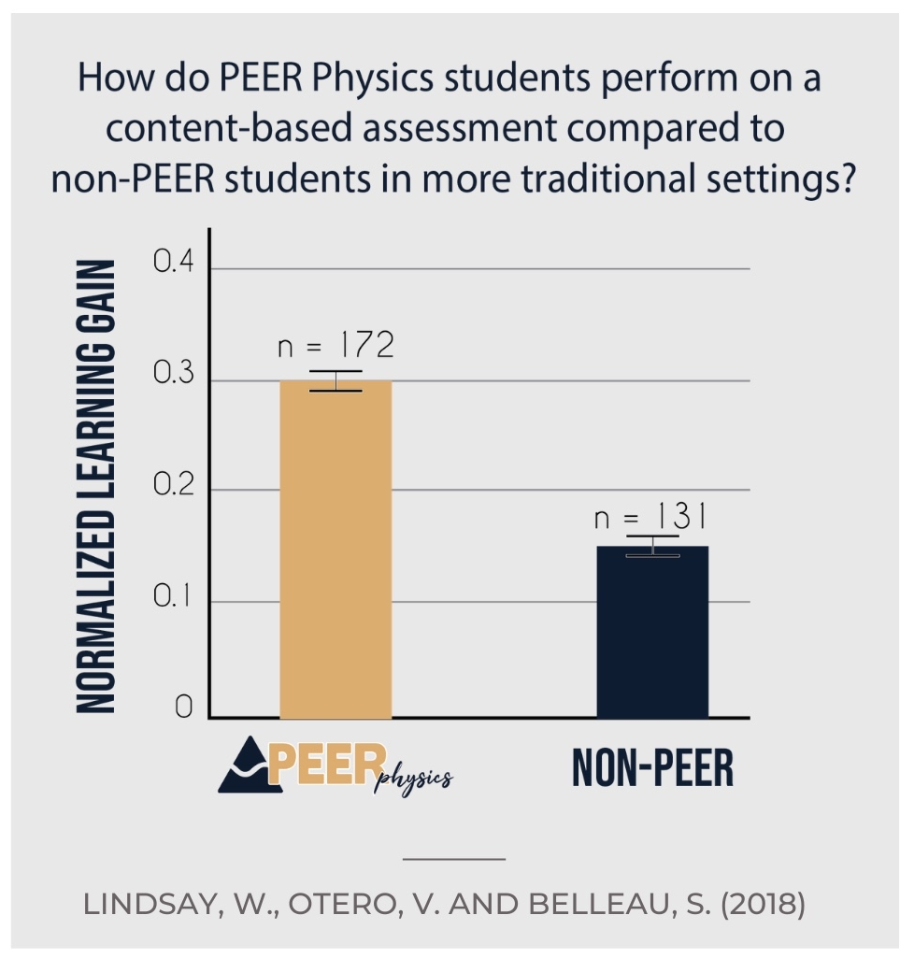
RESEARCH
Students in PEER Physics classes had higher pre/post gain scores in their conceptual understanding of physics concepts compared to traditional physics classrooms.
Lindsay, W., Belleau, S. & Otero, V. (2018). PEER Suite: a holistic approach to supporting inductive pedagogy implementation, in A. Traxler, Y. Cao, and S. Wolf (Eds.) 2018 Physics Education Research Conference Proceedings. Washington DC.

Slide 6
RESEARCH
PEER Physics students relied on evidence rather than their teacher or textbook to determine the correctness of an idea
Schrode, N. (2015). Consensus Paragraphs to Promote Connections Between Inference and Physics Principles. Presented at the bi-annual meeting of the American Association of Physics Teachers, College Park, MD, July 2015.

Slide 7
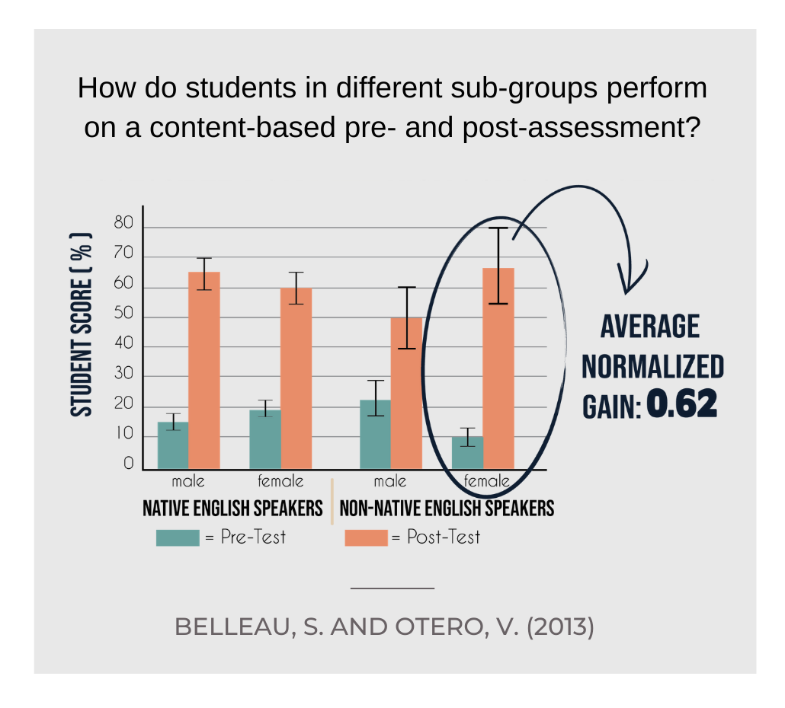
RESEARCH
One of our earliest looks into PEER Physics in the high school was evaluating learning outcomes in terms of growth.
Female students who were non-native English speakers had the greatest normalized learning gain.
Belleau, S. & Otero, V. (2013). Scientific Practices: Equalizing Opportunities for Linguistically Diverse Students, in P. Engelhardt, A. Churukian, D.L. Jones (Eds.), 2013 Physics Education Research Conference Proceedings. Melville, NY: AIP Press.

Slide 8
RESEARCH
Learn more by visiting our website.
peerphysics.org/research

Slide 9
CURRICULAR RESOURCES
Responds to NGSS ideals – students engage in the scientific practices to establish physics principles
Offers lab-based curricular resources

Slide 10
CURRICULAR RESOURCES
Engages students in anchoring phenomena throughout each chapter
Provides multiple assessment resources

Slide 11
CURRICULAR RESOURCES
Learn more by visiting our website.
peerphysics.org/ transforming-classrooms/

Slide 12
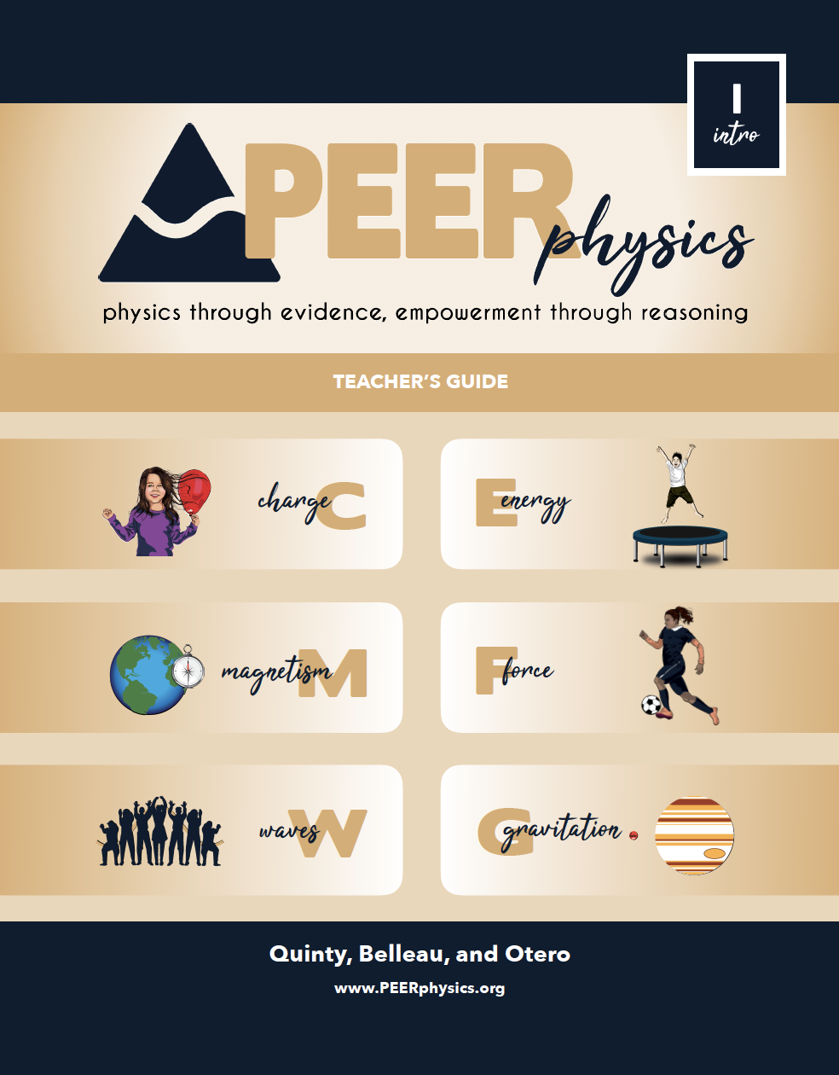
CHAPTER W – WAVES

Slide 13
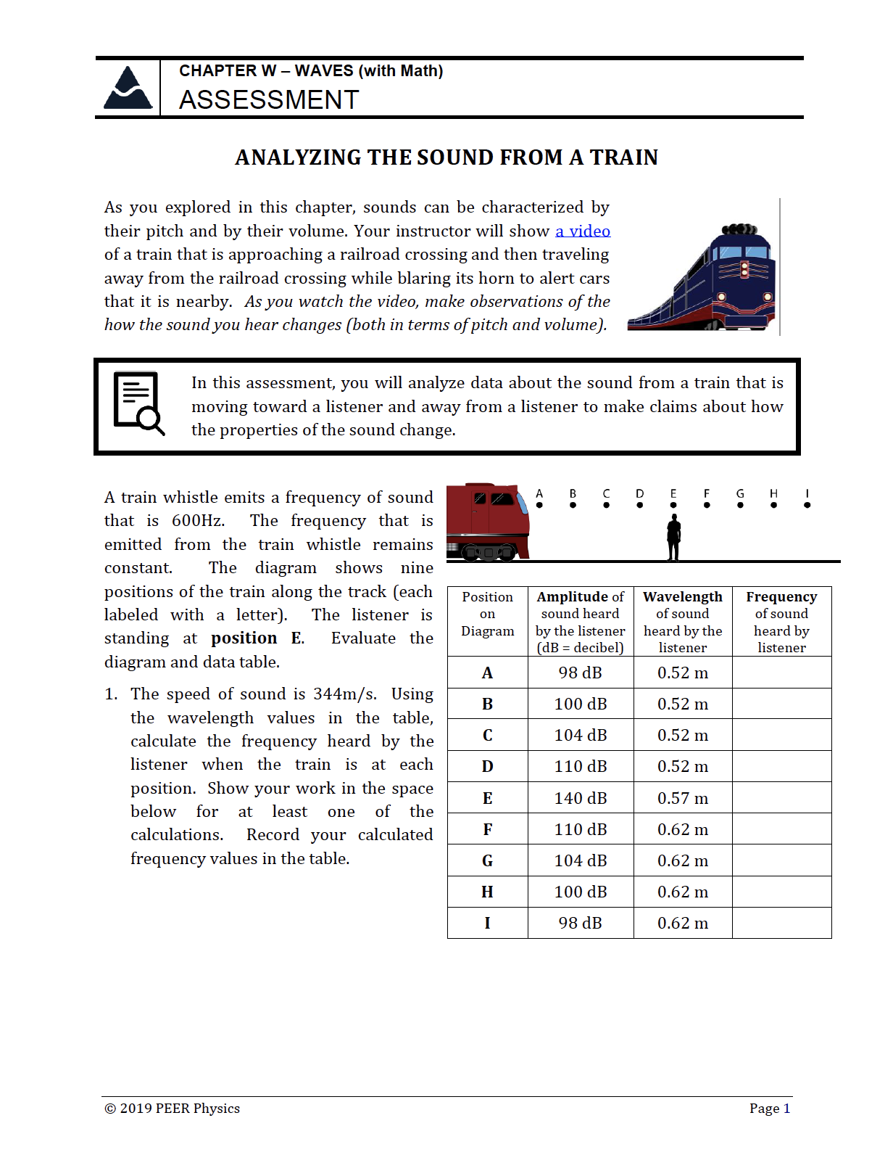
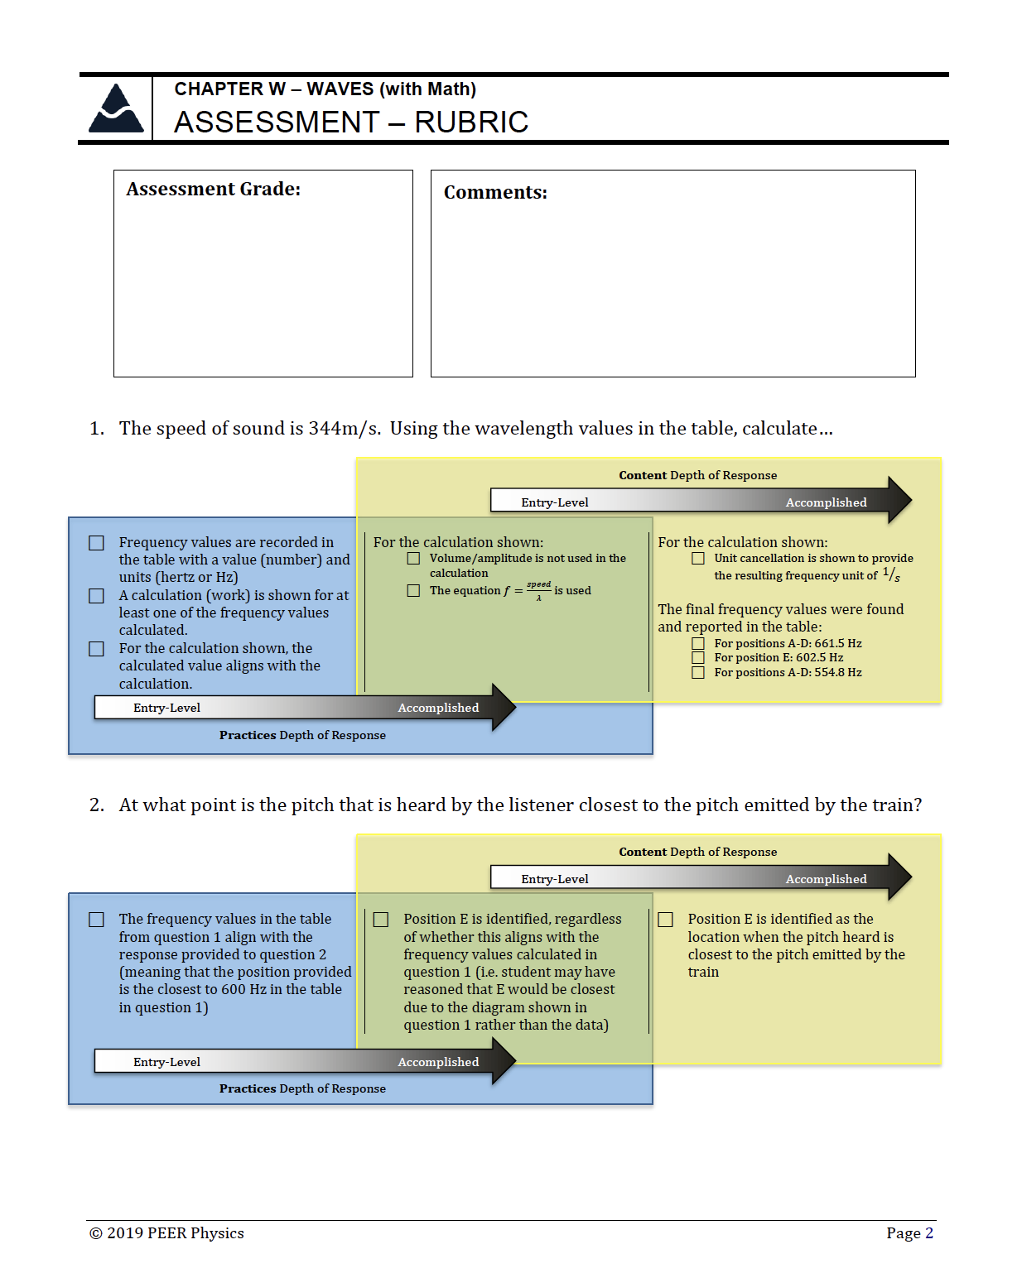
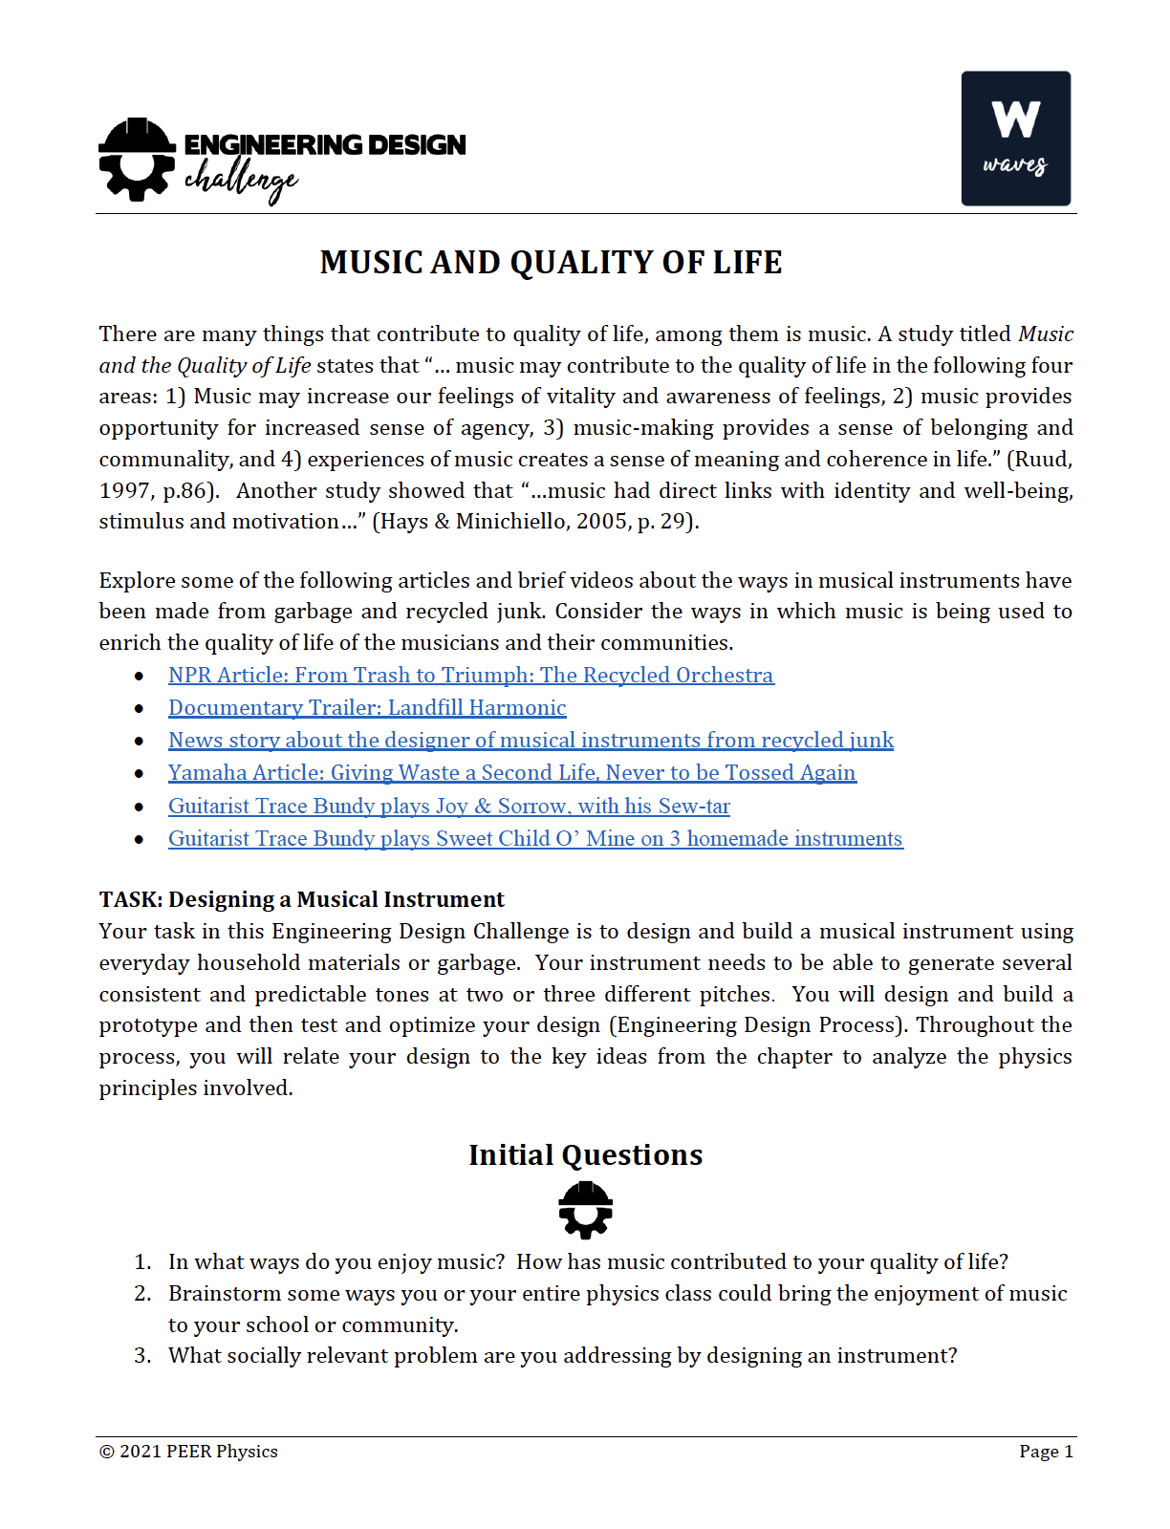
CHAPTER W – WAVES
ASSESSMENT RESOURCES

Slide 14
CHAPTER W – WAVES

Slide 15
CHAPTER W – WAVES

Slide 16
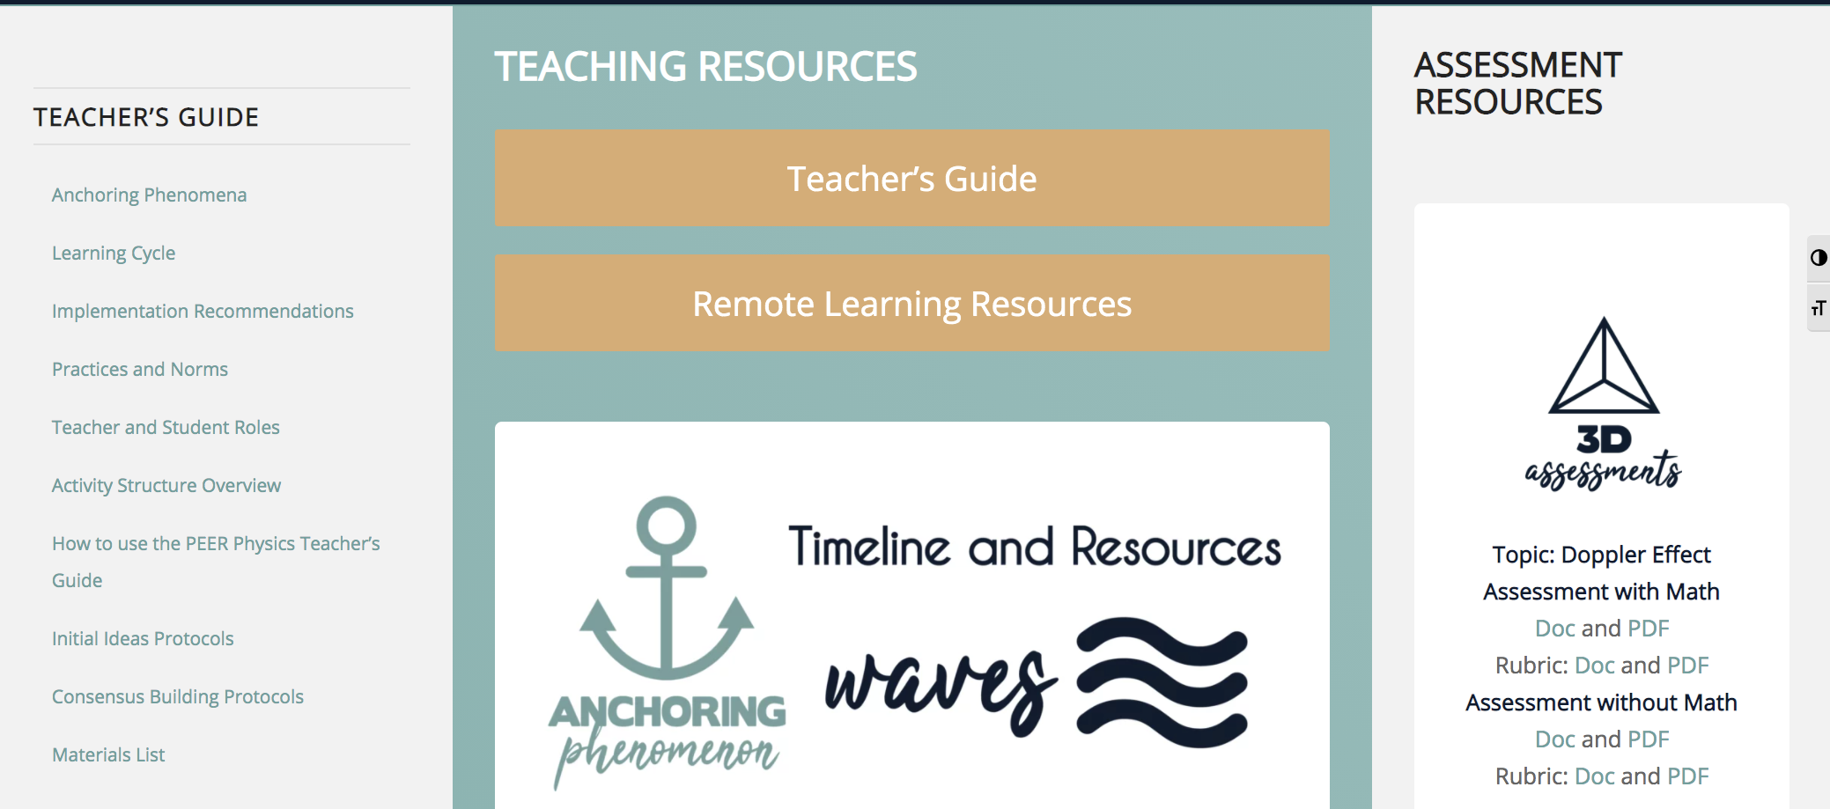
CHAPTER W – WAVES
Learn more by visiting our website.
www.peerphysics.org/w-resources/

Slide 17
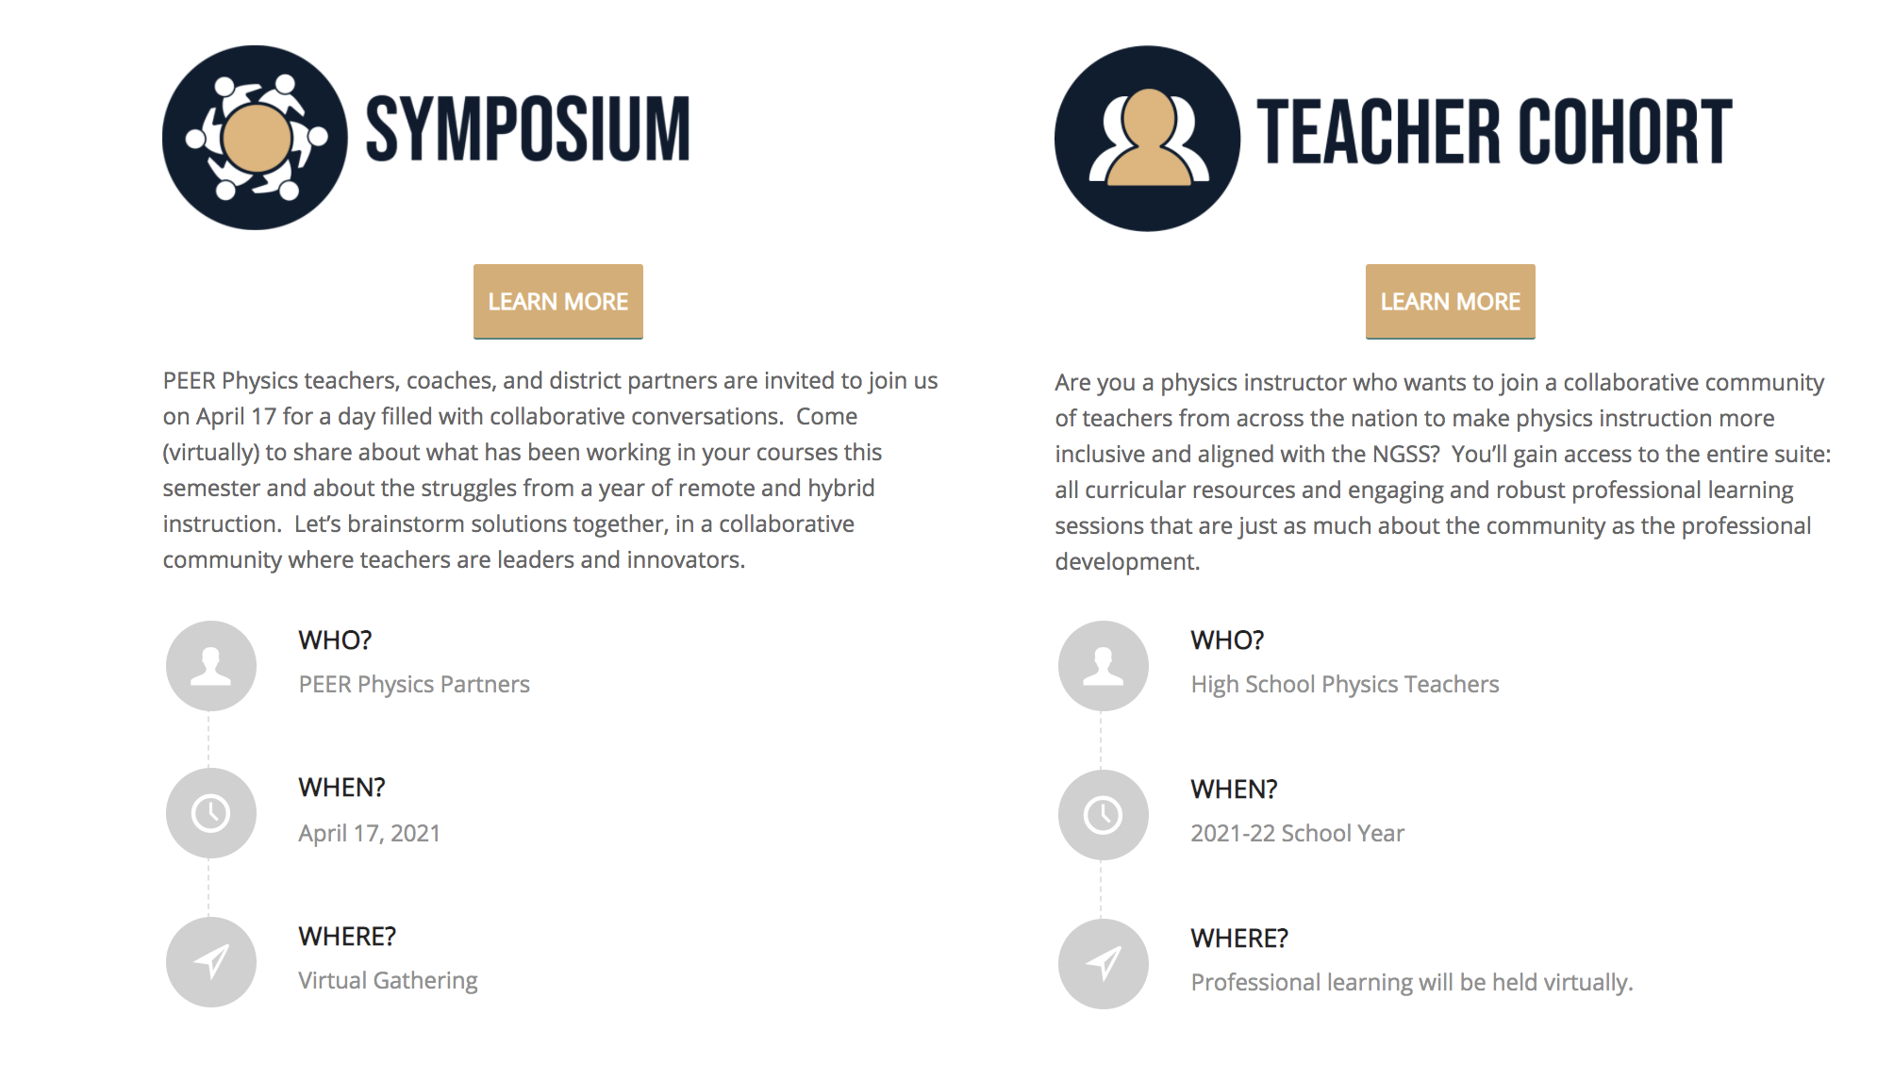
JOIN US FOR MORE
Learn more by visiting our website.
peerphysics.org/ opportunities

Slide 18
CHAPTER W – WAVES

Slide 19
CHAPTER W – WAVES

Slide 20
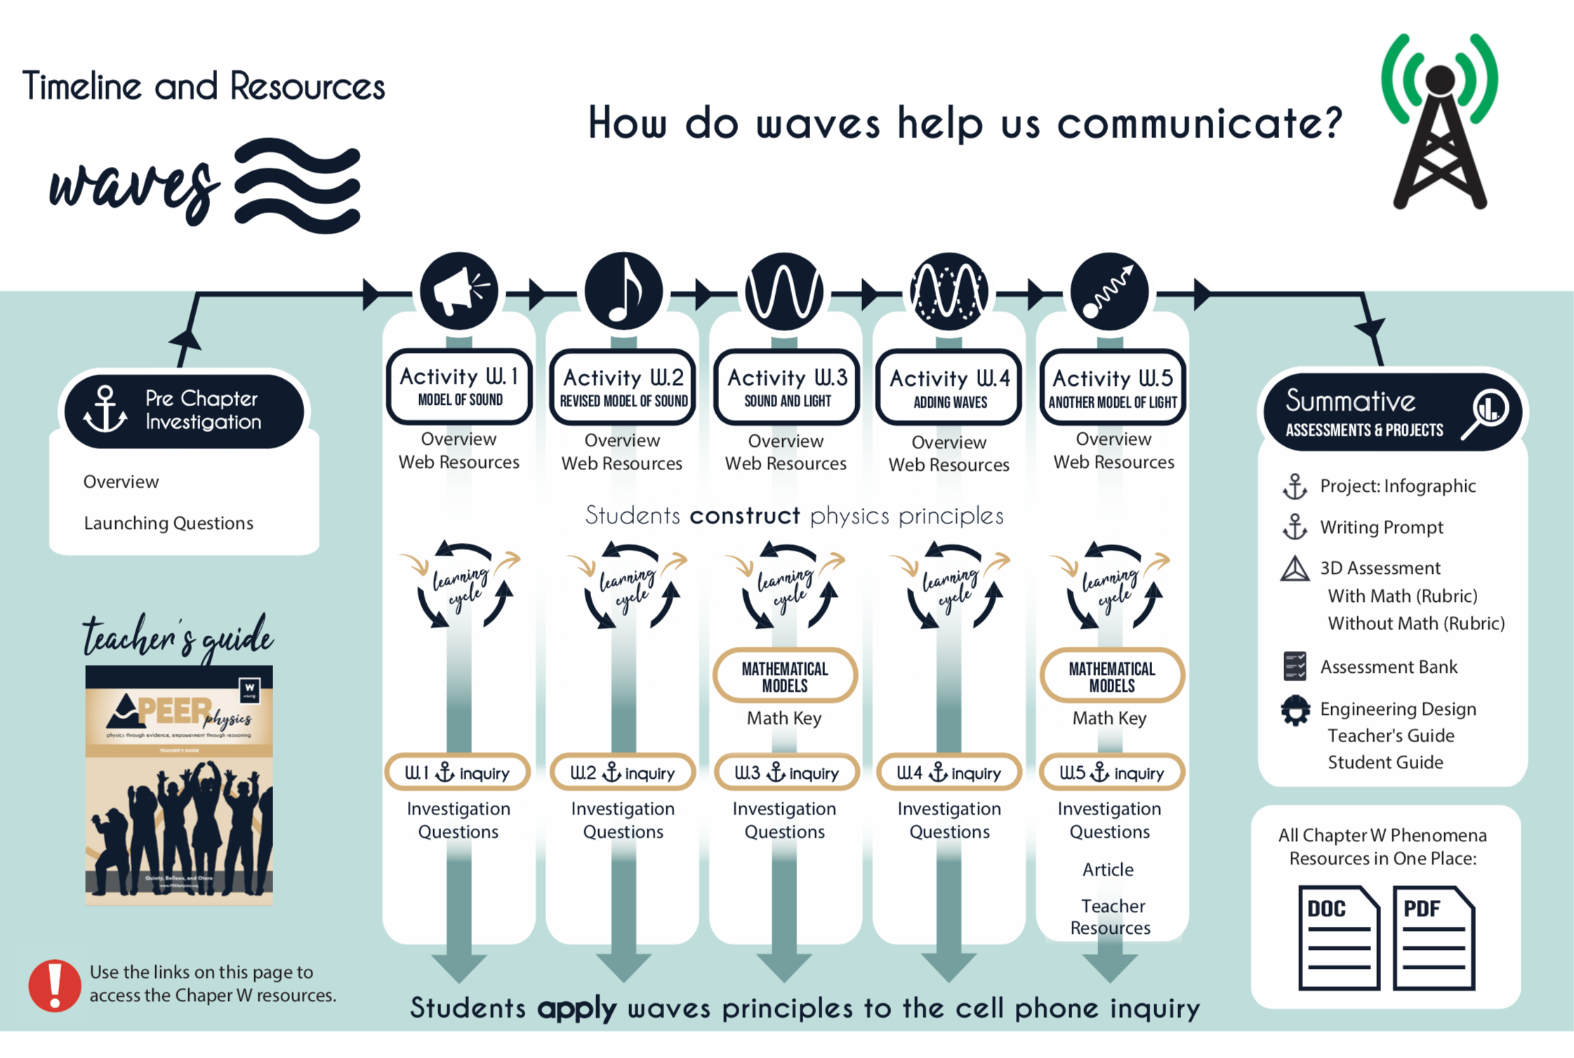
CHAPTER W – WAVES

Slide 21
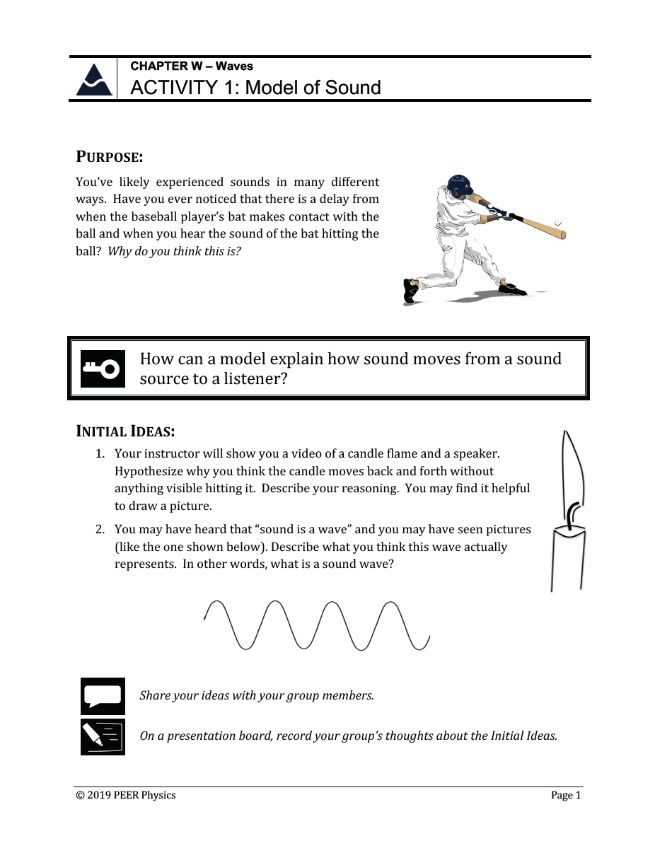
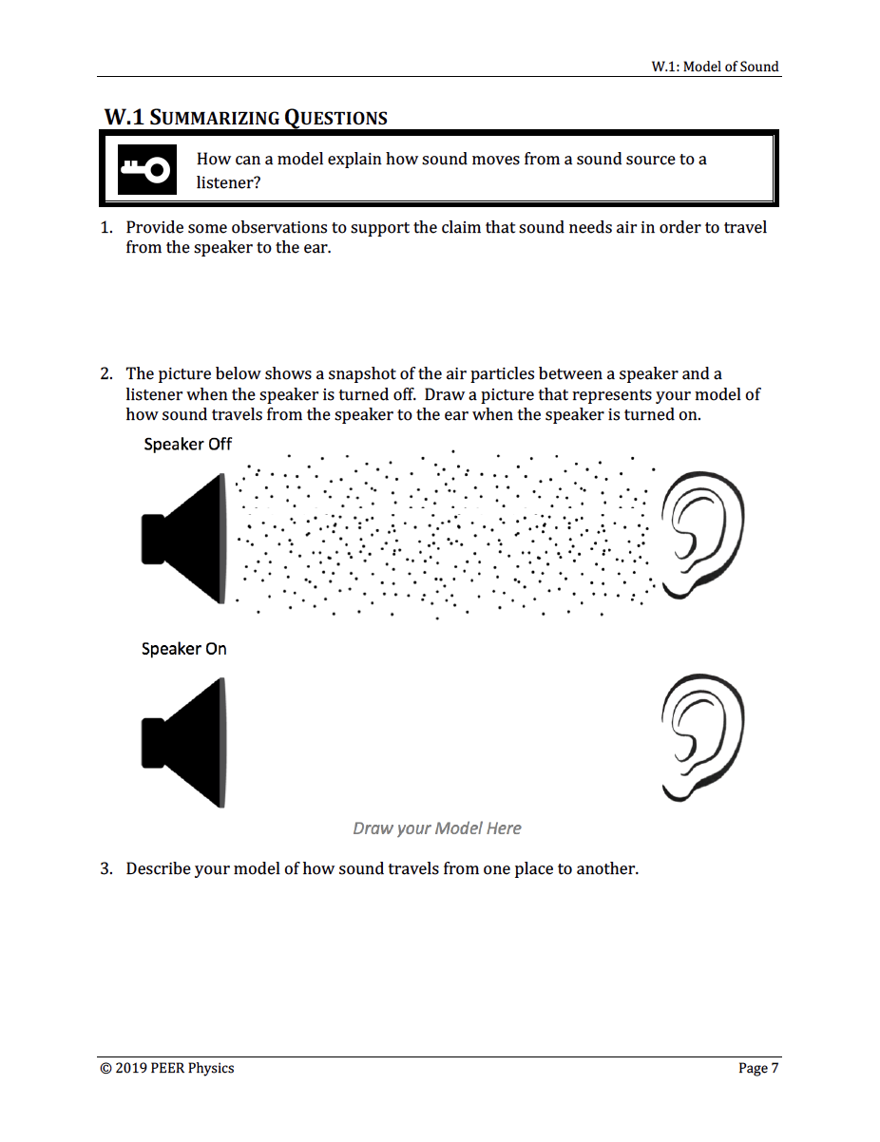
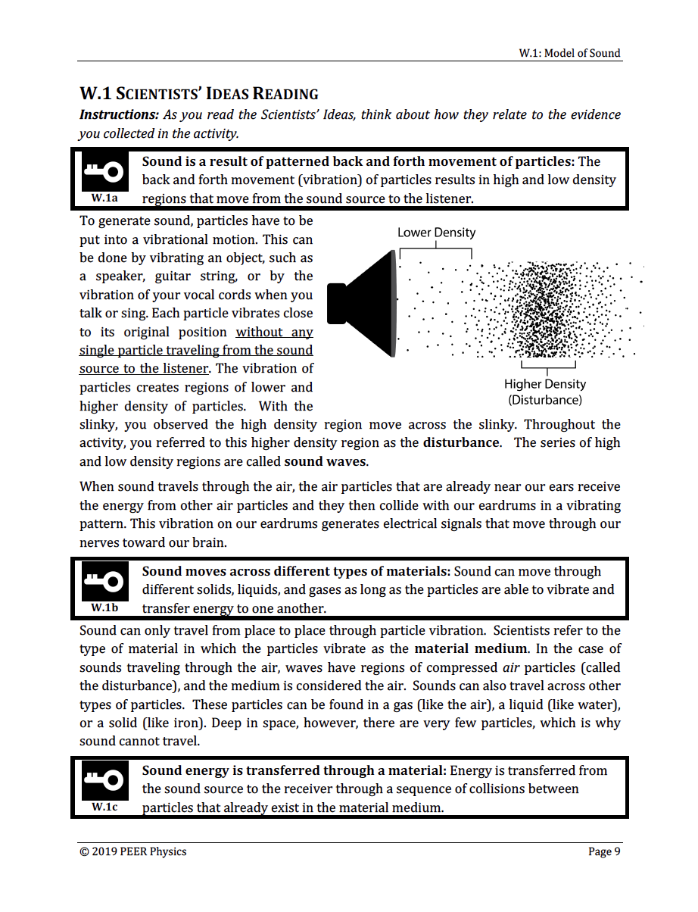
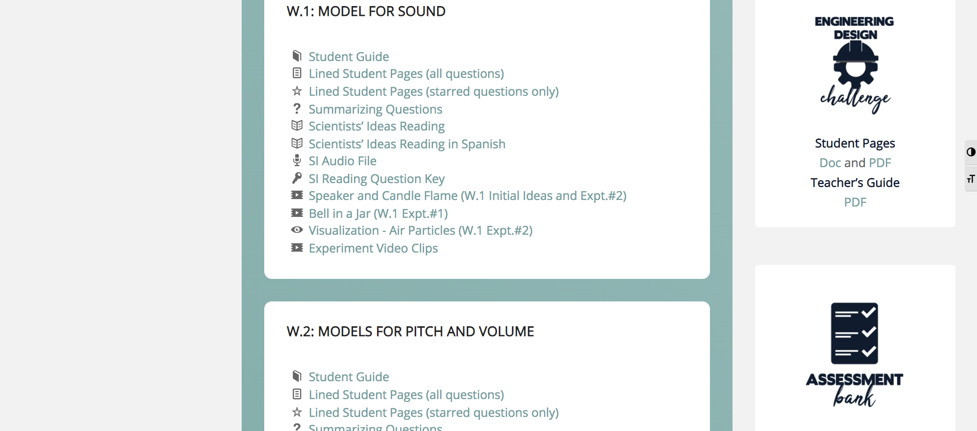
CHAPTER W – WAVES

Slide 22
CHAPTER W – WAVES
Words

Slide 23
CHAPTER W – WAVES
TEACHER’S GUIDE
Chapter Overview
Common student preconceptions
Materials
Activity overviews
Activity preparation
Facilitation moves
Consensus ideas

Slide 24
CHAPTER W – WAVES
PRE CHAPTER INVESTIGATION
Phenomenon overview (for teachers)
Launching readings, videos, and questions

Slide 25
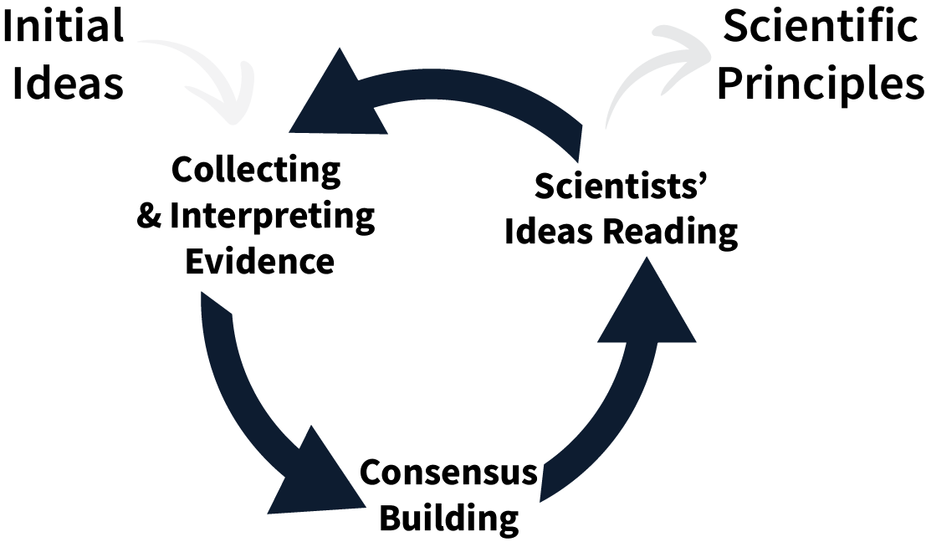
CHAPTER W – WAVES
CHAPTER ACTIVITIES
Activity investigation
Mathematical model building
Application of physics principles to the phenomenon

Slide 26
CHAPTER W – WAVES
SUMMATIVE ASSESSMENTS AND PROJECTS
Phenomenon project and writing prompt
3D Assessment
Assessment bank
Engineering design challenge

Slide 27
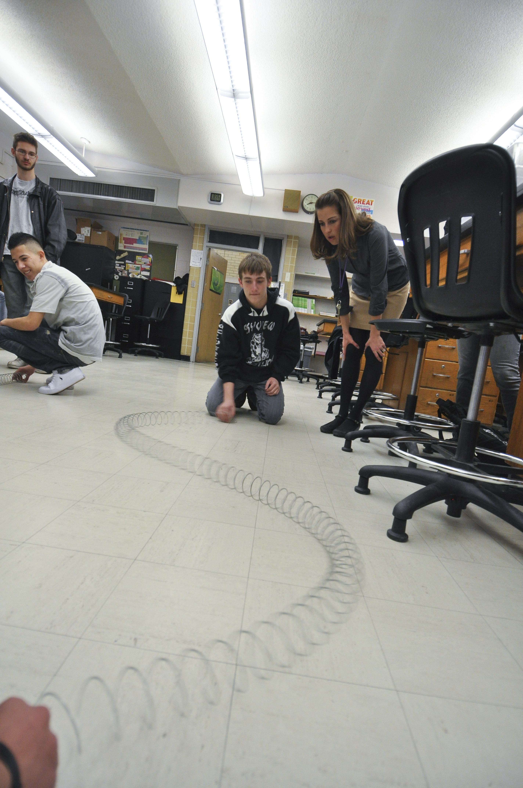
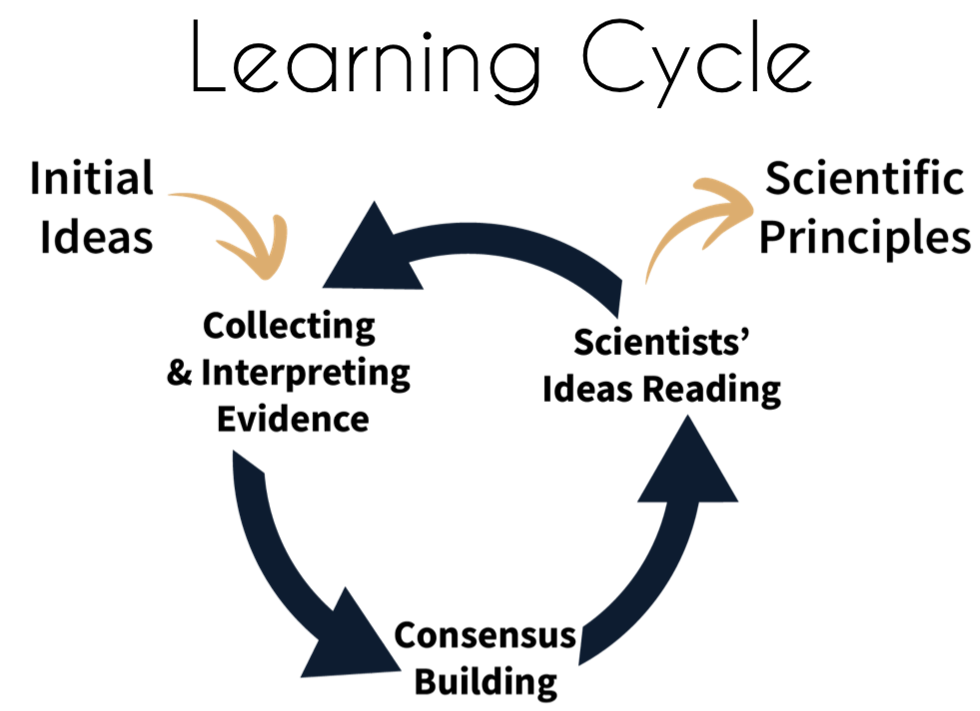
CHAPTER W – WAVES

Slide 28
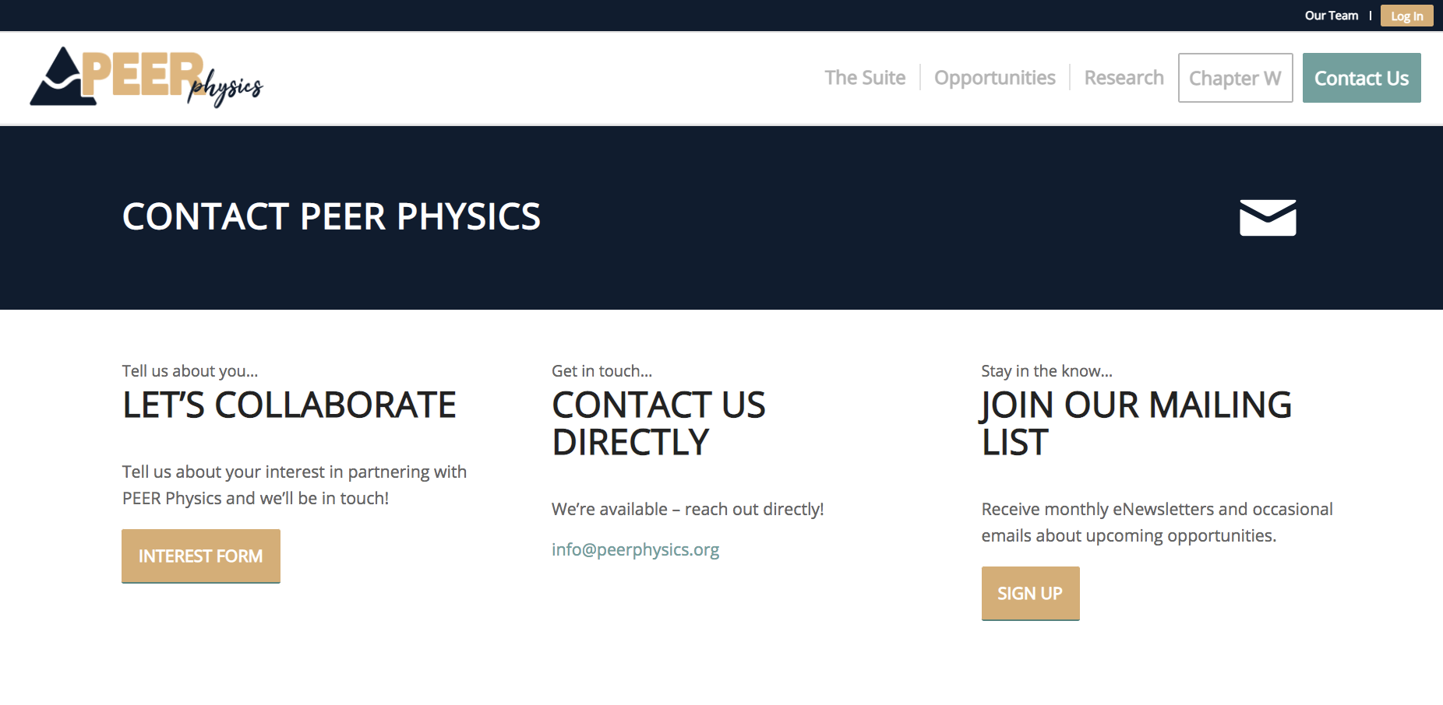
LEARN MORE AND JOIN US!
Learn more by visiting our website.
peerphysics.org/contact
Join our mailing list to be the first to know about opportunities and newly released materials.
@peerphysics
@PEERphys

Slide 29
JOIN US FOR MORE
Learn more by visiting our website.
peerphysics.org/ opportunities
Notes:
Learn more about how you can join the PEER Physics community by clicking Opportunities on our website.

