Slide 1
A question of modalities
Dr. M. Suzanne Taylor
Western Colorado University

Slide 2
Four modes of teaching
Standard in-person lecture
Class time: Lecture and active learning
Variety of homework assignments
Synchronous online
Class held via Zoom
Class time: primarily lecture, limited peer activities
Variety of homework assignments
Flipped in-person
Pre-recorded video lectures
Class time: addressing questions and active learning
Limited homework assignments
Asynchronous online
All course materials prepared ahead of time and online
Students view lecture videos and complete course on their own schedule (with deadlines)

Slide 3
Modality Comparison
In Class
Standard
Synchronous
Where learning happens
Flipped
Out of class
Asynchronous
Before the semester starts
Class Preparation
Walking into the classroom

Slide 4
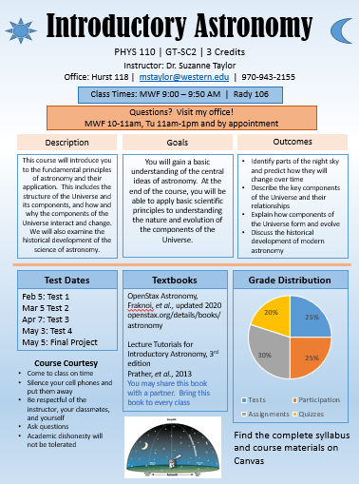
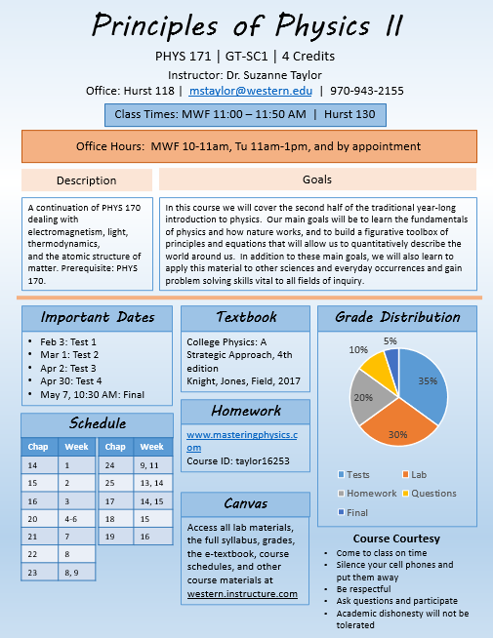

Slide 5
My Impressions
Standard in-person lecture
Lecturing to humans is fun
Flexible
Never enough time
Synchronous online
Lecturing on Zoom is terrible
Flexible
Hard to get students to engage
Flipped in-person
Can cover more material
More time for active learning
Requires student buy-in
Easy to lose touch with topics
Asynchronous online
Major time investment upfront
Minimal time investment to teach
Minimal student contact
Students 100% responsible for learning

Slide 6
Student Survey Results
N = 51 students from Flipped and Asynchronous Introductory Astronomy classes and Flipped Principles of Physics

Slide 7
Student Survey Results

Slide 8
Assessing student learning
Introductory Astronomy:
Methodology: Comparing results on similar test questions asked in all modalities
Classes assessed:
Fall 18 (Standard),
Spring 20 (Standard/Synchronous),
Summer 20 (Asynchronous)
Spring 21 (Flipped and Asynchronous)
Principles of Physics:
Methodology: Comparing results on Mastering Physics homework problems
Classes assessed:
Spring 2020 before 3/15 – Regular in-person (17 students)
Spring 2020 after 3/15 – Synchronous online (17 students)
Spring 2021 – Flipped in-person (9 students)

Slide 9
Data: Introductory Astronomy

Slide 10
Data: Principles of Physics II

Slide 11
Results and Thoughts
Students prefer in-person classes, but like having the asynchronous option
Student engagement is a concern with flipped and asynchronous classes
Student learning appears lower in asynchronous and flipped approaches over standard lecture.
Flipped approach may better serve students in non-GE classes

Slide 12
Questions?

Slide 13
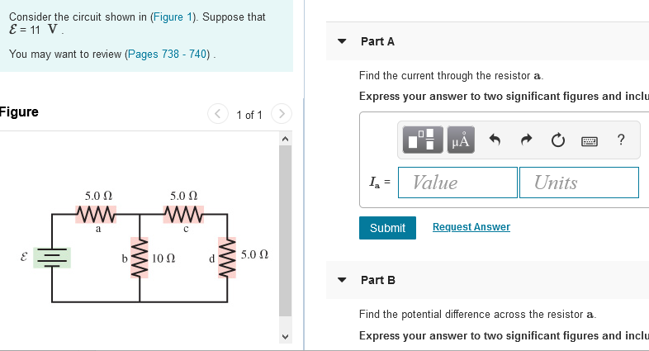
Examples of questions used
Four stars are plotting on the HR Diagram above. Rank the sizes of the stars from largest to smallest.

