Slide 1

STeLLA: Science Teachers Learning from Lesson Analysis
Transforming Science Education Through Research-Driven Innovation
2021 CO/WY AAPT Spring Meeting
April 10, 2021
Presenter:
Connie Hvidsten, BSCS Science Learning
Please navigate to our session resources
https://tinyurl.com/ASTE-videoworkshop
This material is based upon work supported by the National Science Foundation under Awards #0310721, 0918277, #0957996, #1118643, #1220635, #1321242, #1503280, and #1725389. Any opinions, findings, and conclusions or recommendations expressed in this material are those of the author(s) and do not necessarily reflect the views of the National Science Foundation.
Notes:
Begin at 11:15
If possible, print out two of the resources in the file link you see.
The Transcript for today’s video analysis
The Lesson Analysis protocol.
Today’s session has two goals.
We’ll engage in a brief analysis of a classroom video episode and consider how having professional discussions based in video can support deep teacher learning.
I’ll introduce you to the BSCS Videoverse – a free library of classroom videos that you could use at your university site, your school district, your department, or as an individual teacher to reflect and learn from teaching episodes.
First, a little background on the STeLLA Program and what brings me to the AAPT meeting.

Slide 2
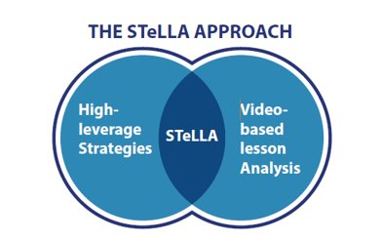


Science Teachers Learning from Lesson Analysis
Notes:
Start this slide at 11:16
STeLLA is an approach to teacher learning that has been shown to impact teachers and what they do in the classroom, but more importantly, has been shown to improve student learning outcomes.
The STeLLA approach has two prongs – a framework of high leverage practices to help teachers focus on revealing and responding to student thinking in the classroom and creating deep and rigorous science learning by connecting ideas in a science storyline, combined with an approach to teacher learning using video-based analysis of practice.
In today’s session, we won’t focus on the STeLLA framework of specific strategies, but will focus on the power of video analysis for teacher learning.

Slide 3
Addressing a Grand Challenge
Education
Courses
Practicum Experiences
Science
Courses
Notes:
Start this slide at 11:17
I’m here with you today because I’ve been working with some of your colleagues from the University of Northern Colorado on a program that introduces the STeLLA approach to Preservice teachers in a program called STeLLA Colorado-2 == because it is our second big STeLLA project in Colorado. In this case our goal is to improve the quality of science teachers from the outset of their career by addressing one of the most troublesome aspects of teacher education, the disconnect between a Preservice teachers’ experience of science teaching in their university science courses, their science education methods course, and their practicum experiences. Our goal at UNC is to bridge this gap by introducing the STeLLA program to a group of faculty and mentor teachers.
We seek to reduce or eliminate the sometimes-conflicting images of effective science instruction that PSTs encounter prior to entering the classroom by establishing a seamless community of support that shares a common vision of effective classroom teaching.

Slide 4
Addressing a Grand Challenge
Common vision of effective science instruction
Common language for talking about teaching and learning
Common mission in preparing the next generation of secondary science teachers
Notes:
Start this slide at 11: 18
Working with three partner universities with very different and very successful secondary science teacher education programs, our goal is to help them to establish and communicate a common vision, a common language for talking about effective teaching and learning, and a common mission in preparing secondary science teachers.
The framework that we used to establish this common vision and language is based on a long line of research at BSCS.

Slide 5






Who are our partners?
University of Colorado, Boulder
University of Colorado, Colorado Springs
University of Northern Colorado
Cooperating teachers
Preservice secondary science teachers
McREL International
BSCS Science Learning
Notes:
Start this slide at 11:19
Our partners in this project are:
That’s enough background. Let’s dive into a video-based learning experience and see how it can bring about deep conversations about teaching and learning.

Slide 6
Resources You Need
https://tinyurl.com/ASTE-videoworkshop
Please download (and print if you prefer)
Transcript: Waves and Energy
Lesson Analysis Protocol – Waves and Energy
Notes:
Start this slide at: 11:20
We don’t have time to deep and rich analysis conversations in this 45 minute session, but you’ll get just a taste of the kinds of conversations that might be sparked by video analysis.
You’ll need access to the transcript for this short clip and a protocol for analysis of the clip.

Slide 7
Norms for Video Analysis
Analysis Basics
Viewing Basics
Look past the trivial, the little things that “bug” you.
Avoid the “this doesn’t look like my classroom” trap.
Avoid making snap judgments about the teaching or learning in the classroom you are viewing.
Focus on student thinking and key teaching moves.
Look for evidence to support any claims.
Look more than once (video and transcript).
Consider alternative explanations and teaching strategies.
Notes:
Start this slide at 11:21
We’re going to dive right into our first video analysis, but first we want to set up some norms. An expanded explanation of these norms is included in your resources folder. For now, why might these viewing basics be important when watching classroom video?

Slide 8
Tools for Video Analysis
Transcript
  Take time to read the context at the top of the transcript
  After watching the video, read the transcript and make note of the points where you identify the strategy(ies)
  After negotiating our understanding of the focus strategy, analyze the transcript to generate a claim
Lesson Analysis Protocol
  Identify the teaching strategy of focus?
    Is there a common understanding of what we’re seeing?
  Analyze the clip with a claim, evidence and reasoning
    Focus on either student thinking or teaching moves
    Turn an observation into a claim supported by evidence from the transcript and
  Reflect and apply to your own teaching context
Notes:
Start this slide at 11:22
We’ll watch the video as a whole group.
Then, I will put you into breakout rooms to identify key teacher moves you identify in this clip.
Normally this process would take about 2 hours to complete for one clip, so we will only have a brief time to explore the process.
Once you are in your breakout rooms, re-read the transcript and identify key teacher moves – marking them or highlighting on the transcripts. Once everyone has had a chance to read and mark on their transcript, spend about 5 minutes sharing key teaching moments and why you thought those moments were important.
Then turn your focus to the LAP. Consider the questions in the analysis and reflect phase. We don’t have time to create our own claims, so discuss with your group how this process might lead to deeper discussions of the classroom clip.

Slide 9
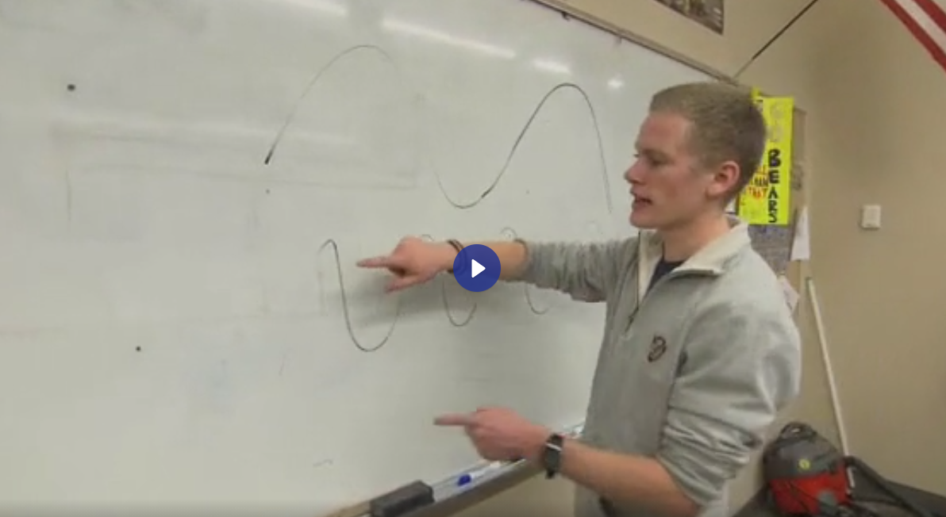
In small group:
Using the identify prompt on the Lesson Analysis Protocol, re-read the transcript and individually identify what you think are key teacher moves.
  Take about 5 minutes sharing the teaching instances you identified using timestamps in the transcript to keep everyone focused on the same examples.
Using the LAP, consider the questions in the analysis and reflect phases.
  We don’t have time to create our own claims, so discuss with your group how this process might lead to deeper discussions of the classroom clip.
Notes:
Review the process at: 11:22
Show the video from 11:25 – 11:30
Break into breakout groups at: 11:30 - YOU HAVE about 12 minutes for these two questions
Return from breakout groups at: 11:42
I’ll show the video while we’re still in whole group, but after
IN BREAKOUT, first briefly introduce yourselves
We’ll end the breakout at 11:42, so use your time wisely.
You have two parts to your breakout group – I’ll pop in briefly to put these questions into your breakout room chat.

Slide 10
Highlights of Your Conversation
Have one person share with the group the highlight of your conversation
  About your Identify conversation
    Did you all identify the same key teacher moves?
    Did the conversation cause you to think more deeply about teaching and its impact on learning?
  About the process used for video analysis
    How might the Analysis process (making a claim supported by evidence in the transcript) lead to deeper discussions of the classroom clip?
    How would the Reflect phase support changes in teaching practice?
Notes:
Start this slide at 11: 43
7 minutes for this sharing

Slide 11
The BSCS Videoverse: https://videoverse.bscs.org/
A compilation of BSCS classroom videoclips
  K-12
  Searchable by
    Grade
    Content
    NGSS SEP/CCC
  Resources to support teacher learning
    Transcripts
    Lesson Plans
    Content Deepening
    Common Student Ideas
    Links to interactives
When you register on the site, be sure to type the code FREEACCESS into the coupon box. This will prevent you from needing to enter any credit card information.
Notes:
Start this slide at 11:50
10 minutes to explore the Videoverse
Now that you’ve had that brief introduction to video analysis as a way to get teachers talking about teaching and learning, I want to introduce you to a new, free, video resource
In a soft launch – Beta version
It’s a work in progress – you might find some glitches as we’re working through the set-up
Free for now as we work out the kinks – use the coupon code FREE ACCESS
New videos are being added every month
Feel free to share the link with others – and the FREEACCESS code
We are asking all who register to complete a survey form with a few basic questions to help us refine the site to better meet the needs of our users. Please fill out the survey – and let us know how we can serve the needs of the community.

Slide 12
Your feedback
Before you leave, please reflect on your learning in this workshop.
Please write at least one comment in the chat box as feedback, gots, or needs.
Notes:
Start this slide at 12:00

Slide 13


THANK YOU!
Please feel free to contact me
chvidsten@bscs.org
This material is based upon work supported by the National Science Foundation under Awards #0310721, 0918277, #0957996, #1118643, #1220635, #1321242, #1503280, and #1725389. Any opinions, findings, and conclusions or recommendations expressed in this material are those of the author(s) and do not necessarily reflect the views of the National Science Foundation.

