Slide 1
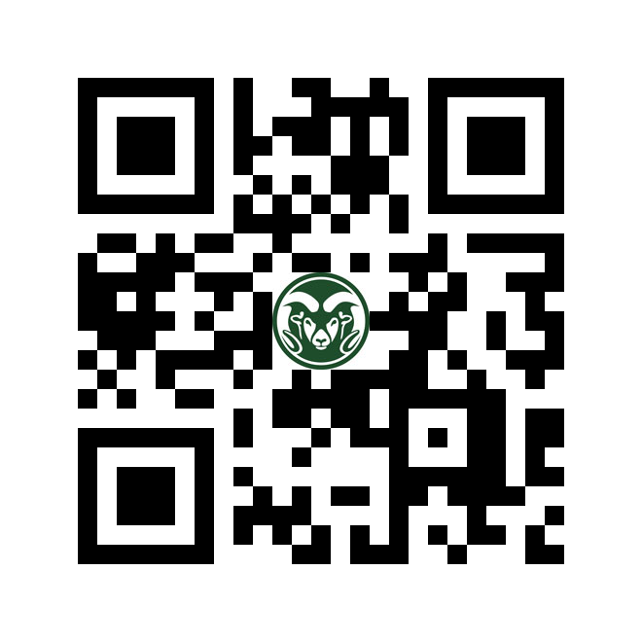
Science is something that anyone can cook-up!
SCIENCE
https://www.lsop.colostate.edu/
You can do science with anything, anywhere, and at any time!

Slide 2
Team work makes the dream work.
Form a team of 3-5 people.
For challenge choose people you don’t know.
Create a team name based on something unique your group has in common.

Slide 3
Appetizer round! Challenge our expert science chefs to demonstrate A3 (anywhere, anything, anytime) skills using 2 ingredients from our pantry. Basketballs,chuck-its, leaf blower, stuffed toy, PVC tube, slippery tablecloth, wood blocks, plastic wine glasses…

Slide 4
Iron Chef Science Challenge!
Now it’s time for you to cook up your own recipes.
Work as a team to use ingredients on your table in creative ways
Use items from our “pantry”
Prepare one recipe for the “feedback round”:
name your creation
write down “What to do”
explain “What is happening”

Slide 5
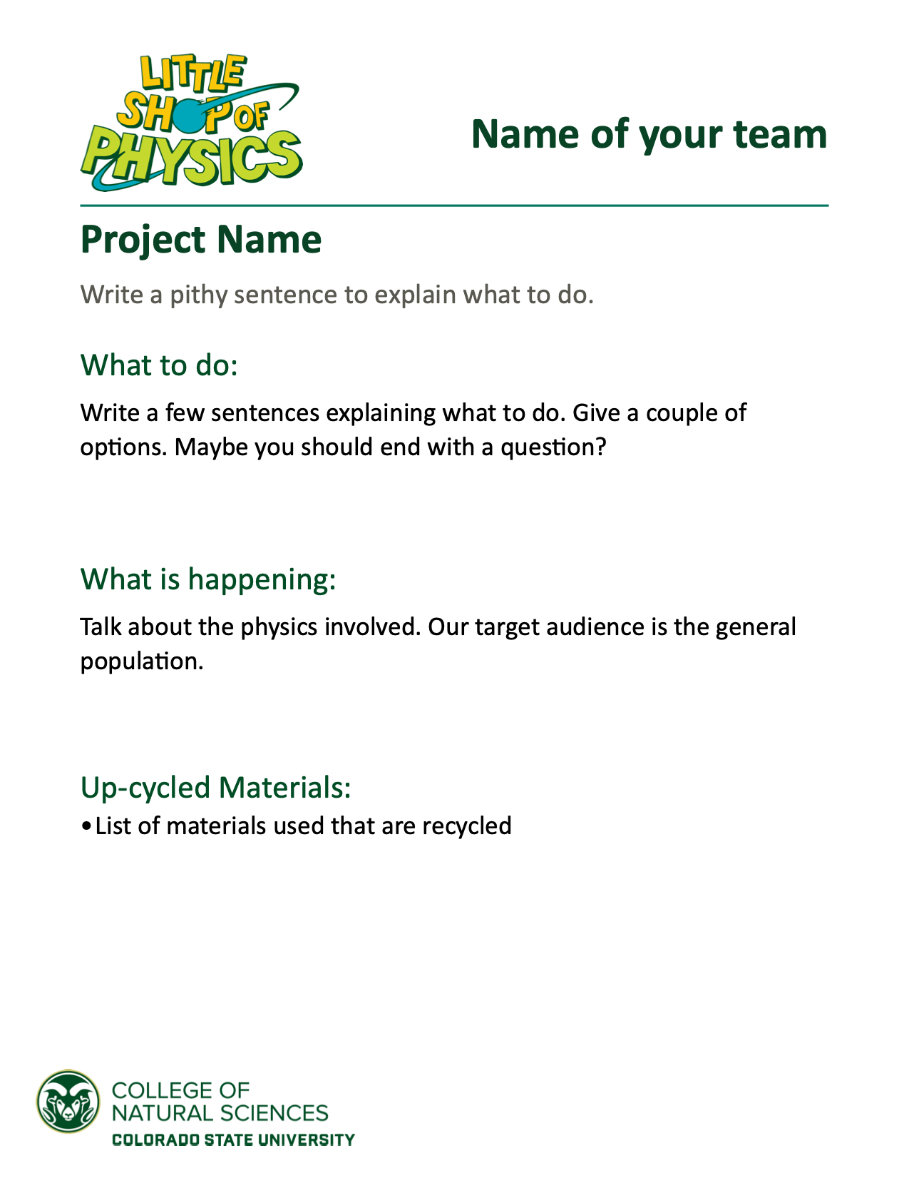
Example Signs

Slide 6
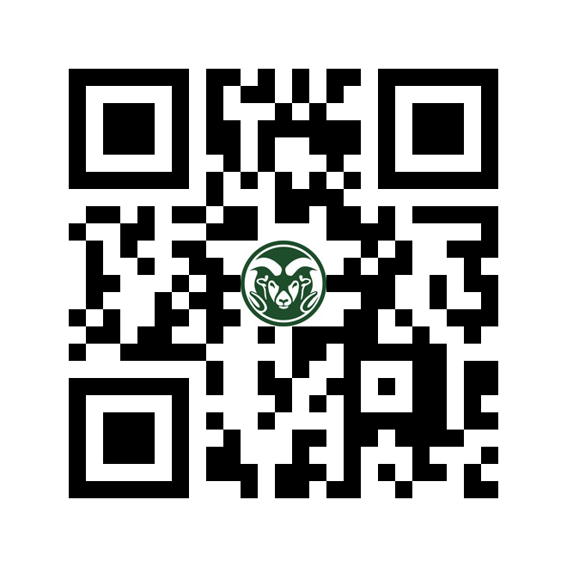
Feedback round!
- Explore the creations of your peers
- Leave positive/constructive feedback
Check out our video series
Get Your Science On to learn more about building your own projects:

